Slide 1
How to create a Pre-Approval Report in Chrome River

Slide 2
Pre-Approval
Wu Shock is going to attend a Mascot Conference.
We will create a Pre-Approval for Wu’s trip.
Trip Details:
Location - Dallas, Texas
Dates – 6/17/2019-6/19/2019
Expenses –
Airfare
Mileage to & from ICT
Hotel
Per Diem
Conference Registration

Slide 3
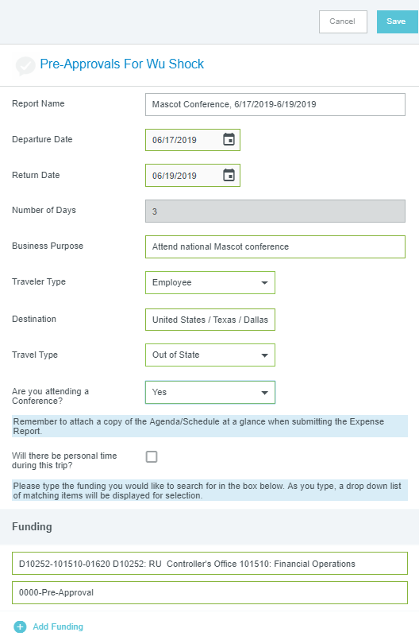
Create Pre-Approval
Click +Create in the upper right corner of the Pre-Approval swim lane
Complete the header information and click Save in the upper right-hand corner

Slide 4
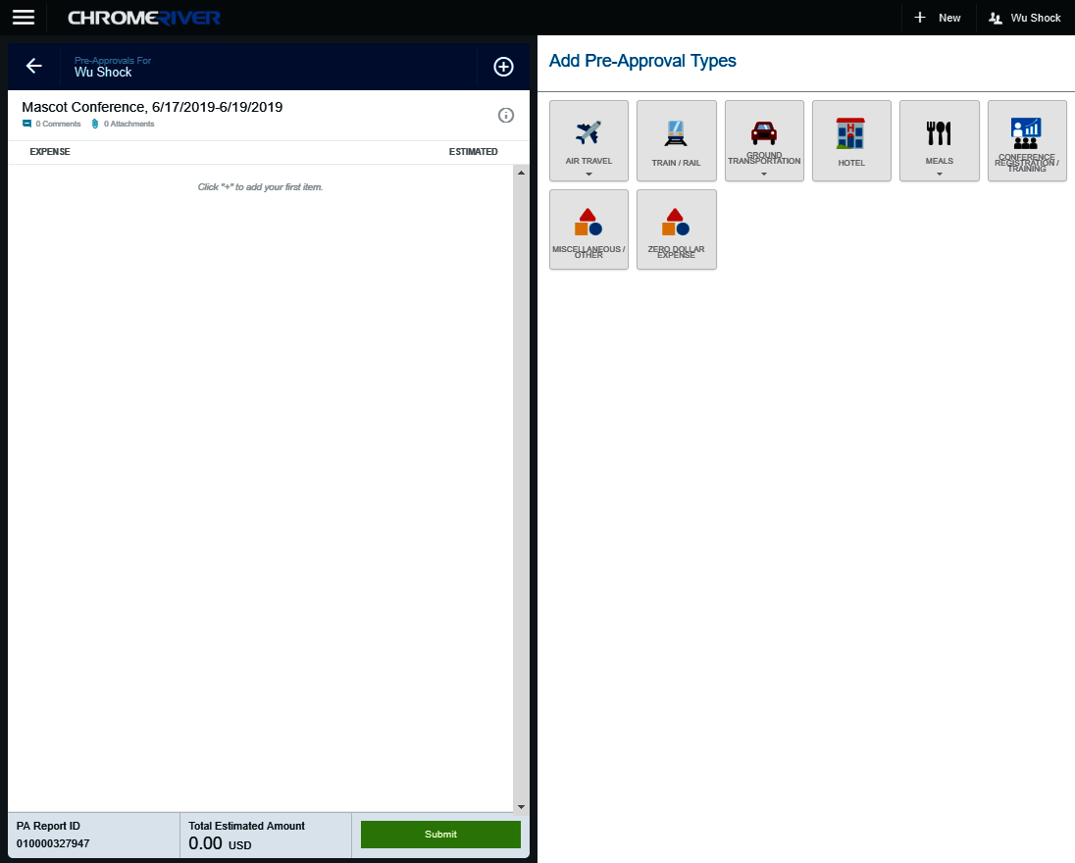
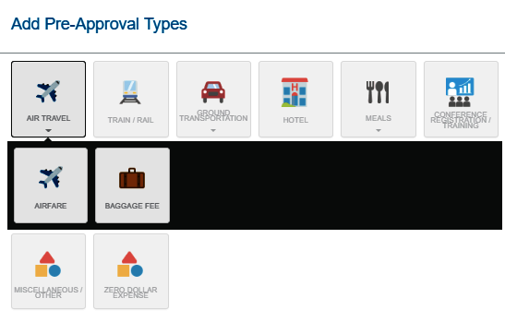
Add Airfare
Select the Air Travel tile
Notice other expense types are displayed in the Air Travel drawer

Slide 5
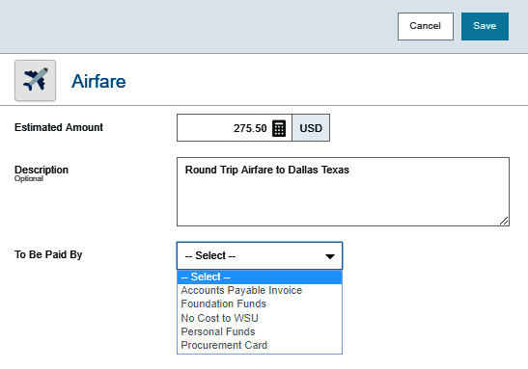
Add Airfare
Select the Airfare tile
Complete the fields displayed on the Airfare form and click save

Slide 6
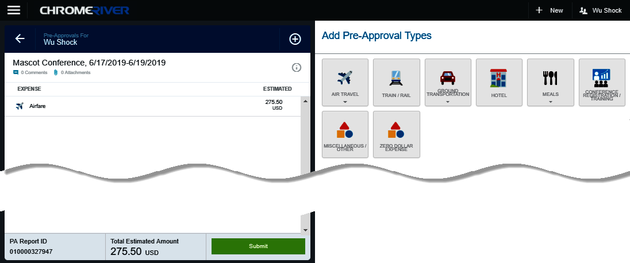
Review Entries
The expense is added to the left side of the Pre-Approval Report

Slide 7
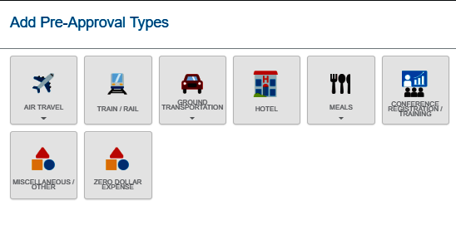
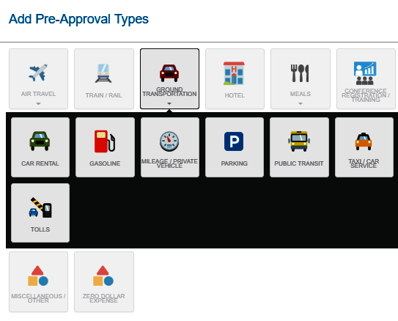
Add Mileage
Select the Ground Transportation tile
Notice other expense types are displayed in the Ground Transportation drawer

Slide 8
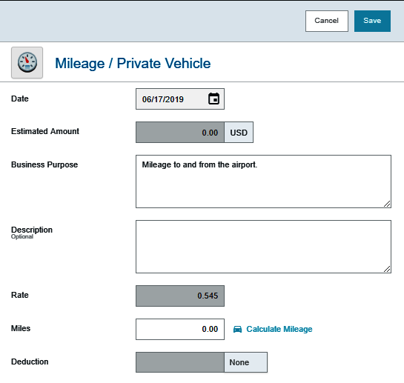
Select Mileage Expense Tile
Select the Mileage / Private Vehicle tile
Complete the Date and Business Purpose fields displayed on the Mileage form

Slide 9
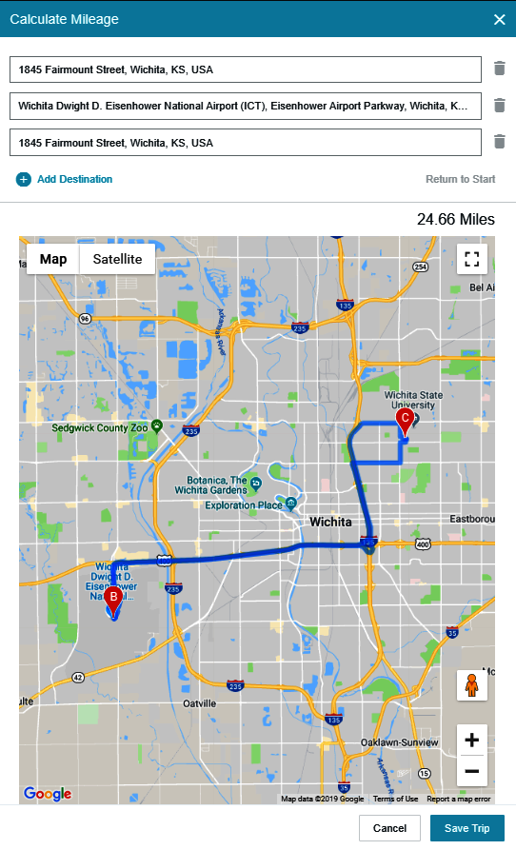
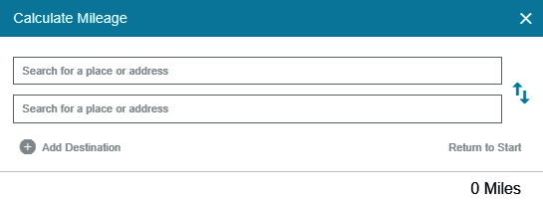
Calculate Mileage
Select the Calculate Mileage link
Enter the beginning and ending destinations
When finished, click Save Trip in the lower right-hand corner

Slide 10
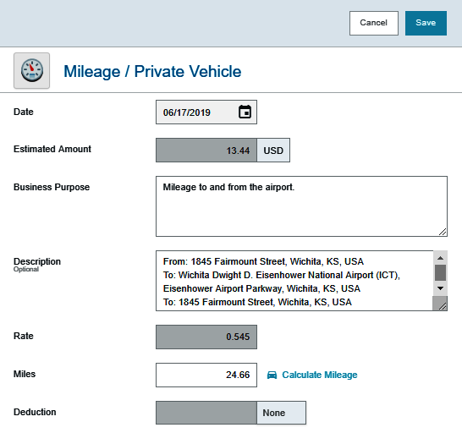
Complete Mileage Form
The following fields will populate based upon the information entered on the Calculate Mileage page:
Estimated Amount
Description
Miles
Click Save in the upper right-hand corner.

Slide 11
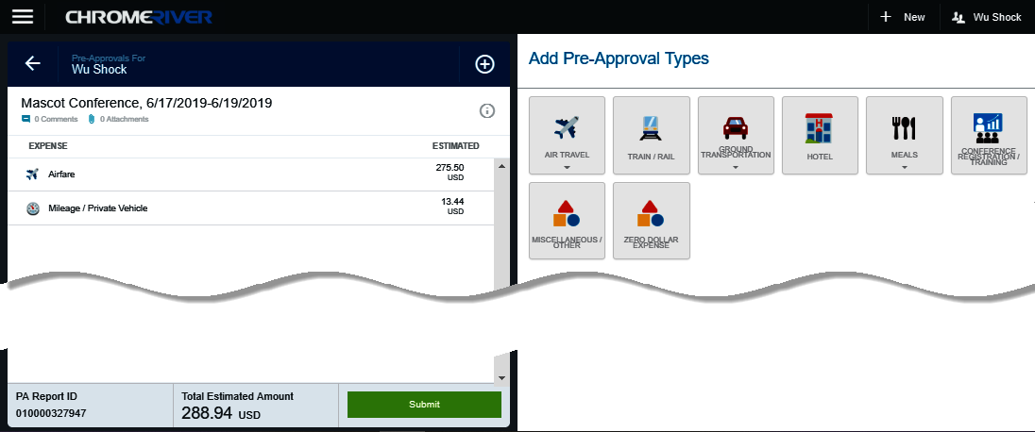
Add Another Expense
The expense is added to the left side of the Pre-Approval Report

Slide 12
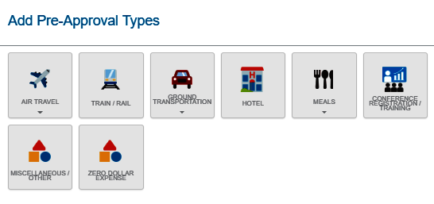
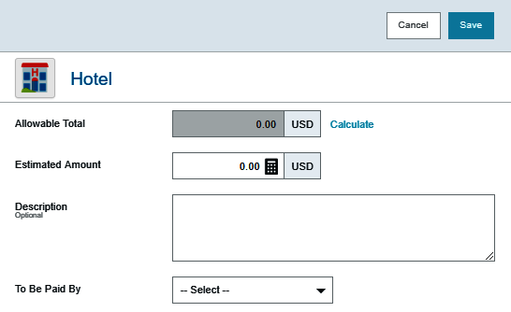
Add Hotel Expense
Select the Hotel tile
The Hotel form is displayed
Click the Calculate link in the Allowable Total field

Slide 13
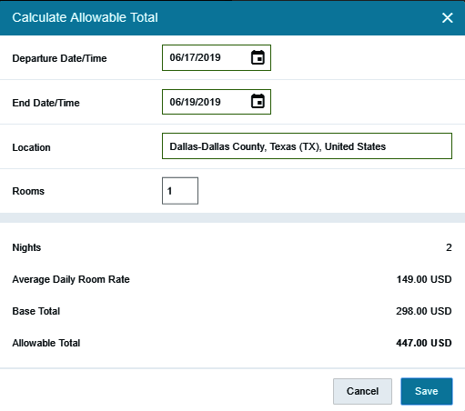
Add Hotel Expense
The Calculate Allowable Total form is used to establish the maximum lodging limit
Complete the following fields:
Departure Date
End Date
Location
Rooms
Click Save

Slide 14
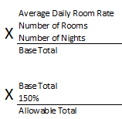
Hotel Expense
The Allowable Total field is now populated.
This amount is calculated as follows:
The maximum reimbursable lodging rates do NOT include taxes and surcharges
No allowance for any tips is included within the lodging rate

Slide 15
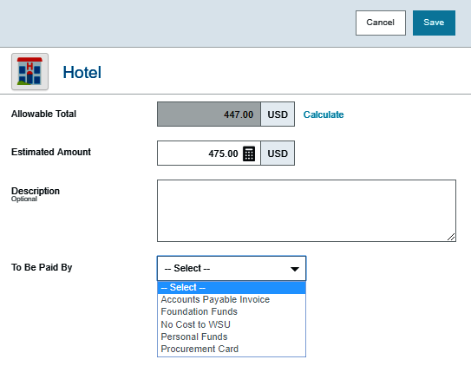
Hotel Expense
Enter the estimated amount
The Description field is optional
Select the To Be Paid By source
Click Save

Slide 16
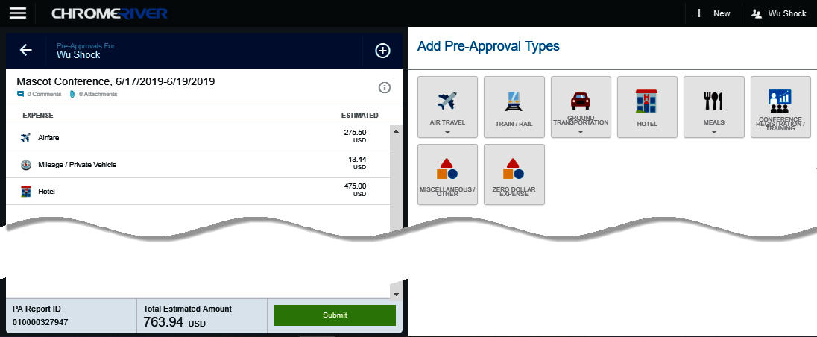
Review Entries
The expense is added to the left side of the Pre-Approval Report

Slide 17
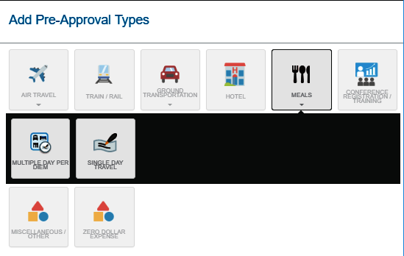
Add Per Diem Expense
Select the Meals tile
Notice other expense types are displayed in the Meals drawer

Slide 18
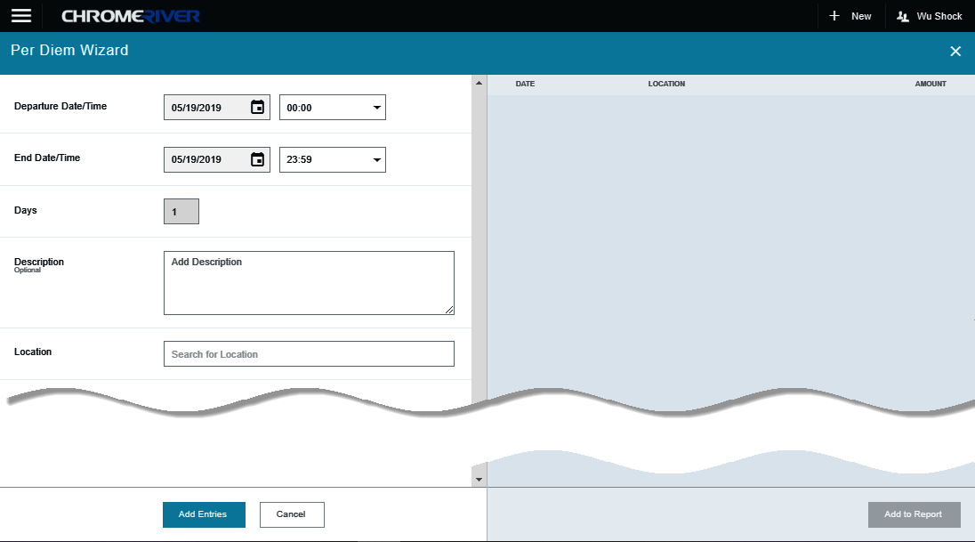
Select Multiple Day Per Diem Tile
Select the Multiple Day Per Diem tile
The Per Diem Wizard form is displayed

Slide 19
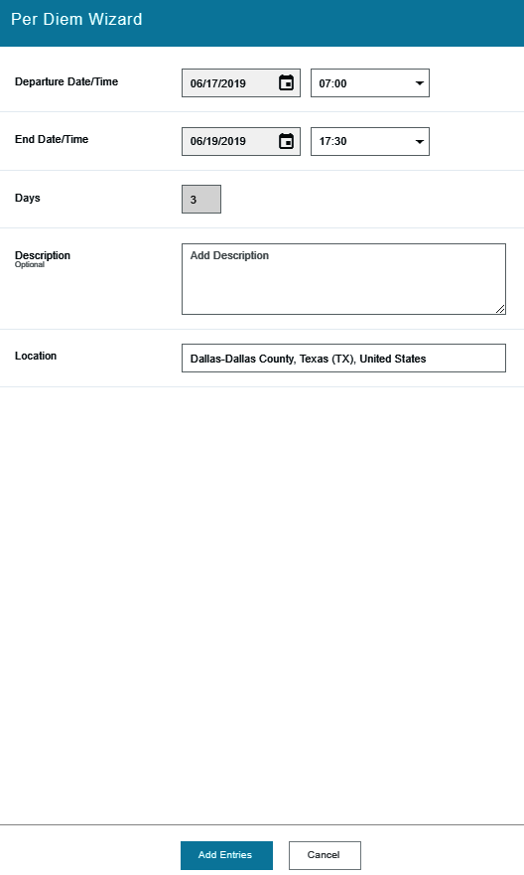
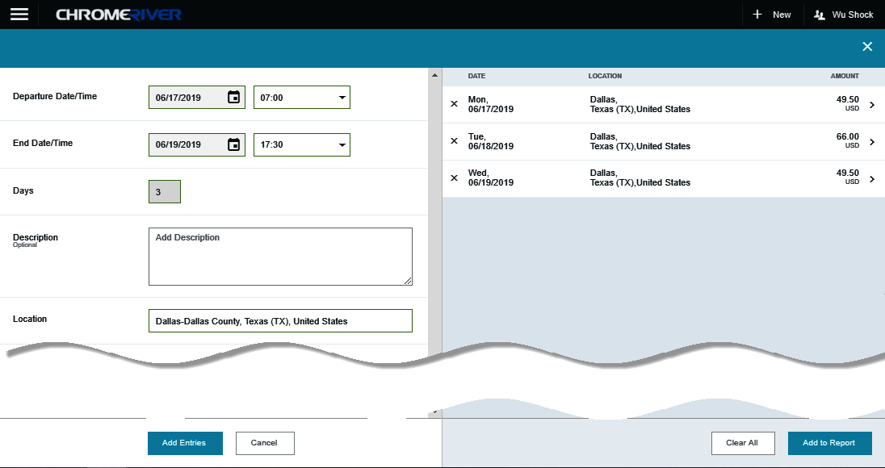
Complete Per Diem Wizard
The Per Diem entries are displayed on the right-hand side of the form.
Complete the following fields:
Departure Date/Time
End Date/Time
Description
Location
Click the Add Entries button

Slide 20
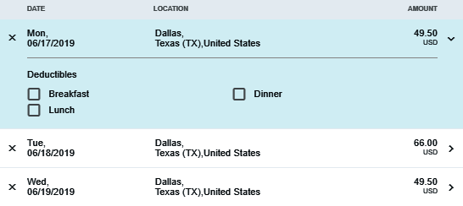
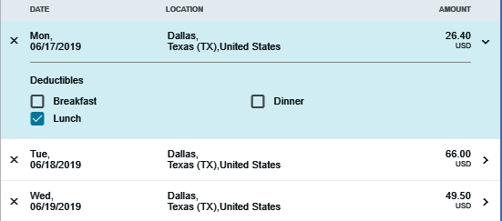
Select Deductibles
Clicking the down arrow next to each entry will open up the Deductibles section.
If you will be provided a meal as part of the travel event or conference, select the corresponding meals check box
Selecting the check box will reduce the Per Diem amount accordingly

Slide 21
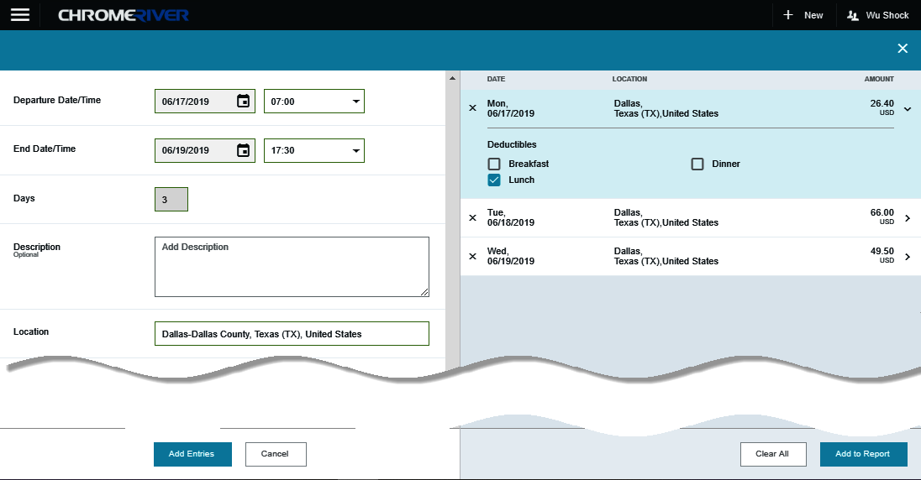
Add Entries to Report
Click the Add to Report button

Slide 22
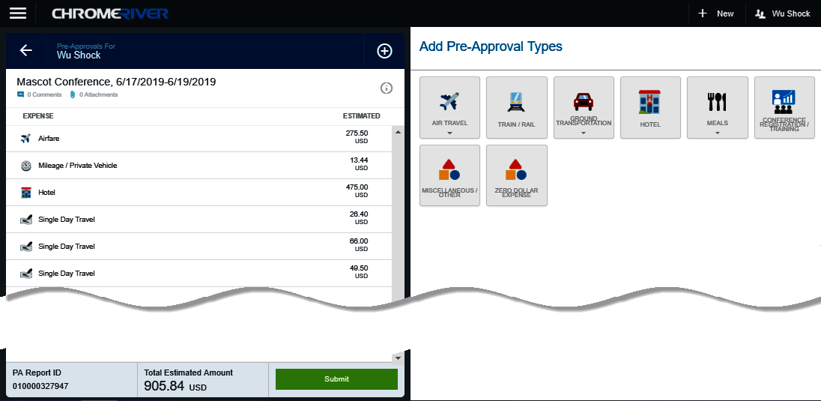
Review Entries
The expenses are added to the left side of the Pre-Approval Report

Slide 23
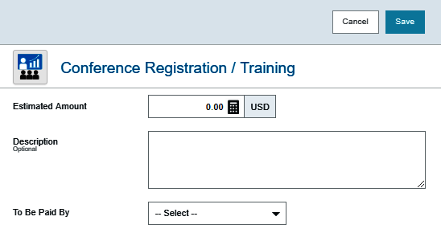
Add Conference/Registration Expense
Select the Conference Registration / Training tile
The Conference Registration / Training form is displayed

Slide 24
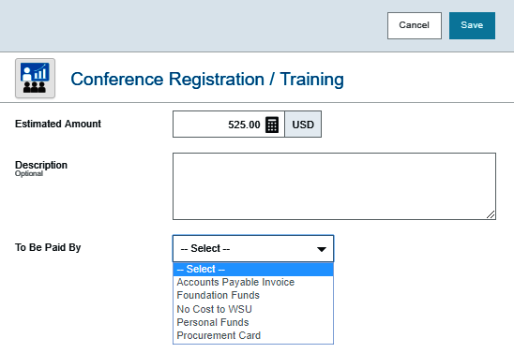
Add Conference/Registration Expense
Enter the estimated amount
The Description field is optional
Select the To Be Paid By source
Click Save

Slide 25
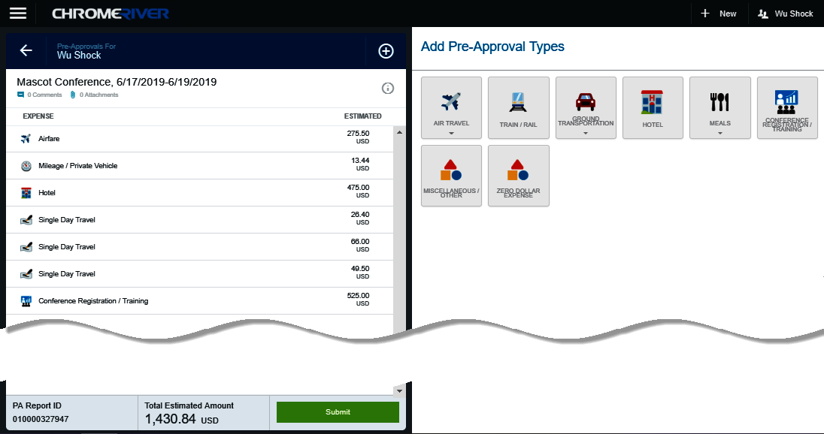
Review Entries
The expense is added to the left side of the Pre-Approval Report

Slide 26
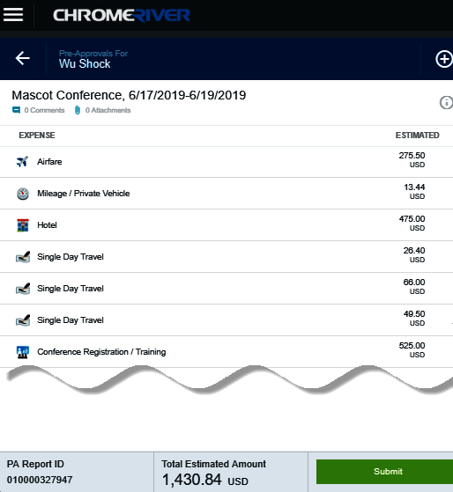
Submit Pre-Approval
When you are finished adding expenses to the Pre-Approval, click the Submit button.

Slide 27
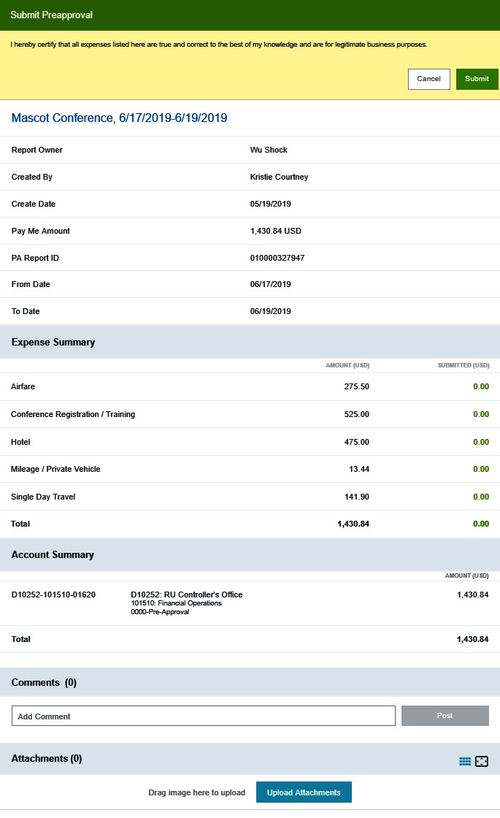
Submit Pre-Approval
The Submit Preapproval page will be displayed. This page also displays a summary of the Pre-Approval information.
Comments and/or attachments can be added to the report at this point.
Click the Submit button.

Slide 28
Chrome River
Success!!!
The Pre-Approval has been successfully submitted for approvals.

