Slide 1
Wichita State University (WSU) College of Health Professions (CHP)
“Leading Change in Healthcare Education”
Sandra C. Garmon Bibb, DNSc., RN, FAAN
Dean, College of Health Professions

Slide 2
WSU & CHP are Pre-Positioned for Innovation & Sustained Relevancy
WSU
CHP
Vision: “WSU is internationally recognized as the model for applied learning and research”.
Mission: “… be an essential educational, cultural and economic driver for Kansas and the greater public good.”
Values:
Seizing opportunities
Success for all stakeholders
Diversity of culture, thought and experience
Adaptive approaches
Teamwork
Positive risk-taking
Vision : “Leading change in healthcare education”.
Mission: “improve the health of the community by engaging students, faculty, staff, and the larger community in the preparation of healthcare leaders, scholars, and professionals…create an innovative learning environment embracing:
Adaptive leadership
Inter-professional education
Scholarly engagement
Community partnership

Slide 3
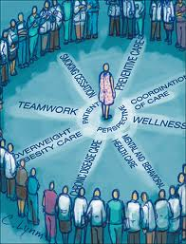
Changes in 21st Century Health Care Delivery are being driven by Disruptive Innovation

Slide 4
University Goal 1: Guarantee an applied learning or research experience for every student by each academic program. College Goal: Enhance Academic Quality of Academic Programs. Strategy 1.1 Ensure that all College graduates engage in significant and meaningful inter-professional (IPE) educational activities.
CHP IPE Program Framework
2015-2016 Academic Year
Targets Met
Conversion of Nursing Learning Lab to an Applied Learning Lab
Institutionalization of CHP IPE Bylaws Supported Advisory Committee
Implementation of Health Summit to formalize Cross-University (WSU/KU-Wichita/Newman) IPE

Slide 5
University Goal 3: Capitalize systemically on relevant existing and emerging societal and economic trends that increase quality educational opportunities. College Goal: Expand Academic Programs and Increase Enrollments. Strategy 3.1 Develop and implement online degree programs at the rate of at least one-two per year for the next 3-5 years and build college-based support structure to support this initiative.

Slide 6
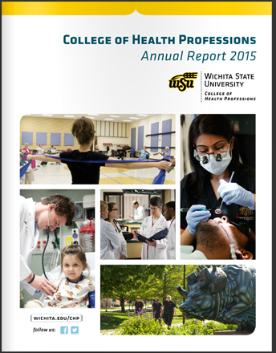
University Goal 2: Pioneer an educational experience for all that integrates interdisciplinary curricula across the university. College Goal: Enhance Academic Quality of Academic Programs. Strategy 2.2 Enhance interdisciplinary/inter-professional educational opportunities for students, faculty and staff through collaborations across the university and in the community. Implemented CHP Branding Taskforce Marketing Plan

Slide 7
University Goal 1: Guarantee an applied learning or research experience for every student by each academic program. College Goal: Enhance Academic Quality of Academic Programs. Strategy 1.2 Establish appropriate base budgets for educational clinics.
Metrics 2015 and Ongoing
Increased clinic patient base.
Increased clinic revenue.
Balanced revenue/expenditure ratio.
Adequate clinic staff/personnel to support student learning experiences.
Collaboration and/or consolidation of processes between patient serving clinics, for marketing, insurance processing, and group CPR training.

Slide 8
University Goal 7: Create a new model of assessment, incentive and reward processes to accomplish our vision and goals. College Goal: Enhance Academic Quality of Academic Programs Strategy 7.1 Ensure that all programs have the ability to hire and retain appropriately trained and credentialed faculty.
Review and Evaluation of Progress
Lead university initiative to develop a reward and promotion system for clinical educator faculty.
In Progress. CHP Department Chairs have developed guidelines for promotion for a Non-Tenure Educator Track within the CHP. All departments have voted to support the initiative.
Memo will be drafted and presented to President’s Executive Team with a request to approve funding to support advancement (promotion of educators).
Approximately 36 CHP Educators are interested in moving to Non-Tenure Educator Track

Slide 9
Strategy 7.1 Ensure that all programs have the ability to hire and retain appropriately trained and credentialed faculty.
Review and Evaluation of Progress
Intensify efforts for the College to ‘grow its own’ doctoral prepared faculty.
In Progress. There are four (4) School of Nursing faculty who completed doctoral studies in 2015-2016;
One (1) Dental Hygiene; two (2) Physical Therapy; and four (4) School of Nursing faculty currently enrolled in doctoral programs.
2016-2017 - Continue intensified efforts for faculty/educators
to acquire terminal degree in their discipline
Area/Department/Level Faculty/Educator is Teaching | # of Faculty | # of Faculty with Terminal Degree | Percentage
Audiology Clinical Educators (AuD) Clinical Supervision | 1 | 1 | 100%
Speech Language Pathology Clinical Educators (Masters) Clinical Supervision | 6 | 6 | 100%
Audiology & Speech Language Pathology Didactic Faculty (Doctorate) | 7 | 7 | 100%
Dental Hygiene (Masters) | 7 | 7 | 100%
Medical Laboratory Sciences (Masters or Higher) | 4 | 4 | 100%
Physician Assistant (Masters or Higher) | 6 | 6 | 100%
Physical Therapy (with a DPT or PhD) | 8 | 7 | 88%
Physical Therapy (with a PhD) | 8 | 3 | 38%
Public Health Sciences (with a PhD) | 9 | 8 | 88%
School of Nursing – Undergraduate Program (MN or MSN) | 30 | 30 | 100%
School of Nursing – Undergraduate Program (Doctorate) | 11 | 30 | 37%
School of Nursing –Graduate Program (Doctorate) | 15 | 20 | 75%

Slide 10
Progressive, Positive, Change
Assessment
Planning
Implementation
Evaluation

Slide 11
Questions

