Slide 1
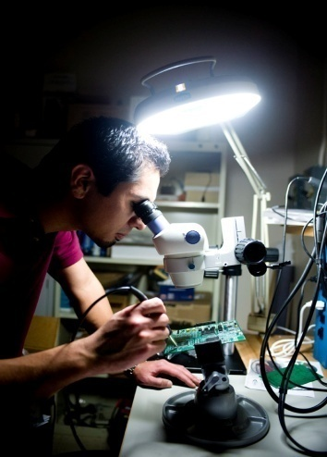
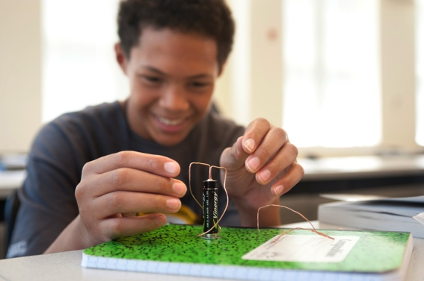
.
.
College of Engineering
Advancing the Wichita State Vision and Mission
Royce Bowden
Professor and Dean
Notes:
1

Slide 2
Presentation Outline
CoE Aligned with WSU Strategic Goals
Top Two Highlights
One Multidisciplinary Collaboration
Top Two Challenges
Next Steps…Our Pathway of Continuous
Improvement

Slide 3
Highlight—Expand Topflight Faculty
Additional topflight faculty and staff to graduate growing number of students in our classrooms and to compete successfully for externally funded research grants
WSU Goal 1: Guarantee an applied learning or research experience for every student by each academic program.
WSU Goal 4: Accelerate the discovery, creation, and transfer of new knowledge.
WSU Goal 6: Be a campus that reflects—in staff, faculty, and students—the evolving diversity of society.

Slide 4
Highlight—Expand Topflight Faculty
Additional topflight faculty and staff to graduate growing number of students in our classrooms and to compete successfully for externally funded research grants
Faculty
72% Growth
Notes:
4

Slide 5
Highlight—Expand Topflight Faculty
Additional topflight faculty and staff to graduate growing number of students in our classrooms and to compete successfully for externally funded research grants
Faculty
42% with
< 3 years experience
Effectively—a young CoE
72% Growth
Notes:
5

Slide 6
Highlight—Expand Topflight Faculty
Additional topflight faculty and staff to graduate growing number of students in our classrooms and to compete successfully for externally funded research grants
Faculty
Students
72% Growth
28% Growth
Notes:
6

Slide 7
Highlight—Expand Topflight Faculty
Additional topflight faculty and staff to graduate growing number of students in our classrooms and to compete successfully for externally funded research grants
Faculty
Students
53 Students/Faculty
72% Growth
28% Growth
Notes:
7

Slide 8
Highlight—Expand Topflight Faculty
Additional topflight faculty and staff to graduate growing number of students in our classrooms and to compete successfully for externally funded research grants
Faculty
Students
39 Students/Faculty
53 Students/Faculty
72% Growth
28% Growth
Notes:
8
From 2 advisors in 2013 to 4 in 2015

Slide 9
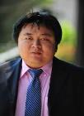
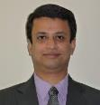
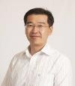
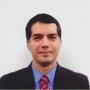
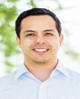
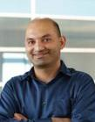
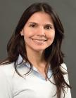
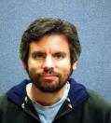
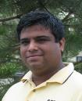
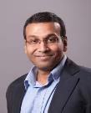
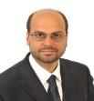
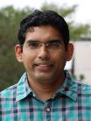
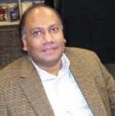
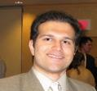
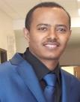
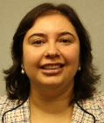
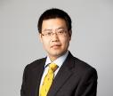
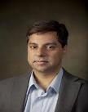
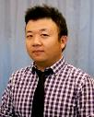
Highlight—Expand Topflight Faculty
Additional topflight faculty and staff to graduate growing number of students in our classrooms and to compete successfully for externally funded research grants
Faculty and Student Growth from 2012 to 2015
Notes:
9

Slide 10
Highlight—Expand Topflight Faculty
Faculty, staff, and students making terrific progress on the Engineering Expansion Grant!
Notes:
10

Slide 11
Highlight—Build Topflight Facilities
Additional space and equipment for instructional labs, research labs, and offices for an advancing CoE
WSU Goal 1: Guarantee an applied learning or research experience for every student by each academic program.
WSU Goal 2: Pioneer an educational experience for all that integrates interdisciplinary curricula across the university.
WSU Goal 4: Accelerate the discovery, creation, and transfer of new knowledge.

Slide 12
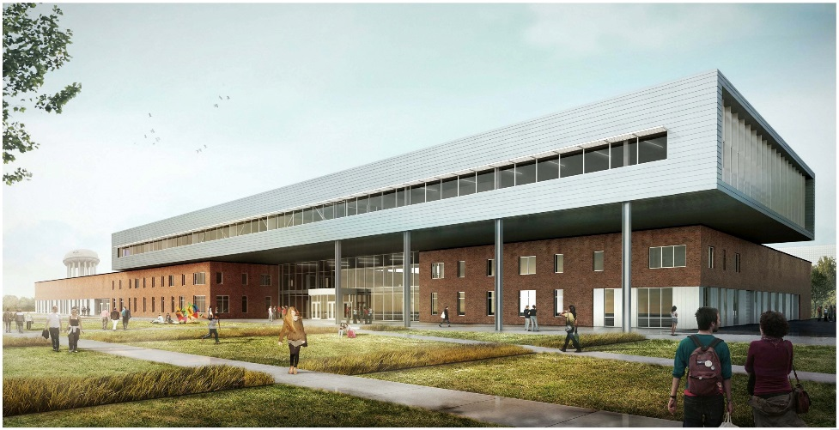
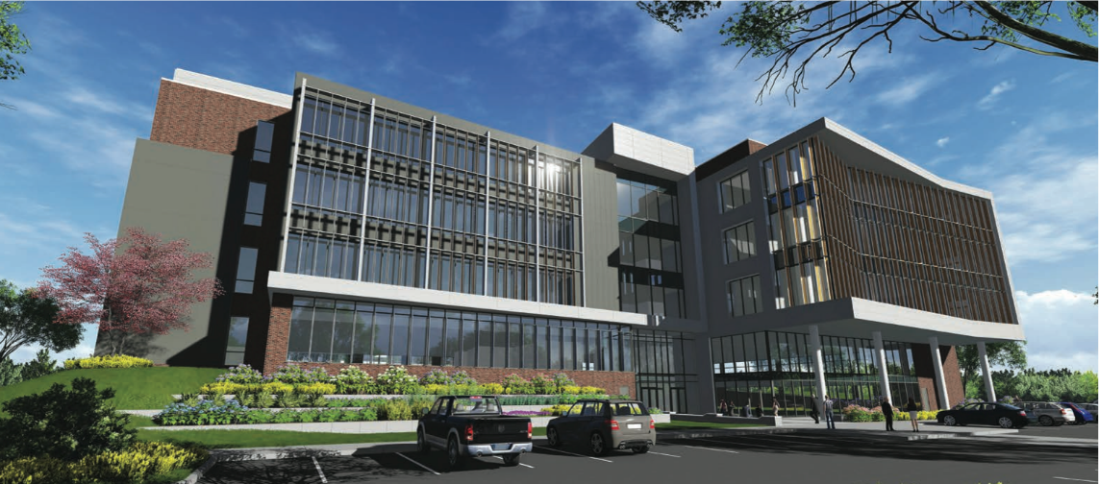
Highlight—Build Topflight Facilities
Additional space and equipment for instructional labs, research labs, and offices for an advancing CoE
Experiential Engineering & Makerspace
Student Success Space in Partnership 2
Fall 2016
Future
Notes:
12

Slide 13
One Multidisciplinary Collaboration
Additional tools added to cultivate a creative confidence and entrepreneurial mindset among students and faculty across campus…1) NSF Pathways to Innovation, 2) University Innovation Fellows, 3) GoCreate makerspace, 4) General Education Technology Course, and 5) Koch Innovation Challenge
WSU Goal 2: Pioneer an educational experience for all that integrates interdisciplinary curricula across the university.
WSU Goal 5: Empower students to create a campus culture
and experience that meets their changing needs.

Slide 14
Multidisciplinary—Build Collaboration
WSUE 102 – Introduction to Technology and Innovation
CoE General Education Intro to Social and Behavior Science course.
Helps students from all disciplines understand the impact of technology in our society.
Multidisciplinary teams of students learn and get hands-on experience in:
- Design Thinking - Teamwork
- Prototyping - Leadership
- Student Success - Market Assessment
- Compete for innovation scholarships via the
Koch Innovation Challenge

Slide 15
Top Two Challenges
Enrollment and retention—adding new degree programs and new persistence programs
Growing externally funded research to advance economic development and further engineering and computer science bodies of knowledge

Slide 16
Top Challenges—Next Steps
Enrollment and Retention
- New degree programs
M.S. Biomedical Engineering, submit KBoR Fall ’16
M.S. Supply Chain (with Barton School), submit Fall ‘16
Grad Cybersecurity Certificate, EECS submit Fall ‘16
B.S. Cybersecurity Engineering Tech, ET submit Fall ’16
Request for new Chemical Engineering Department
- New ABET accredited program
B.S. Engineering Tech accredited August 2016
- New Engineering Ambassadors program to enhance
student recruiting starting Fall 2016

Slide 17
Top Challenges—Next Steps
Enrollment and Retention
- New persistence programs starting Fall 2016
CoE Teaching Fellow Assistantship program brings
more support for the academic success of students by
providing 87 more teaching assistants.
Engineering Mentor UPP (Undergraduate Peer
Partner) program with 100 undergraduate student mentors
organized to mentor first-year students to achieve a
foundation that ensures their pathway to graduation.
- Launched improvement study on advising process Fall 2016

Slide 18
Top Challenges—Next Steps
Externally Funded Research (peer and KS schools)
Tenure Track (TT) Faculty

Slide 19
Top Challenges—Next Steps
Externally Funded Research (peer and KS schools)
Tenure Track (TT) Faculty
Students per TT Faculty

Slide 20
Top Challenges—Next Steps
Externally Funded Research (peer and KS schools)
WSU
Tenure Track (TT) Faculty
Students per TT Faculty
Expenditures per TT Faculty

Slide 21
Top Challenges—Next Steps
Externally Funded Research
A 19% increase in award amount

Slide 22
“from class assignment to new startup company” College of Engineering
Dr. Ramazan Asmatulu and Vamsi Patlolla (PhD student)
Fall 2012 Problem posed to CoE’s Recycling Advanced Materials course
2013 to 2014
New process discovered
by CoE’s Dr. R. Asmatulu and Vamsi Patlolla
March 2016
Process independently tested by NIAR to verify reclaimed carbon fiber is of aerospace quality
May 2016
Company formed and patent filed
facilitated by WSU Ventures. Company founded by Vamsi Patlolla and Jeff Turner
Early 2016
Process perfected in CoE Mechanical Engineering Nano-technology research lab
Development of Process to Reclaim Carbon Fiber from Prepreg Carbon Composites

Slide 23
Top Challenges—Next Steps
Externally Funded Research
Research and Technology Transfer
Graduate School
College of Engineering
Strategic Communications
Cornerstones to a Higher Tier of Excellence
Notes:
23

Slide 24
Envision graduates who are experienced, entrepreneurially minded, and ready to advance economic and technological prosperity, health, and well-being.
This is engineering education and research at WSU.
.
.
College of Engineering
Notes:
24

