Slide 1
Who We Are and Where We’re Going
Graduate School Strategic Planning Update
September 7, 2016

Slide 2
VISION: The Graduate School is a driver in the development and execution of innovative academic programs and transformative research at Wichita State University.
MISSION: The Graduate School provides strategic leadership, assessment, and support to ensure excellence in research and graduate education. Moreover, the Graduate School supports interdisciplinary activities through innovative educational programs and research collaborations to create new opportunities for the intellectual, economic, and social growth of our community.

Slide 3
VISION: The Graduate School is a driver in the development and execution of innovative academic programs and transformative research at Wichita State University.
MISSION: The Graduate School provides strategic leadership, assessment, and support to ensure excellence in research and graduate education. Moreover, the Graduate School supports interdisciplinary activities through innovative educational programs and research collaborations to create new opportunities for the intellectual, economic, and social growth of our community.

Slide 4
The Graduate School oversees all aspects of graduate study at WSU. Moreover, we take an active role in the development and execution of the University’s strategic goals. As such, the Graduate School strategic plan is a mix of aims focused on big picture ideals and process improvements needed to support them.
Goal 1: Develop and support innovative academic programs
Goal 2: Create a vibrant and engaged graduate community
Goal 3: Develop data-driven mechanisms to reward graduate program innovation
Goal 4: Optimize Graduate School processes to promote increased admissions, retention, and graduation rates

Slide 5
A Vision for Graduate Enrollment Management at Wichita State
Graduate Student Lifecycle
Marketing
Recruiting and Admissions
Financial Support
Student Engagement
Graduation
1.) Fully integrated
2.) Both quantitative and qualitative
3.) Iterative process built upon a hierarchical structure
4.) Resource allocations from GS will be tied to program specific plans
(i.e., How does this investment advance program goals?)
5.) Effective, but reasonable reporting and evaluation structure

Slide 6
Master of Innovation Design
The complexity of today’s technology requires innovators from multiple disciplines to collaborate across disciplines. The MID curriculum flexibly merges arts, science, and technology to create such opportunities, with a specific focus on design thinking skills.

Slide 7
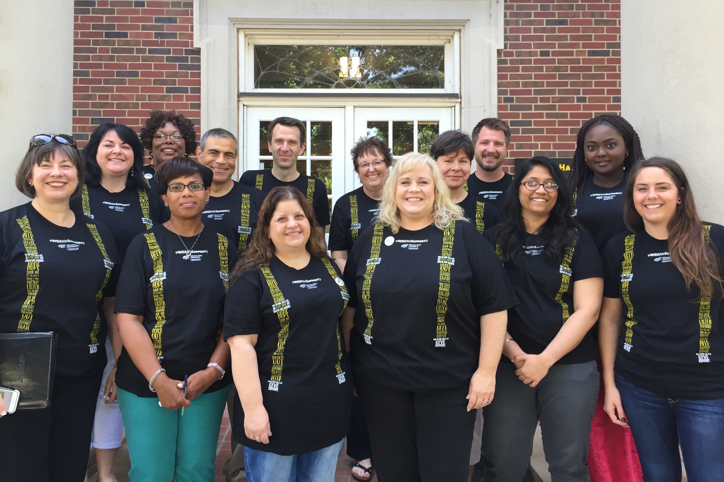
Questions?

