Slide 1
“Who We Are and Where We are Going” Highlights, Collaborations and Challenges
Ron Matson, Dean
Fairmount College of Liberal Arts and Sciences
September 7, 2016

Slide 2
Highlight: Capitalize on Societal Trends with Online Learning
Online learning fits with Goal Three of our strategic plan: Capitalize on existing and emerging societal and economic trends that increase quality educational opportunities.
Carey Dickison is a new online teaching specialist and assistant professor in the department of English
Dickison’s presence in the department helped produce a 52% increase in online credit hours between fall of 2015 and 2016.

Slide 3
Highlight: Online Learning (continued)
Enrollment Data shows large increase in online student credit hours:
Increased online student credit hours from 7,379 in fall 2015 to 10,714 in fall 2016; 3,334 credit hours or a 45% increase!
Fairmount College courses account for 40% of all WSU online credit hours.
Math and Natural Sciences division increased online student credit hours by 345% from fall of 2015 to 2016.

Slide 4
Highlight: Discover and Create New Knowledge with Funded Research
Increasing funded research fits with Goal Four of our strategic plan: Accelerate the discovery, creation and transfer of new knowledge.
81% increase in funded research from 2014 to 2016
Fiscal Year 2014 = $2,737,545
Fiscal Year 2015 = $3,707,700
Fiscal Year 2016 = $4,942,890

Slide 5
Highlight: Discover and Create New Knowledge (continued)
Fairmount College Advisory Committee created and implemented projects to assist Fairmount College faculty to develop disclosures and patents.
Fairmount Neighborhood Project – Facilitates a partnership between WSU and the Fairmount Neighborhood; Hugo Wall School of Urban and Public Affairs is the grantee.

Slide 6
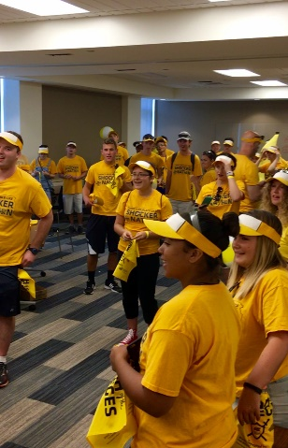
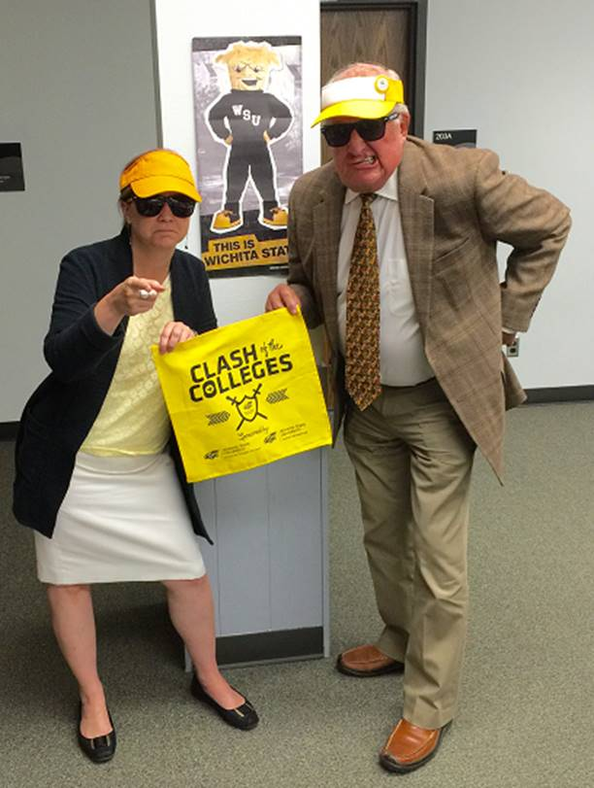
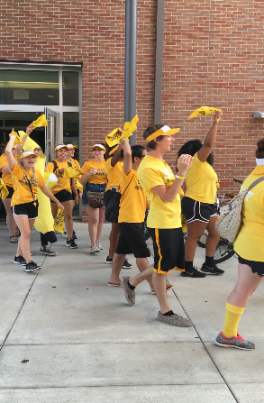
Collaboration: Fairmount College and the Honors College
Fairmount College Offers 21 of 33 or 64% of Honors College Classes as well as many LAS sections that are taken for honors credit.
29% of all honors majors are enrolled in Fairmount College degree programs.
Clash of the Colleges: Join the Alliance!

Slide 7
Challenges: Update Assessment, Incentive and Reward Processes
UniSCOPE model of scholarship for the 21st Century
Expansion of the traditional tenure and promotion model incorporating newly recognized forms of scholarship
UniSCOPE provides an alignment of tenure and promotion with innovation and creativity at Wichita State University.
Position Liberal Arts within the “Innovation University.”
Advocate for a general education diversity requirement.

Slide 8
Strategic Planning: Next Steps
Identify reasonable metrics to measure strategic planning goals.
Tie resources to strategic planning priorities.
Address workload issues in a rapidly changing culture.

