Slide 1
Computer Architecture and Parallel Programming Laboratory (CAPPLab)
An introduction to the
Director:
Dr. Abu Asaduzzaman (Zaman), Ph.D.
Associate Professor and Undergraduate Program Director
Abu.Asaduzzaman@wichita.edu
+1-316-978-5261
Wichita State University (WSU)
College of Engineering (CoE)
Department of Electrical and Computer Engineering (ECE)
Updated on Jan. 11, 2024

Slide 2
CAPPLab: Right on the money
College of Engineering, Michigan Tech
“Engineers Get Top Pay”
https://www.mtu.edu/engineering/outreach/welcome/salary/
Who/What will determine your salary?
You!
Your degree
Your knowledge
We can help you!
U.S. Bureau of Labor Statistics (BLS)

Slide 3
CAPPLab: Research in/with Education
ECE/SoC Courses and DRZ
ECE 696
HW-Based Cybersecurity
ECE 875
Comp Sys Data Analytics
ECE 194:
Digital Design
ECE 394:
Intro Comp Arch
or
CAPPLab teaching supports:
Hardware
Microcontroller boards
FPGA boards
GPU cards
Software
EASy68K / IDE68K emulators
CodeWarrior IDE
CUDA Programming API
ECE 694
HPC Sys
CS 211:
Prog in C/C++
ECE 8??
Sys Mod and Perf Analysis
ECE 794
Parallel Computing
ECE 475:
Mod, Simu,
Analysis
or
(Math &
Python)
ECE 238:
Prog in
Assembly
ECE 594
MP Sys Design
ECE 777AB
ML Essentials & Applications
Field Programmable Gate Array (FPGA)
Graphics Processing Unit (GPU)
EASy68K is for Editor/Assembler/Simulator for the 68000
Application Programming Interface (API)
Integrated Development Environment (IDE)
Compute Unified Device Architecture (CUDA)
Notes:
Electrical and Computer Engineering (ECE)
School of Computing (SoC)
DRZ is for Dr. Zaman (Abu Asaduzzaman)
Notes (cont’d):
CS 211 is a SoC course
Mod is for Modeling
MP is for Microprocessor
Notes (cont’d):
HW is for Hardware
HPC is for High Performance Computer
ML is for Machine Learning

Slide 4
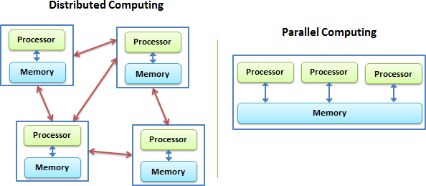
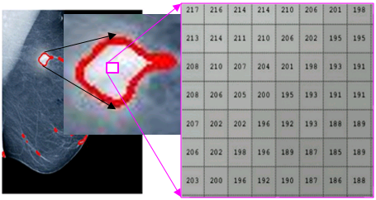
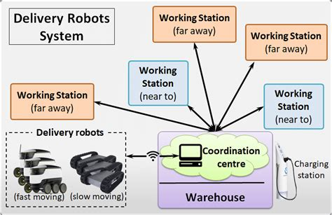
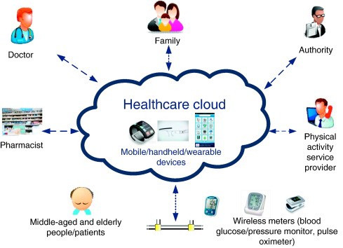
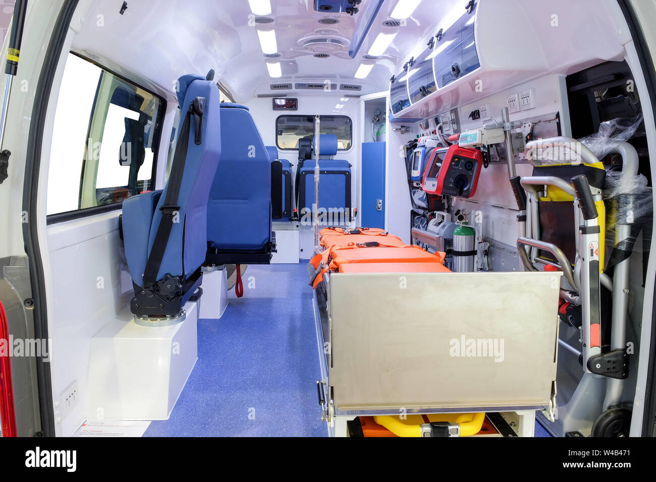
CAPPLab: Research/Project Areas
High Performance Computing (HPC)
Image Processing / Machine Learning (ML)
Data Analytics / Decision Making
HPC and ML in Healthcare

Slide 5
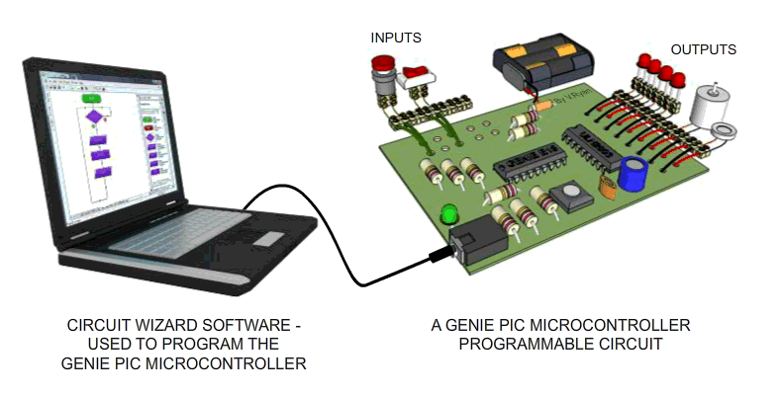
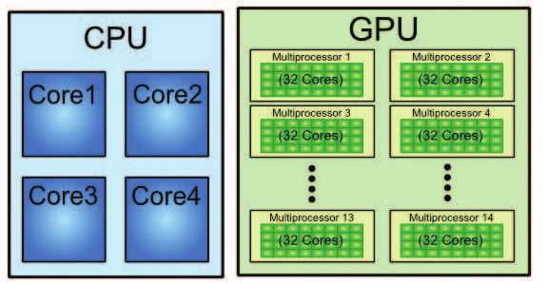
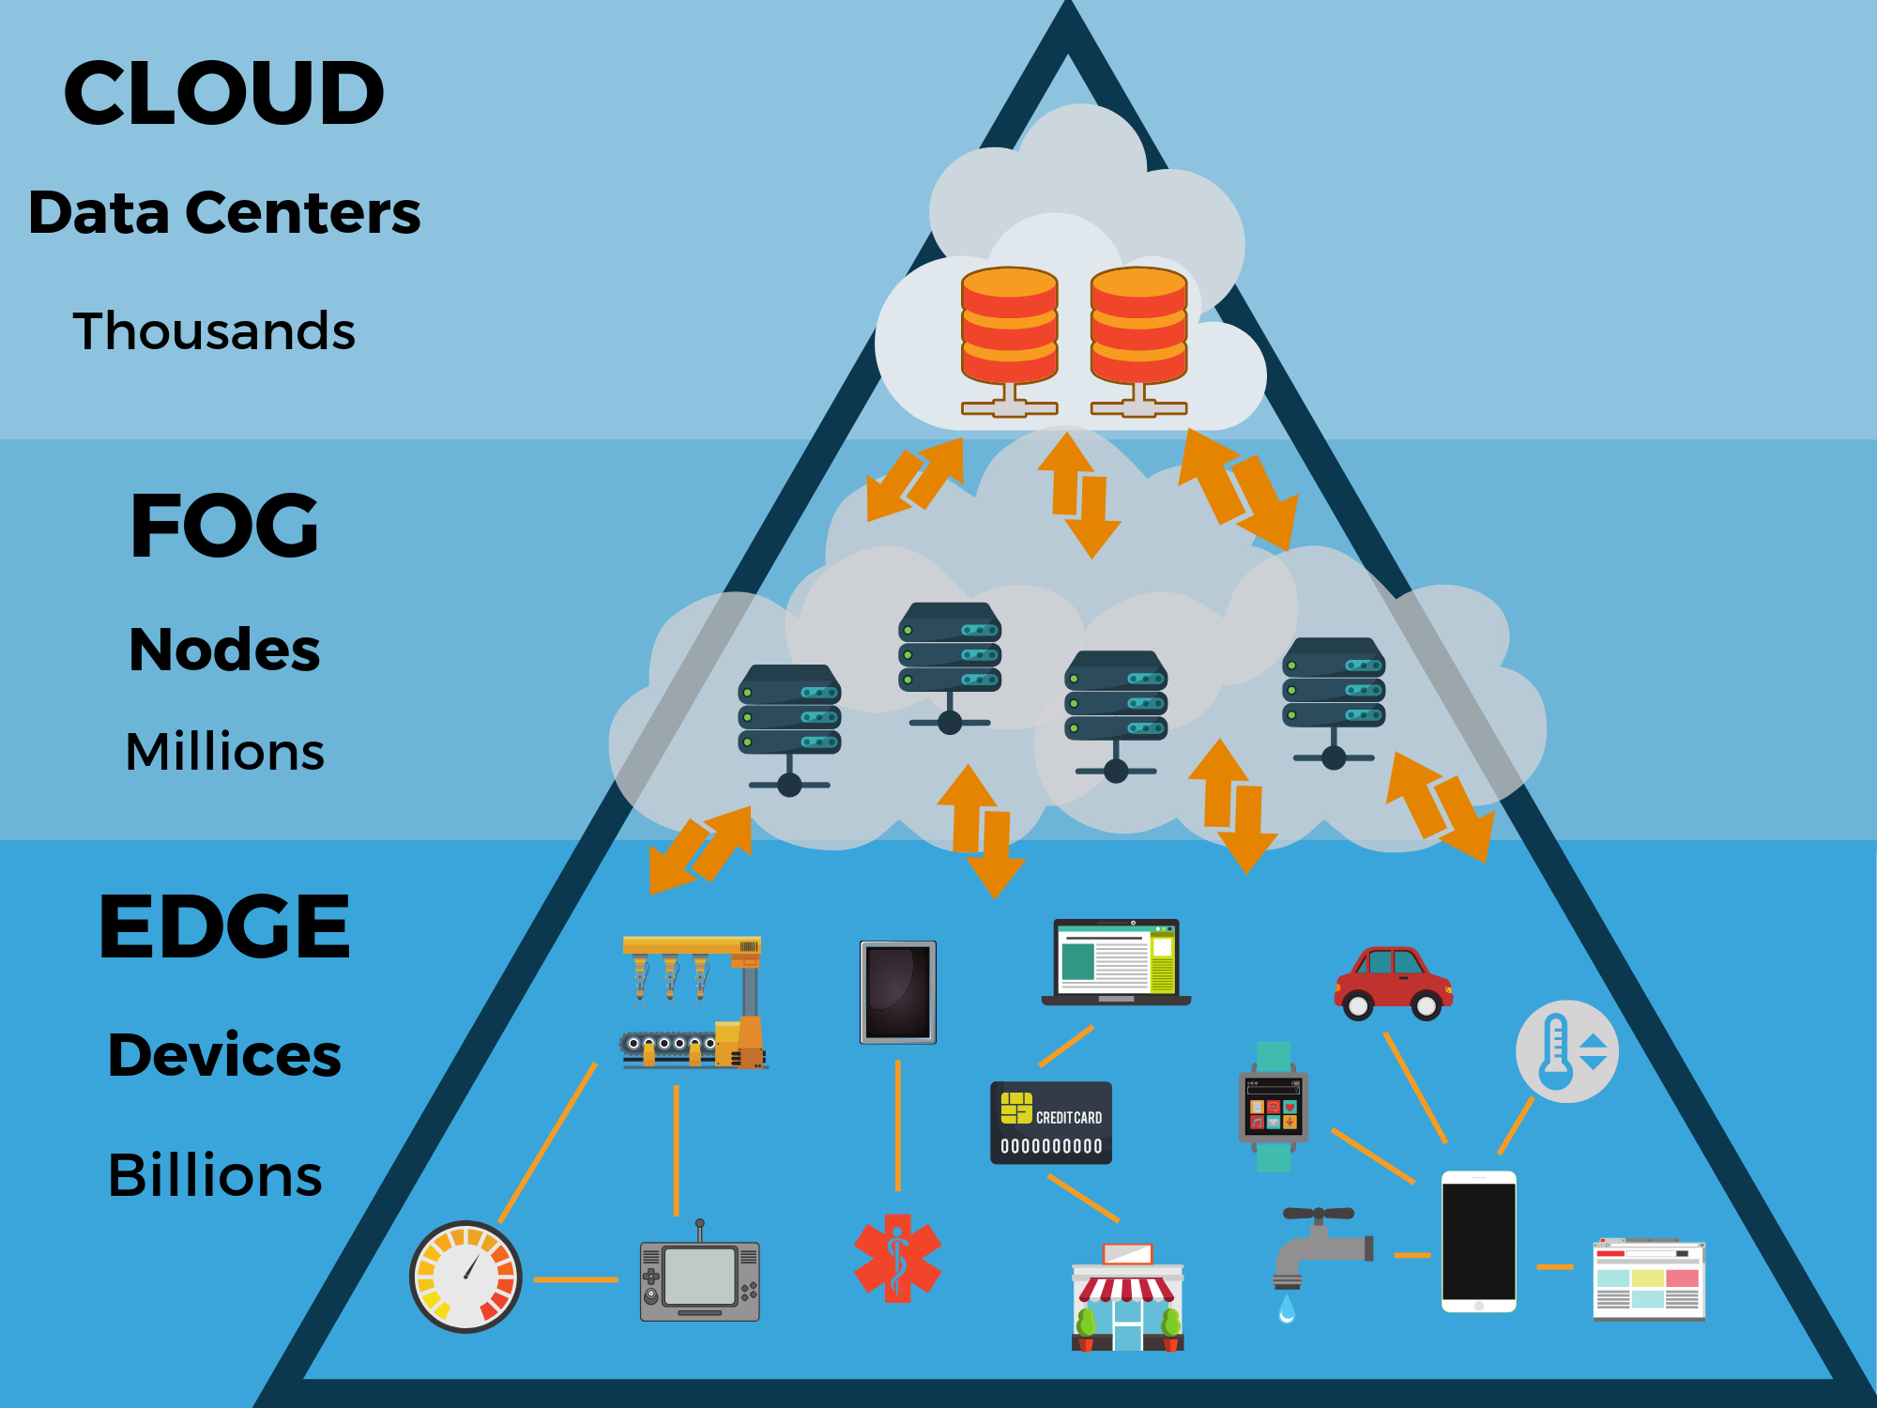
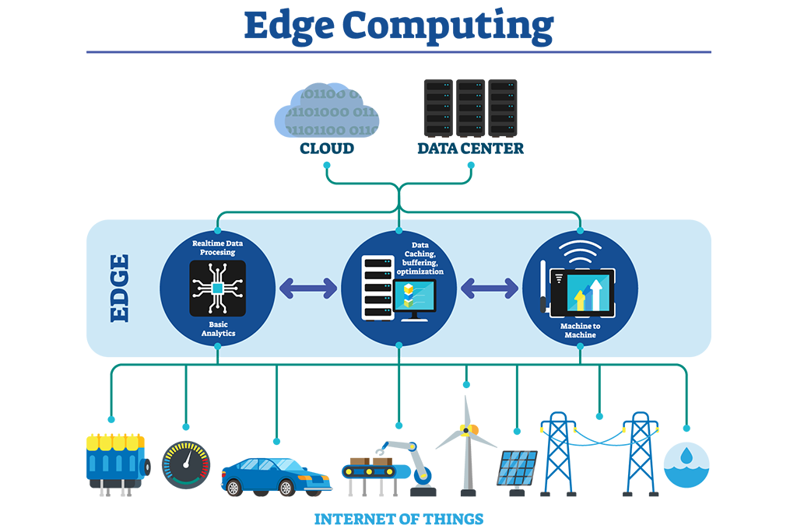
CAPPLab: Undergraduate Research
Previously Mentioned
More Research Opportunities
High Performance Computing (HPC)
Embedded / IoT Systems
Data Analytics / Decision Making
Image Processing / Machine Learning (ML)
HPC and ML in Healthcare
Edge Computing

Slide 6
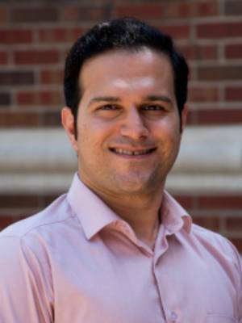
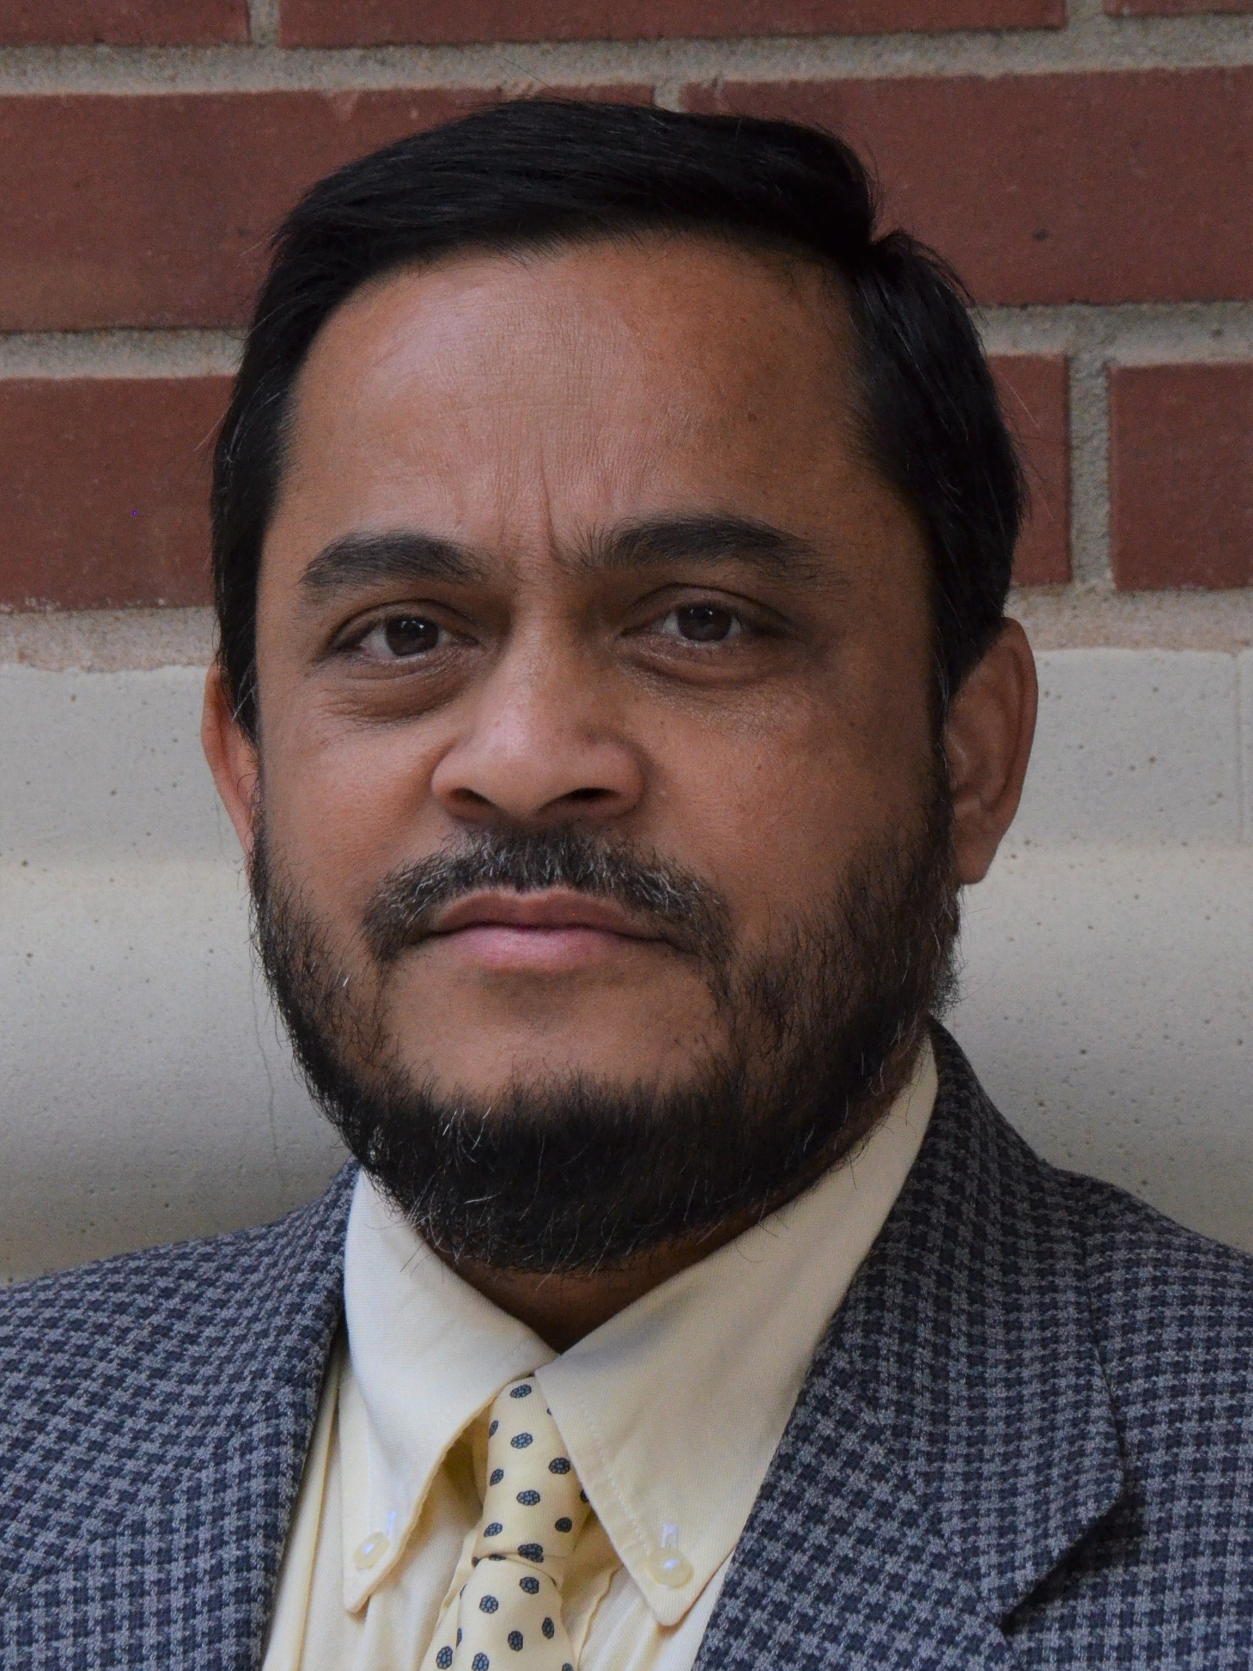
CAPPLab: Research with Industries/Others
BME
Vera Healthcare
Edge technology into healthcare
BSEE
Signals & Data
Embedded Control
BSCE
NVIDIA Corporation
GPU computing
Power Systems
MSECE
Data Driven Decisions
NetApp Inc.
Storage/embedded systems
Advanced Automation
Ph.D.
IS/ME
U.S. Patent 10,689,898
Control doors remotely
SoC

Slide 7
An Image Processing Project

Slide 8
An Image Processing Project (+)

Slide 9
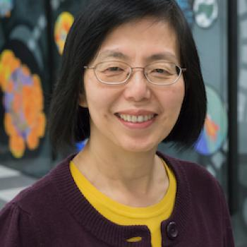
CAPPLab: People
Faculty and Collaborators
Selected Students
Graduated (PhD)
Current (PhD)
Kishore K. Chidella
Graduated in 2018
University of Nevada, USA
Md “Raihan” Uddin
PhD Student
ECE
Dr. Zhang works in Argonne’s Mathematics and Computer Science division
Hong Zhang
ANL PETSc Team
Vidya Suryanarayana
Graduated in 2013
NetApp, USA
Shockers
TBD
TBD
A. Almohaimeed
Graduated in 2019
University, Saudi Arabia
Shockers
TBD
TBD

Slide 10
CAPPLab: People
Faculty and Collaborators
Selected Students (cont’d)
Graduated (MS Thesis)
Graduated (MS Thesis)
Fadi N. Sibai
Associate Dean
College of Eng. & Architecture
Gulf Univ for Sci & Tech, Kuwait
Sri R. Chaturvedula
Graduated in 2011
San Jose, CA, USA
Deepthi Gummadi
Graduated in 2014
Fairfax, VA, USA
Phanendra S.N. Gavara
Graduated in 2012
Phoenix, AZ, USA
Tania Jareen
Graduated in 2014
Wichita, KS, USA
Divya Vardha
Graduated in 2012
Charlotte, NC, USA
Chok M. Yip
Graduated in 2014
Kuala Lumpur, Malaysia

Slide 11
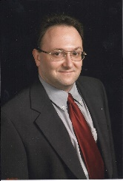
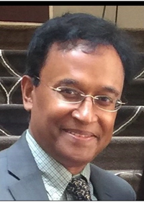
CAPPLab: People
Faculty and Collaborators
Selected Students (cont’d)
Graduated (MS Thesis)
Current (MS Thesis/Project)
Henry J. Neeman
Associate Professor
University of Oklahoma, OK
High Performance Computing
Abhishek Mummidi
Graduated in 2014
Austin, TX, USA
Md Reza-E-Rabbi
MS Thesis
ECE
Md Moniruzzaman
Graduated in 2015
Peachtree City, GA, USA
Koteswara Rao Pandi
MS Project
ECE
Md. Jashim Uddin
Research Associate Professor
Vanderbilt University, TN
School of Medicine
Duncan Campbell
Graduated in 2023
Wichita, KS, USA
AL “Nuwanthi” Perera
MS Project
ECE

Slide 12
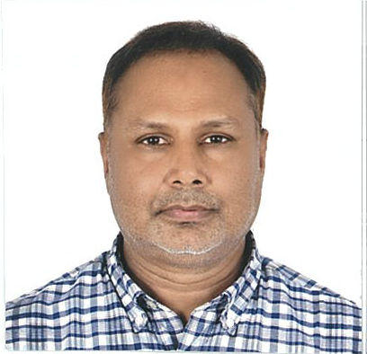
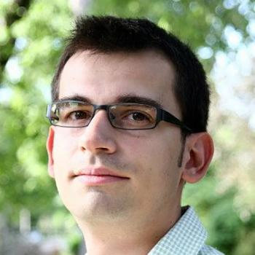
CAPPLab: People
Faculty and Collaborators
Selected Students (cont’d)
Graduated (MS Project)
Current (MS Project)
Dr. Md Altaf-Ul-Amin
Associate Professor
NAIST, Japan
Computational Systems Biology
Neeraj Kumar
Graduated in 2012
San Jose, CA, USA
Declan D’souza
MS Project
ECE
Venkatesh Mabbu
Graduated in 2015
Wichita, KS, USA
Sonu Gangadhar Gowda
MS Project
ECE
VAP “Tanoj” Telikepalli
Graduated in 2023
Dallas, TX, USA
Shockers
TBD
TBD
Emil M. Constantinescu
Computational Mathematician / / R&D Leader

Slide 13
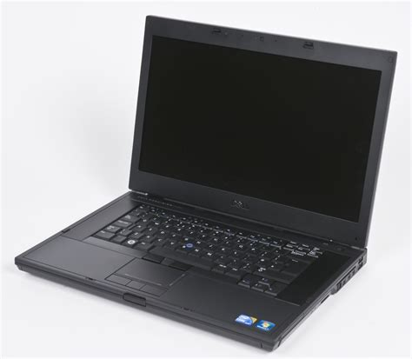
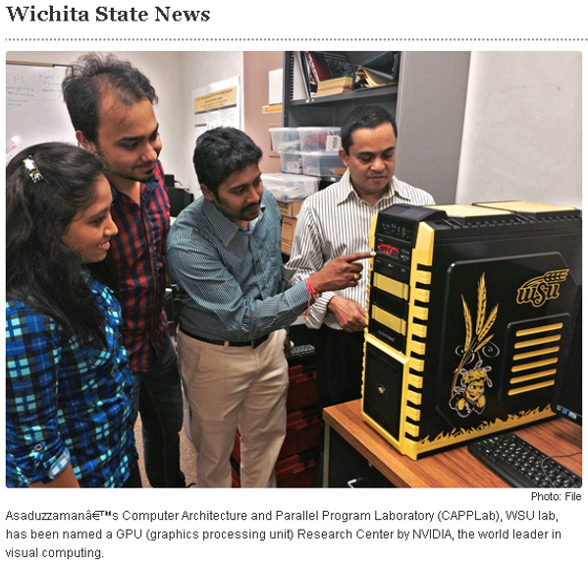
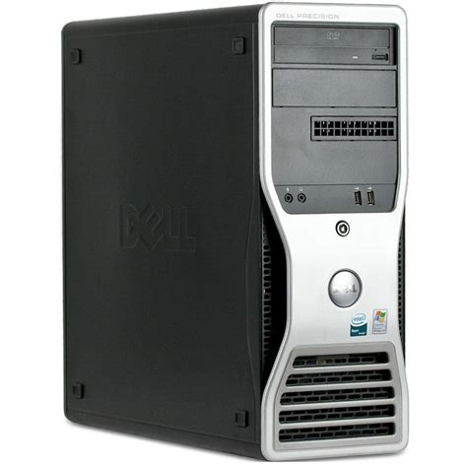
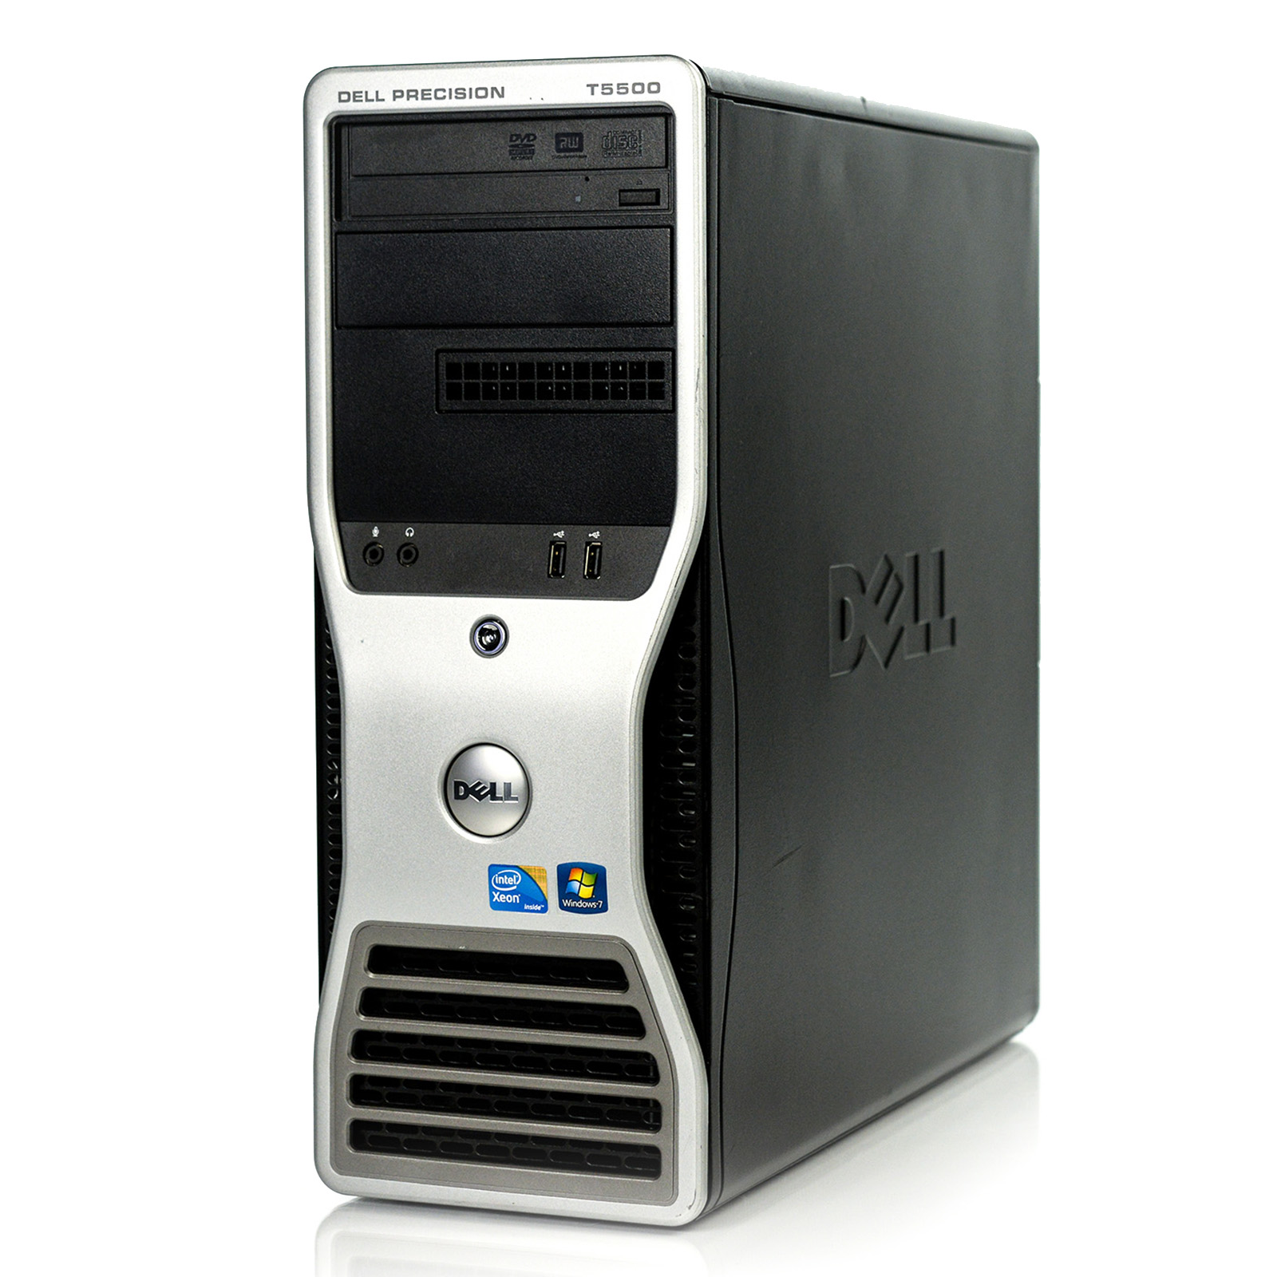
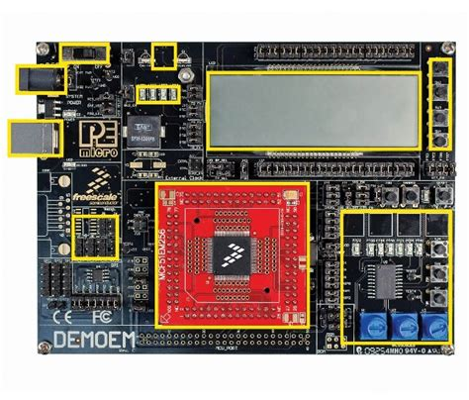
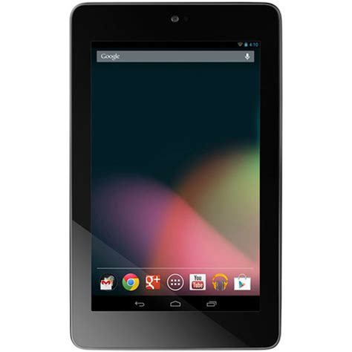
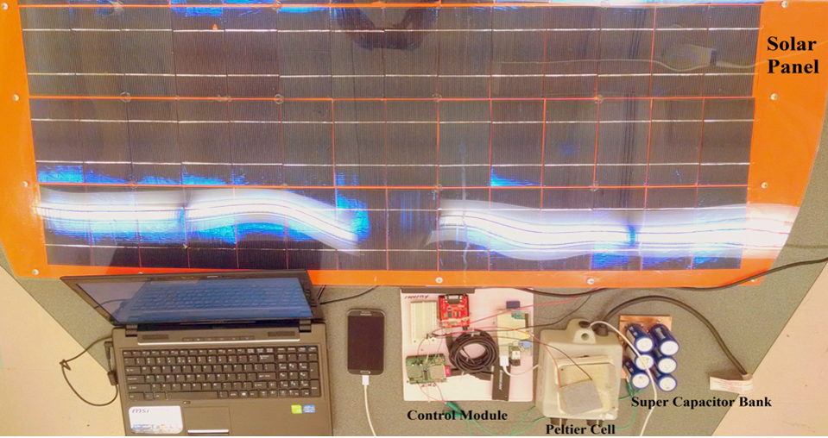
CAPPLab: Resources
Servers / Workstations
Desktop Computers
Server/Workstation: CPU (Intel C610, 16-core, 2.3 GHz, 64GB DDR3, 135 Watt) and GPU (NVIDIA Tesla K40, 2880-core, 12GB GDDR5, 235 Watt).
Laptops / Microcontrollers
Desktop Computer: CPU (Intel Xeon E5506, 8-core, 2.13 GHz, 8GB DDR3, 80 Watt) and GPU (NVIDIA Tesla C2075, 448-core, 6GB GDDR5, 255 Watt).

Slide 14
Education/Research: MS Thesis/PhD Dissertation
WSE Graduate School
PhD: https://www.wichita.edu/academics/majors/electrical_engineering_and_computer_science_phd_129.php
MS: https://www.wichita.edu/academics/majors/electrical_and_computer_engineering_ms_128.php
WSE CoE Electrical and Computer Engineering Department
PhD: https://www.wichita.edu/academics/engineering/ECE/grad/PhD/index.php
MS: https://www.wichita.edu/academics/engineering/ECE/grad/MS/MS-ECE.php
WSE CoE School of Computing
PhD: https://www.wichita.edu/academics/engineering/SoC/grad/PhD/index.php
MS CS: https://www.wichita.edu/academics/engineering/SoC/grad/MS/MS-CS.php
MS CP: https://www.wichita.edu/academics/engineering/SoC/grad/MS/MS-CP.php
MS DS: https://www.wichita.edu/academics/engineering/SoC/grad/MS/MS-DS.php

Slide 15
Education/Research: MS Thesis/MS Project
Both MS Thesis and MS Project will conduct research activities.
However,
MS Thesis
Students spend several semesters doing research work instead of classwork
Students engage more in an intense research (less concerned with classroom environment)
Students are mandated to write and publish a thesis
Prepares students for PhD study and/or work as a researcher in a research facility
MS Project
Students typically spend one semester doing research work instead of classwork
Students are more concerned with classroom environment (engage less in an intense research)
Students are not necessarily mandated to write and publish a thesis
Prepares students for workplaces (no or less research work)
"What is the difference between MS thesis and MS project?"
https://www.quora.com/What-is-the-difference-between-MS-thesis-and-MS-project

Slide 16
MS Project / MS Thesis / PhD Dissertation
How to measure research work?
MS Project
At least one IEEE/ACM conference paper
Venkatesh Mabbu, “A Semantic Knowledge Engine Using Automated Knowledge Extraction from World Wide Web,” (CS, 2015),
Project Report: https://www.wichita.edu/academics/engineering/CAPPLab/PDF/MSP_Venkatesh2015.pdf;
Presentation slides: https://www.wichita.edu/academics/engineering/CAPPLab/PPT/MSP_Venkatesh2015.pptx
MS Thesis
At least one IEEE/ACM or similar journal article
Two or more IEEE/ACM or similar conference papers
Sri Ramya Chaturvedula, “Designing Multi-Core Architecture Using Folded Torus Concept to Minimize the Number of Switches,” (CS, 2011),
Manuscript: https://www.wichita.edu/academics/engineering/CAPPLab/PDF/MST_SriR2011.pdf
Chok M. Yip, “CUDA Accelerated Large Scale Vehicular Area Network Simulator,” (CN, 2014),
Presentation slides: https://www.wichita.edu/academics/engineering/CAPPLab/PPT/MST_Chok2014.pptx
PhD Dissertation
At least three IEEE/ACM or similar journal articles
Six or more IEEE/ACM or similar conference papers
Kishore K. Chidella, “Directory-based wired-wireless network-on-chip architectures to improve performance,” (EECS, 2018),
Manuscript: https://www.wichita.edu/academics/engineering/CAPPLab/PDF/PhD_Kishore2018.pdf;
Presentation slides: https://www.wichita.edu/academics/engineering/CAPPLab/PPT/PhD_Kishore2018.pptx

Slide 17
MS Project / MS Thesis / PhD Dissertation
Show your work?
Fall Opportunity
Engineering Research Symposium with poster competition
https://www.wichita.edu/academics/engineering/events/research-symposium.php
Spring Opportunity
Graduate Research and Scholarly Projects (GRASP) Symposium
https://www.wichita.edu/academics/graduate_school/grasp/index.php
Prepare/Submit (1) Abstracts: Template, Deadlines; (2) Poster
Kansas Undergraduate Research Day at the Capitol
https://www.wichita.edu/academics/research/undergradresearch/Day_at_Capitol.php
Conference/Journal Articles
IEEE/ACM conferences/journals
Selected Elsevier/Springer journals
Others selected venues
Every enrolled student MUST participate!
Every enrolled student MUST participate!
Every student MUST publish!

Slide 18
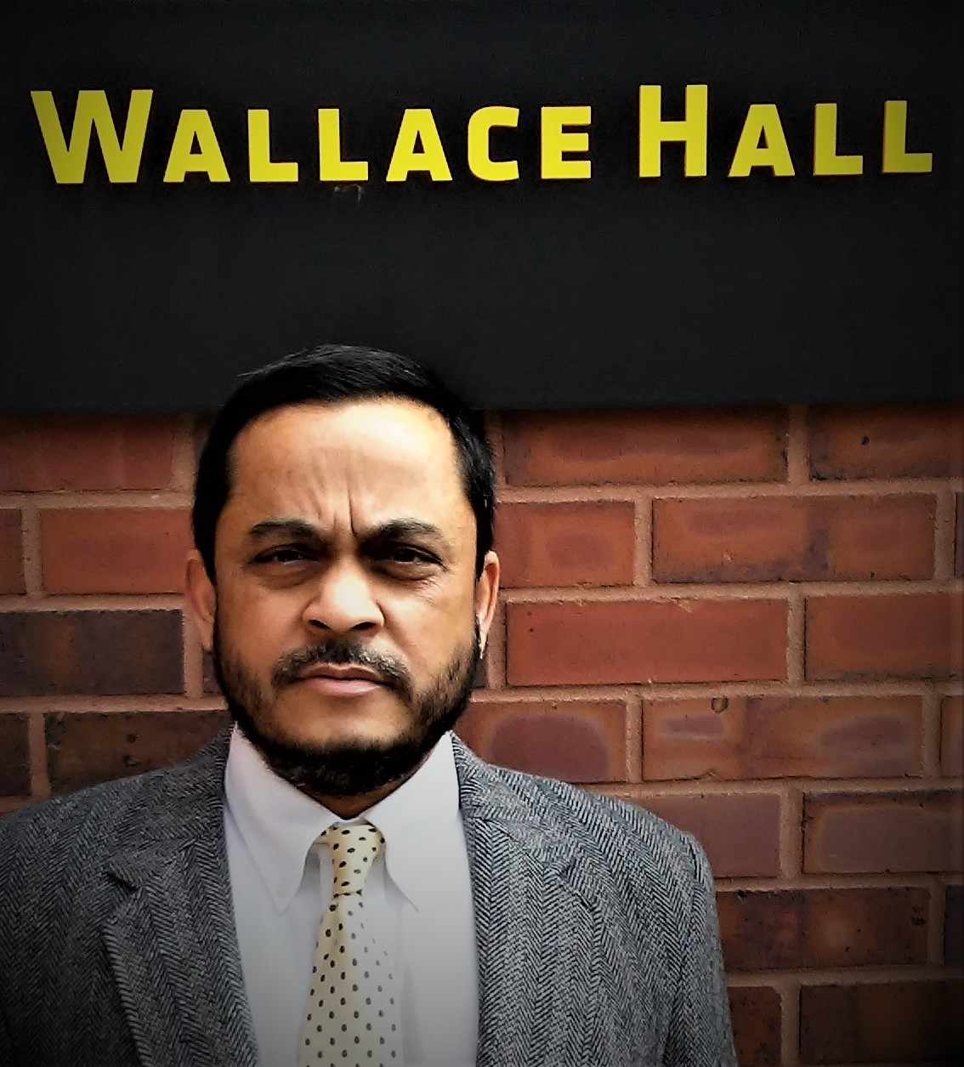
Computer Architecture and Parallel Programming Laboratory (CAPPLab)
Contact:
Abu Asaduzzaman (Zaman)
Abu.Asaduzzaman@wichita.edu
+1-316-978-5261
Thank you!

