Slide 1
Parts List
(1) 4’ x 8’ 5mm Utility Panel (plywood) $26.68
(1) 1” x 4” Whitewood Board 5.48
(4) 1” x 2” Whitewood Board 10.96
(1) 0.25” x 0.25” Square Dowel 1.98
(2) 0.5” x 0.5” Square Dowel 5.96
(2) pkgs of (2) 2.5” Corner Braces 12.96
(2) pkgs of (6) 10-24 x 1.5” Bolts 2.90
(1) pkg of (10) 10-24 x ½” Bolts 1.38
$68.30
Plus (3) ½” diameter steel ball bearings
Plus miscellaneous
Paint (color scheme has no bearing on this course, paint it how you want)
Glue
Velcro
Nails (if required)

Slide 2
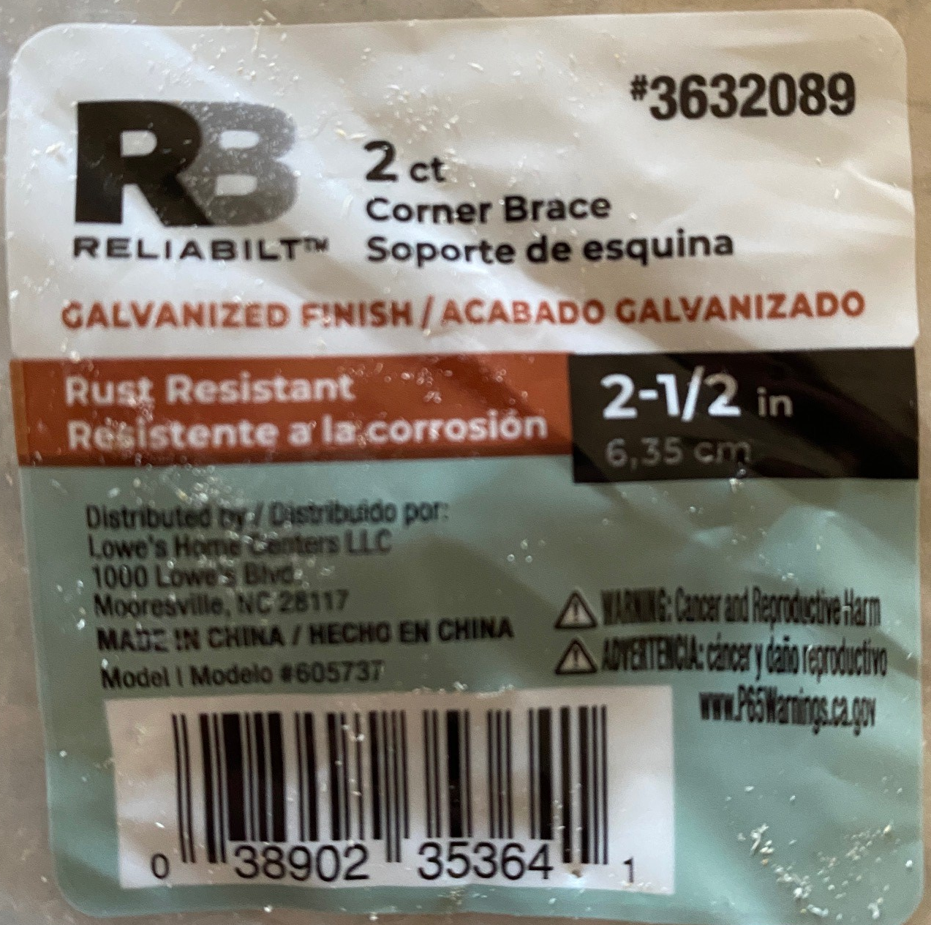
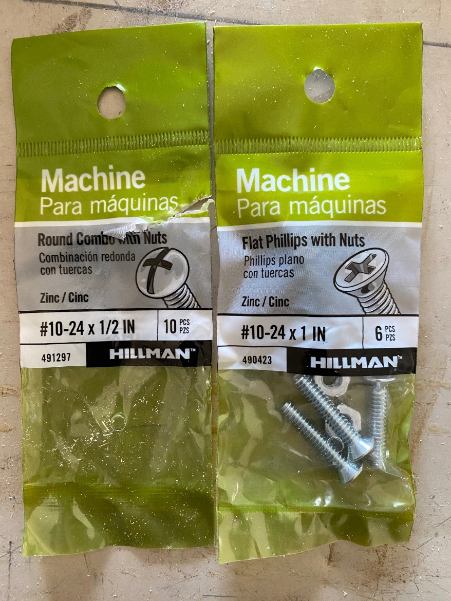
Get 1.5”. These were a little short.

Slide 3
Tightrope Walls
Ramp Walls
Ramp Up/Down & Top
(1) 4’ x 4’ 5mm thick plywood sheet
(2) 1”x2”x48”
(4) 1”x2”x45”
Course frame assembled with glue and nails
(2) Tightrope Walls from 5mm thick plywood sheet
(2) Ramp Walls from 1”x4”
(2) 9”x7” ramp up/down from 5mm thick plywood sheet
9”x6” ramp top from 5mm thick plywood sheet
Ramp assembled with glue and nails
Grid is 3” x 3”

Slide 4
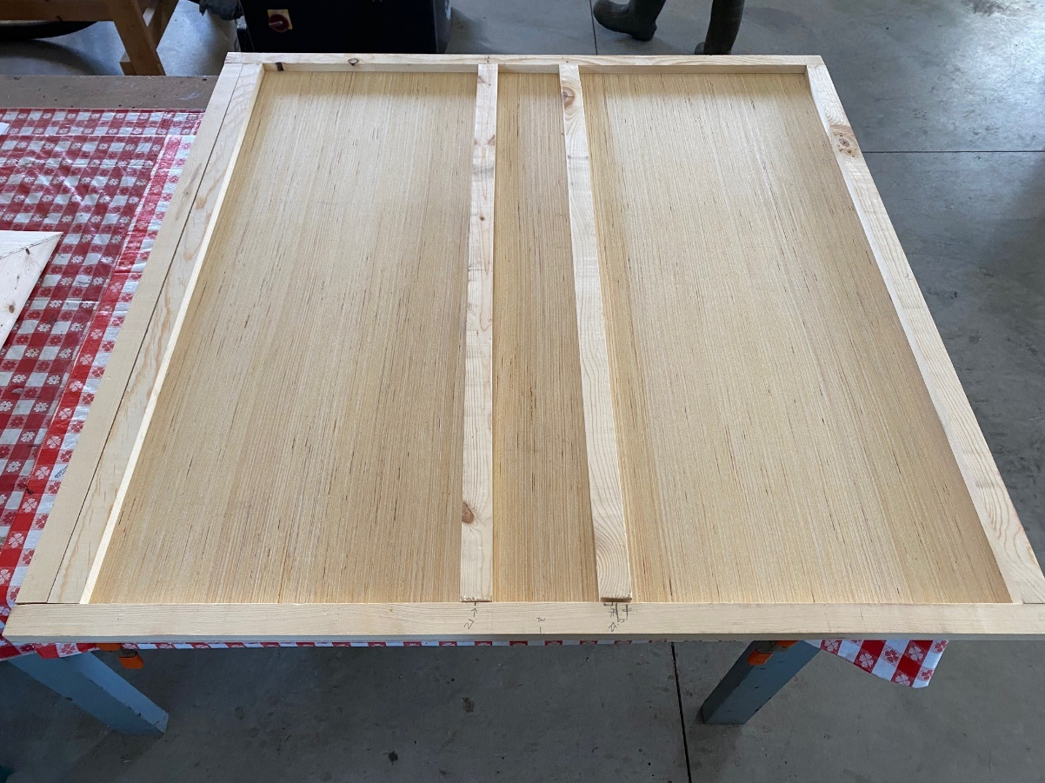
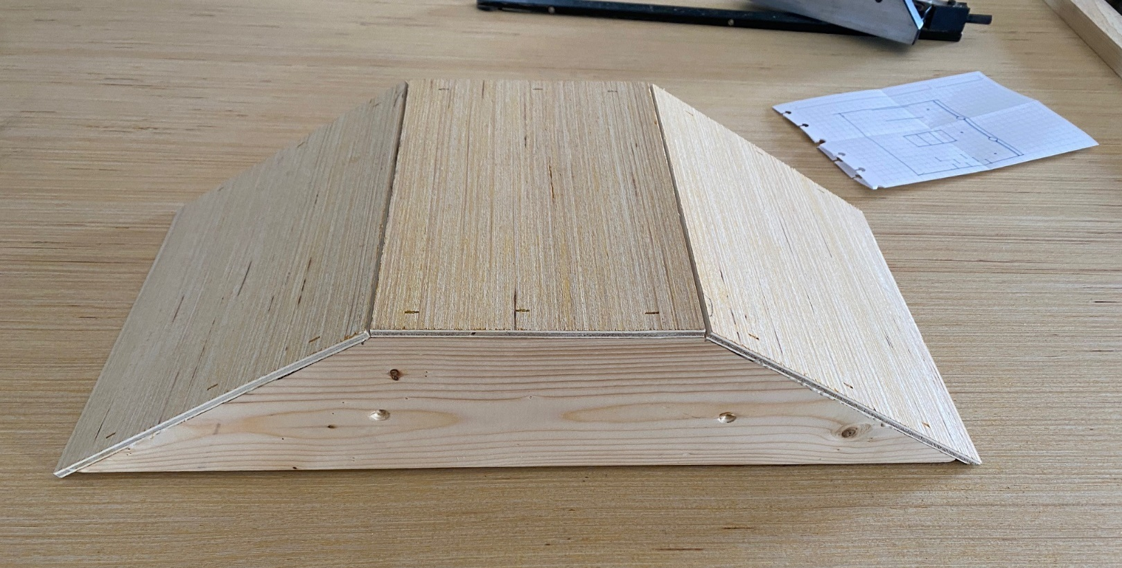

Slide 5
Tightrope Walls
End Barrier
Catch Pocket
Rumble Strip Bars
Ball Start Holes
Layout and placement of all course details.
Ramp attached with velcro
Ball Start holes are 3/8” diameter drilled through the skin
Catch Pockets are 1.5” diameter and only through the skin
Rumble Strip Bars are ¼”x ¼”x3” long, glued in place
End Barriers are ½”x ½” material glued in place
Green stripe is 3” wide painted or electrical tape
Tightrope wall showing placement of ‘L’ brackets.
Brackets attach to walls with 1” bolts.
Brackets attach to course base with 1.5” bolts and should line up with supports below.
Grid is 3” x 3”

Slide 6
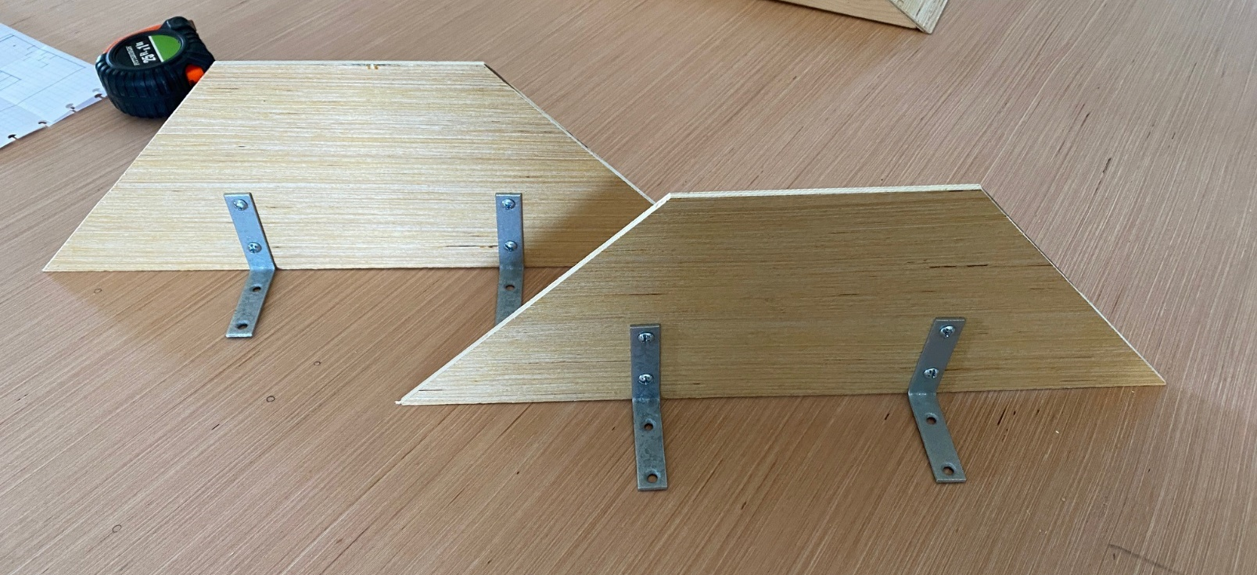
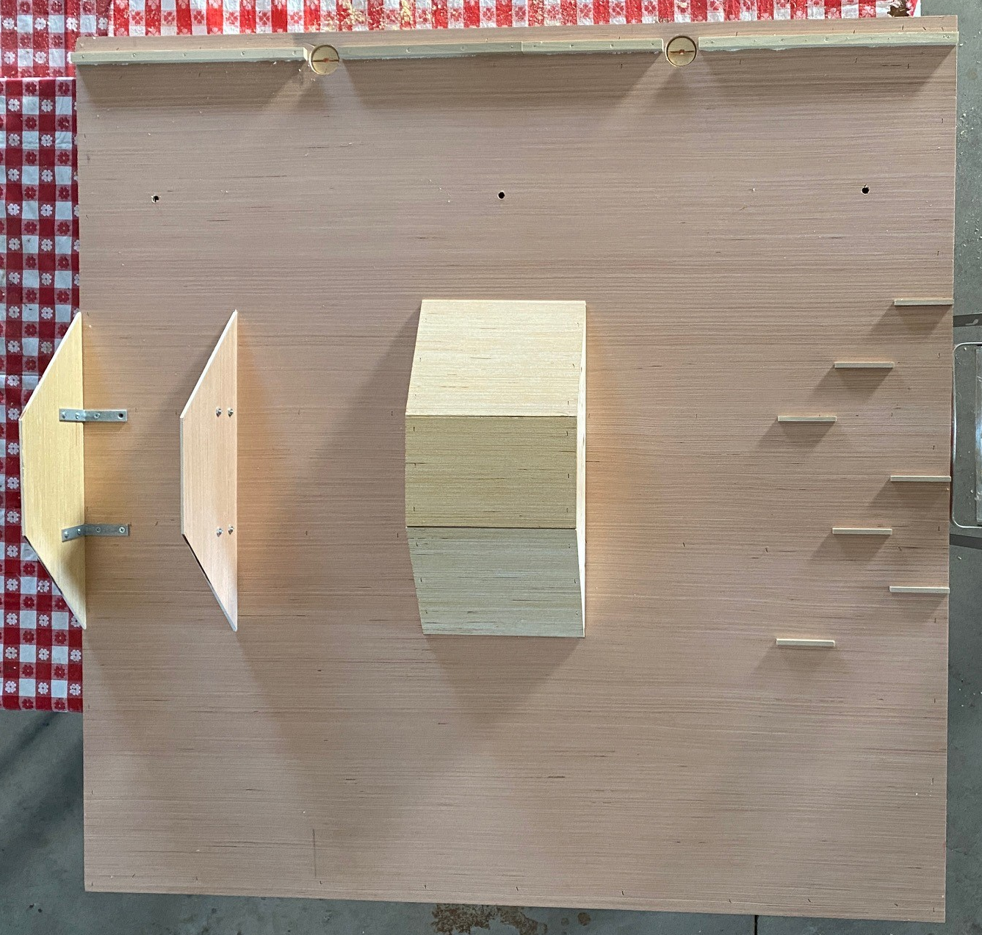

Slide 7
Course Base is White.
Obstacles are Red.
Start Stripe is Green.

