Slide 1
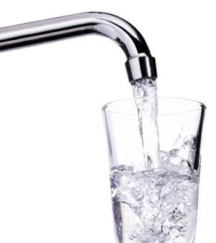
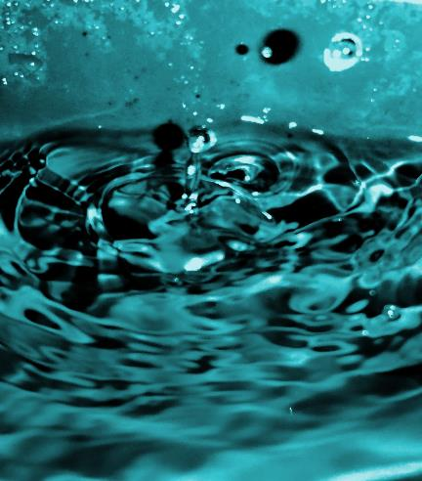
Water Workshop

Slide 2
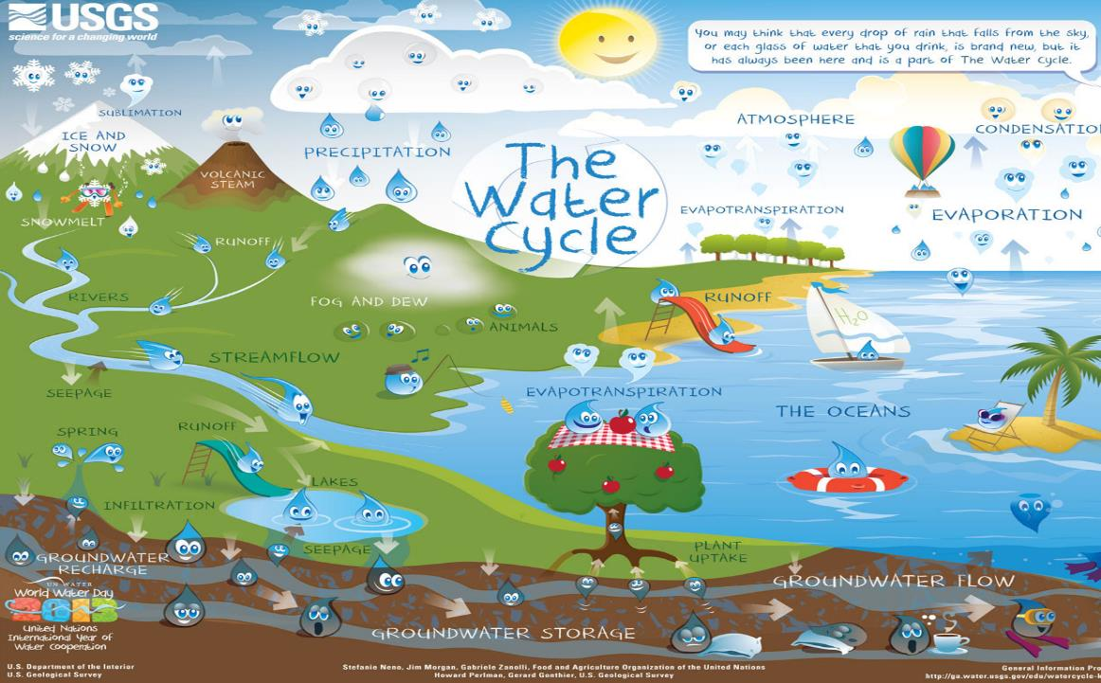
Notes:
The same amount of water exists on Earth now as it did when the Earth began. How can that be? Because water is constantly cycling from salty ocean water into clouds, into fresh water as rain, which flows back to the oceans. This is called the Water Cycle (Water Cycle slide - point out the five main parts). The water cycle has five parts: evaporation & transpiration, condensation, precipitation, infiltration and surface run-off. The water cycle is powered by the energy of the sun. The sun heats the Earth and changes water into a gas called water vapor, which is called Evaporation. Plants also release water vapor from their leaves, and this is called Transpiration. This water vapor rises into the sky where it clings to dust particles. The colder air up high turns the gas back into liquid water droplets that group together to make clouds. This is called Condensation. Air currents move the clouds around the Earth. Eventually the clouds gather more water than they can hold, and the water falls back to earth as rain or snow. This is called Precipitation. The precipitation either infiltrates (soaks) into the ground, or runs off the surface into streams, rivers, and lakes which eventually flow back to the ocean where the process starts over again.

Slide 3
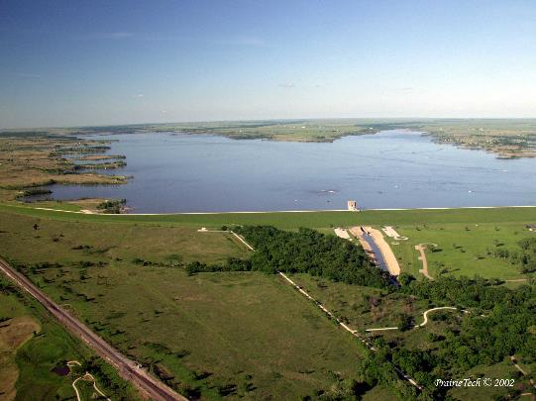
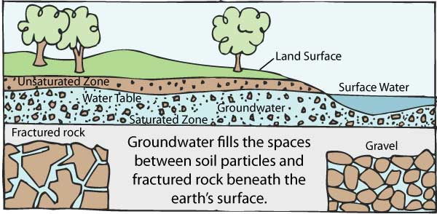
Drinking Water Sources
Surface Water
Groundwater
CA State Water Resources Control Board
eldoks.com
Notes:
So where does the water we use for drinking here come from? Drinking water sources come from either surface water or groundwater. Surface water is water you can see that sits on the surface of the Earth - streams, lakes, rivers, ponds, etc. Groundwater is found underground in the cracks and spaces made by the soil, sand and rock.

Slide 4
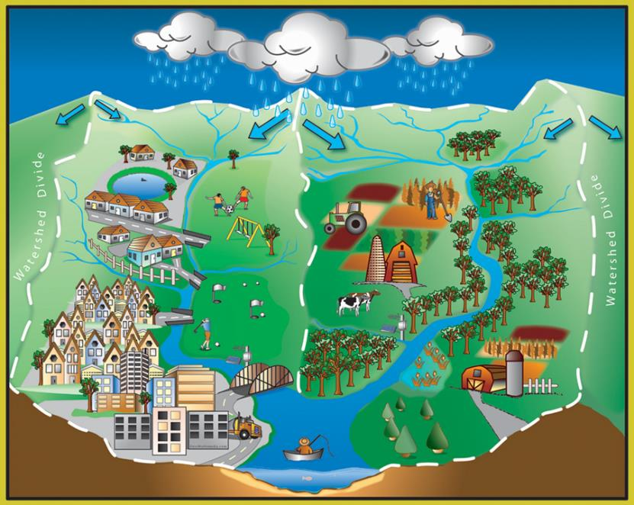
Watersheds
Everyone lives in watershed
Watersheds drains into a receiving body of water
Receiving bodies can be streams, ponds, lakes, rivers or oceans
Notes:
To understand where your drinking water comes from, we first have to learn about watersheds. Who can tell me what a watershed is? Take an answer, then show slide. A watershed is an area of land that drains water towards a downhill point. The point can be a stream segment, river, lake or pond. Movement of water is directed by gravity, so a watershed is separated from other watersheds by land with higher points of elevation.
***WATERSHED ACTIVITY

Slide 5
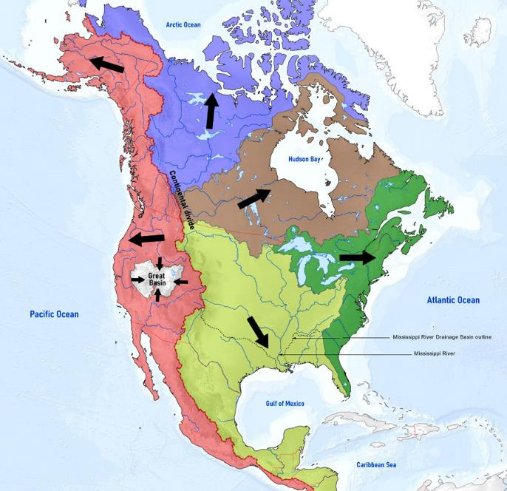
North America Watersheds
Water Today New York: wtny.us/watersheds-basics.asp
Notes:
Which watershed are you in? What ocean does water from your house end up?

Slide 6
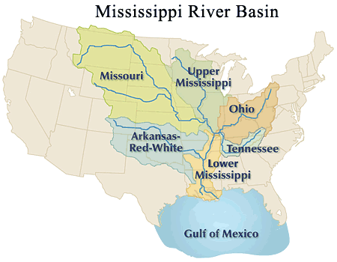
Watersheds.org
Notes:
The Mississippi River Basin, the largest watershed in the US. (Point out watersheds on slide and direction of flow.) The water that flows across the land flows into the streams, creeks, then rivers that then empty into the Mississippi River and then in to the Gulf of Mexico.
Which watershed path does the water that falls at your house take?

Slide 7
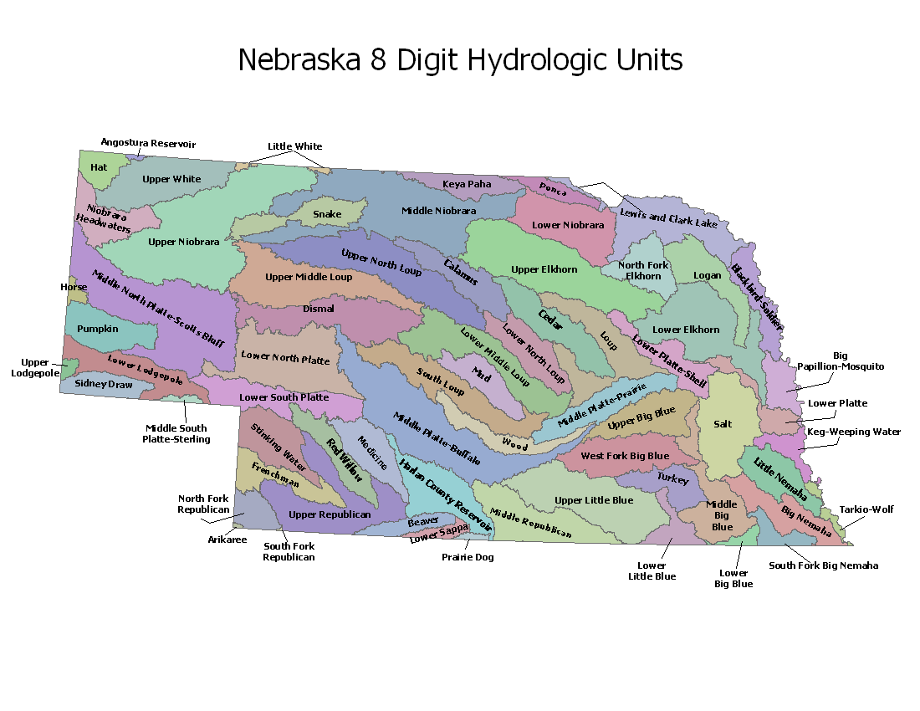
Nebraska Watersheds
Natural Resources Conservation Service – Nebraska
Notes:
There are many small watersheds inside each state, ex: Nebraska.
The trouble with watersheds is that as water flows across the surface of the land it picks up things and carries them along. Where does the runoff eventually get to? Right. Streams, lakes, ponds, ocean. We call this type of pollution nonpoint source pollution because we can’t just “point” to the source, it comes from all of us over a wide area.
Think about the types of things that could get picked up and carried along during a rain storm in your neighborhood and carried along to the nearest stream. (soil, gravel, oil, road salt, pesticides, dog poop (bacteria), etc)
**ACTIVITY: Nonpoint Source Pollution
Have students dry or shake off their watersheds a bit if they are too wet.
Have students place a drop of food coloring representing a type of nonpoint source pollution of their choice.
“Rain” again on the watershed. What happens to the pollution?
How could they have stopped the pollution?
What do they do now if the lake or river that now has the pollutant in it is where they get their drinking water?
Give students pieces of sponge and have them see if that stops some of the pollution. Natural buffers like grass swales, etc. make good pollution sponges.

Slide 8
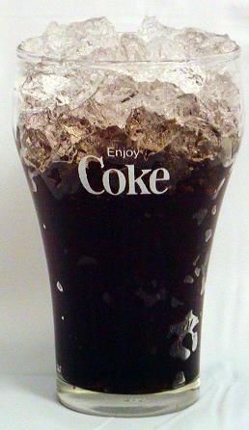
Groundwater
Notes:
The other source of water available to Nebraskans is water from under the ground. Groundwater is held in aquifers. Let’s do a short demonstration about how aquifers work.
**ACTIVITY: Groundwater Demonstration
Hold up a clear cup or container up filled with ice.
Show students the concept of how water sits in the spaces between the ice cubes (small spaces or large).
Water can then be drawn out of there with a well (straw).

Slide 9
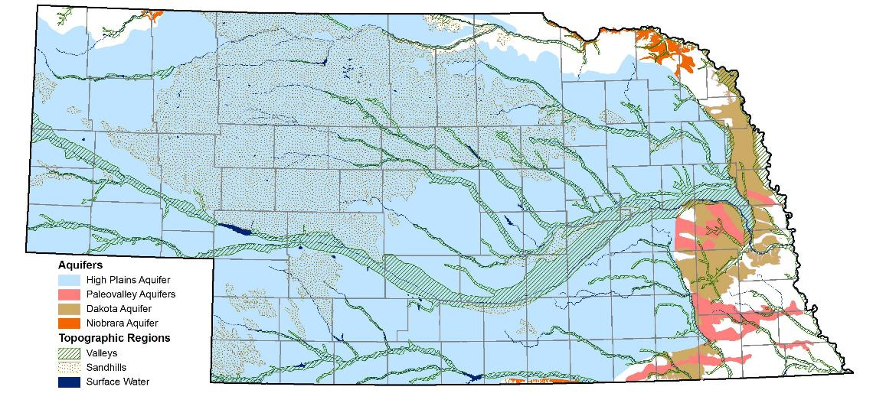
Nebraska Groundwater
Notes:
Underground there are areas that are not permeable, or hold no water, and then areas that hold a great deal of water. Some aquifers are close to the surface and are actually connected to streams and rivers. Those are called Alluvial Aquifers. Show the Alluvial Aquifers map on the slide. Other aquifers are deep underground, and we drill deep wells to find that water to use for irrigation, drinking or industry. Many communities get their drinking water from this underground water source.
When communities get water from aquifers they often have to do less water treatment before sending the water out to their customers. As water infiltrates down from the land’s surface through the soils, sand and gravel it can filter out bacteria and other nutrients and chemicals that the water picked up as it ran across the land. Groundwater is not 100% purified or cleaned up, but it usually needs less treatment to get it to drinking water quality than surface water.
Why do you think that is?

Slide 10
What is your Drinking water Source?
Notes:
Insert information about your drinking water source.
Example: El Dorado gets its drinking water from El Dorado Reservoir. A reservoir is a man-made lake to hold water for a water supply. El Dorado Reservoir was built in 1981. It is 8,400-acres and can store 50 billion gallons of water.
The water from El Dorado lake is transported through large water mains (pipes) to the water treatment plant.
Raw water is water found in streams, rivers, lakes and aquifers. Think of raw water as “uncooked”. Raw water has not been treated, and is considered non-potable – meaning it is not fit to drink. Raw water can have microorganisms that can make humans sick, plus there are tiny particles of dirt and sediment in the water. Therefore we need to treat the water before we drink it.

Slide 11
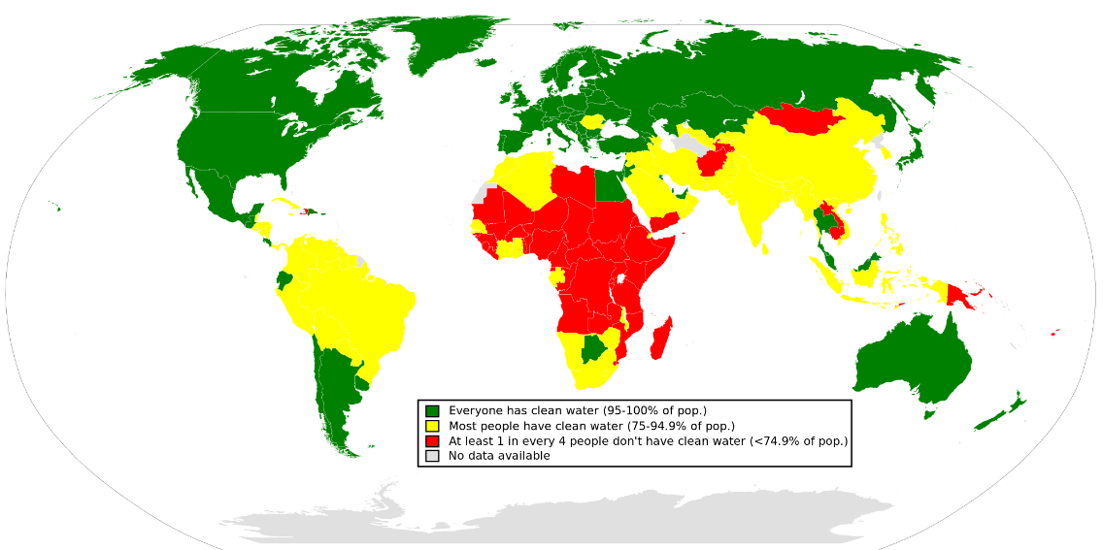
Worldwide Water Quality
UNDP as of 2006
Notes:
The US has some of the safest water in the world thanks to strict regulations. However, other countries are not as fortunate as we are. Take a look at worldwide water quality.

Slide 12
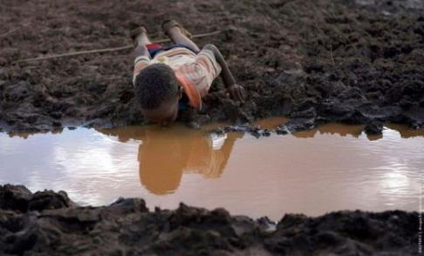
Water health challenges
Half of all hospital beds in the world are full of people who are sick from dirty water
The average distance women travel to collect water in Africa & Asia is ~4 miles
3.4 million people die each year from a water-related disease
1 in 8 people lack a safe source of water
Water facts from United Nations water.org
Notes:
Altogether 3.4 million people die every year because of water related disease. That’s would be as if the entire population of Denver died, twice a year! In developing countries nearly 1 out of 8 people don’t have access to clean water. And many of them have to spend most of their day walking far distances to collect this water that may not be safe to use. We really are lucky to live here where our water quality is monitored, safe, and readily available at the turn of a faucet handle.

Slide 13
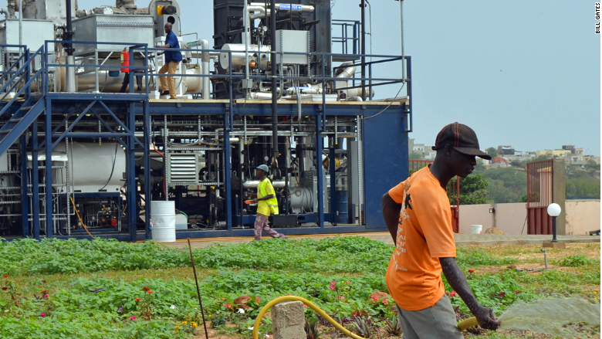
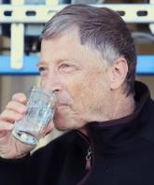
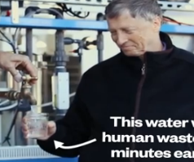
Innovation – you are the future
The Omni Processor turns sewage in to bricks and water safe enough to drink and irrigate crops.
A worker in Dakar, Senegal, irrigates crops using water produced by the Omni Processor.
Notes:
Perhaps you will consider a future career as a water professional. Maybe you can help design an affordable system to bring clean water to developing countries like the Omniprocessor. This unit was designed by students at several universities through funding by Bill Gates. The Omniprocessor takes sewage, separates the solids and incinerates them into ash that can be used to make bricks. The liquid is distilled back into pure water that can be used for drinking or irrigation. Pretty cool!

Slide 14
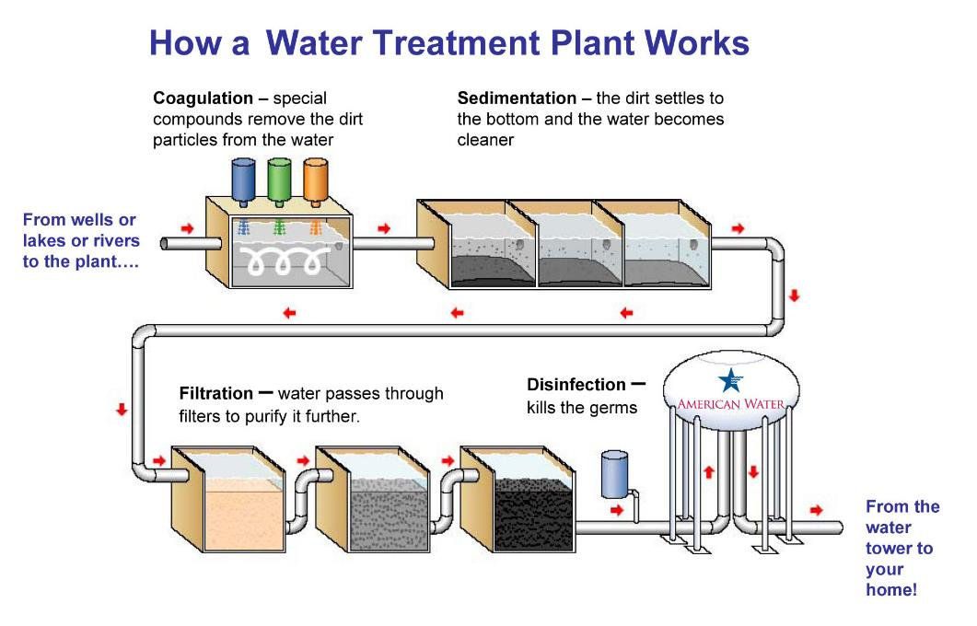
Notes:
*** DRINKING WATER ACTIVITY
Water is treated using 4 steps. And we are going to “act out those steps with our “Lake Water.”
Give each group of students a cup with the lake water, a styrofoam cup, and another clear plastic cup.
First, the water is pumped from the reservoirs to the treatment plant where a chemical like alum (aluminum sulfate) is added to it to make the dirt and particles stick together to make big heavy particles. The water is mixed in large holding tanks with a “propeller” type mixing device. This is called coagulation and flocculation, which is a fancy way of saying “stick together and make bigger pieces. “
2. Sprinkle 1/8 tsp. alum over the surface of the water. The soil particles will stick together and form “floc” this is called flocation or coagulation.
Next the water is allowed to settle the heavy particles to the bottom of the sedimentation tank, while the clarified (clear) water flows off the top to the next step. This second step is called sedimentation.
3. Let samples sit for 5-ish minutes - sedimentation
The third step is called filtration, and leads the water through filters made of materials with varying densities and pore space. Filters are made of anthracite coal on top, followed by fine, medium, coarse sand, and finally gravel on the bottom. Walk around the room to show the filter samples while talking. The water filters trap any remaining suspended solids such as particles including clays and silts, natural organic matter, precipitates from the alum, iron and manganese, and microorganisms. The filters get cleaned about every other day because they get full of particles.
4. Poke 10 small holes in the bottom of a Styrofoam cup
Place a small piece of paper towel in the bottom of the cup to act as a filter. Next, add a layer of gravel then a layer of sand. Pour the water through the filter and catch the water that scomes through with the other clear cup.
The final step in our water treatment process is disinfection. Chlorine is added to the water to kill any remaining harmful microbes, and then it is stored in water storage tanks from where it travels to your house through pipes underground.
6. Add a drop of yellow food coloring to represent chlorine.

Slide 15
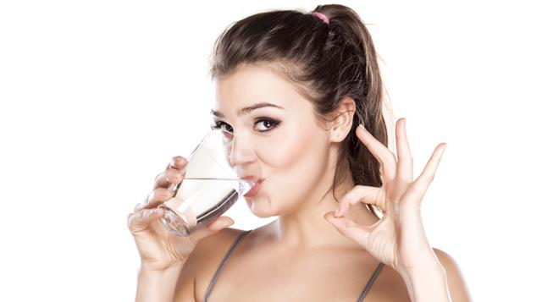
Water quality standards
Drinking water must meet State and Federal regulations before it goes into the distribution system
Federal – Environmental Protection Agency (EPA)
1974 Safe Drinking Water Act
State – Nebraska Department of Environment and Energy
Notes:
The EPA (Environmental Protection Agency) oversees the Safe Drinking Water Act, which is a federal law that requires a certain level of cleanliness before water can be used for drinking. In NE, the NE Department of Environment and Energy oversees that all NE drinking water plants are sending out water that meets the Safe Drinking Water Act requirements.

Slide 16
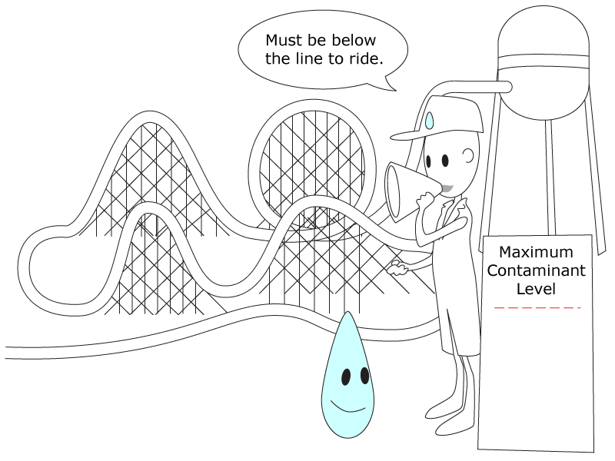
Maximum Contaminant Level
Primary MCLs
  Enforced by KDHE
  Fined if exceed
Secondary MCL
  Not enforced
  This is the goal
Notes:
The EPA has set limits on over 90 contaminants in drinking water. Primary standards are limits on contaminants that pose a health risk to people if they are in our drinking water. Secondary standards are suggested limits on contaminants that could make the water smell, taste or look unappealing, but will not cause health problems. Drinking water utilities must test for these contaminants and compare them to EPA’s Maximum Contaminant Levels or MCLs. When testing the water, the lab wants to see levels below the MCL.

Slide 17
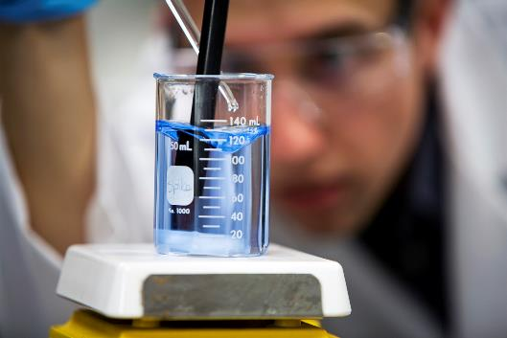
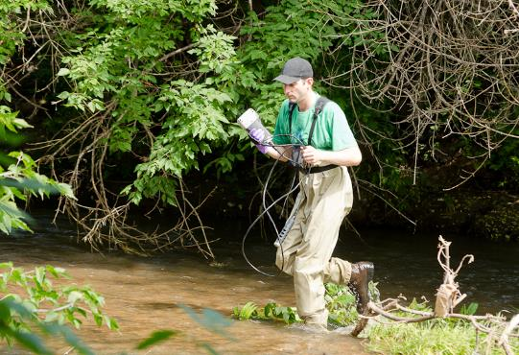
Water Testing
Bacteria Turbidity
pH Organics
Alkalinity Metals
Calcium Chloride
Chlorine Sulfate
Nitrate Nitrite
Color
Notes:
**** ACTIVITY - Pass out the latest Consumer Confidence Report. Our utility tests the water 2,500 each month to make sure it meets the standards, and is as clean or cleaner than required by law. If you like chemistry, consider working in our laboratory after you finish college.

Slide 18
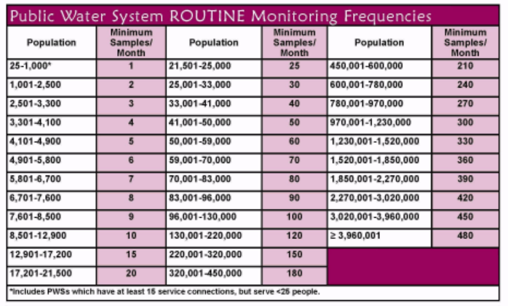

Water Testing Example
Purpose | Improve public health protection by reducing fecal pathogens to minimal levels through control of total coliform bacteria, including fecal coliforms and Escherichia coli (E. coli).
Notes:
Here is just one of the 95 contaminants that your water utility tests for. How many samples each month does your system take for total coliform?

Slide 19
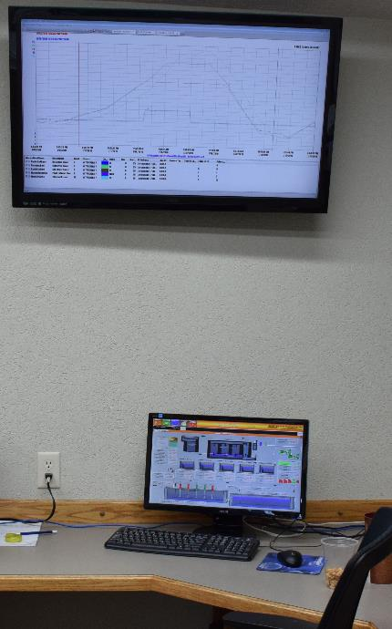
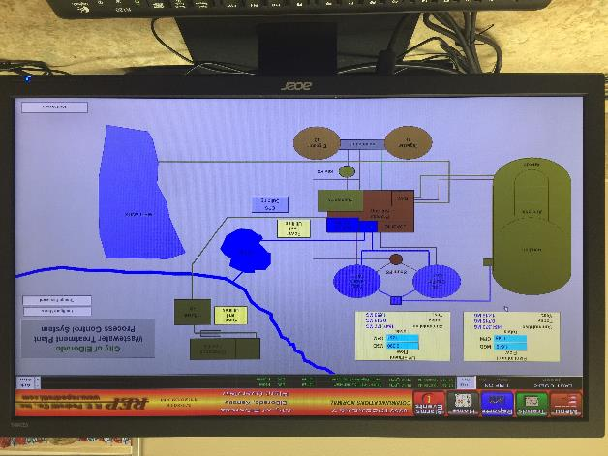
Technology - SCADA

Slide 20
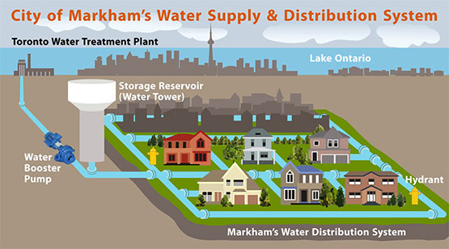
Distribution System
Water mains deliver water from the treatment plant to homes and businesses
Trace amounts of chlorine must be present even in the furthest part of the distribution system
Notes:
After water treatment, water has to get from the treatment plant to your house. The distribution system includes finished water storage tanks, miles of pipes (HOW MANY FOR YOUR SYSTEM?), pressure reducing valves and pump stations. Gravity is used to move the water through the pipes to your house. But, when gravity isn’t enough lift stations are installed to pump and push water through.

Slide 21
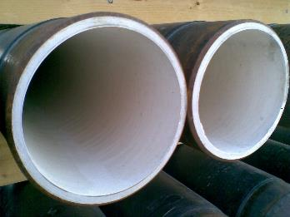
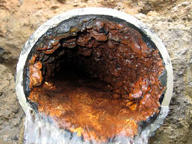
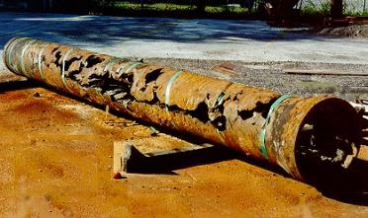
Chemistry for Pipes
Pipe corrosion
When pH is low corrosion occurs
Cement lined steel pipe
Cast iron pipe with scaling
When pH is high scaling occurs
Notes:
Chemistry is still important when the water is in the distribution system. It’s a big job to keep the distribution pipes in good shape and to ensure that the water delivered to your house is excellent quality. We continuously monitor general water quality parameters within the distribution system.
Balancing pH in drinking water is a necessity for all water utilities to control water quality and pipe corrosion or scaling. If pH is too high, we’ll get more scaling. However, if pH is low, then the pipes will corrode faster.
****ACTIVITY -
7. Use pH test strips to test the water sample each group made in the drinking water treatment simulation

Slide 22
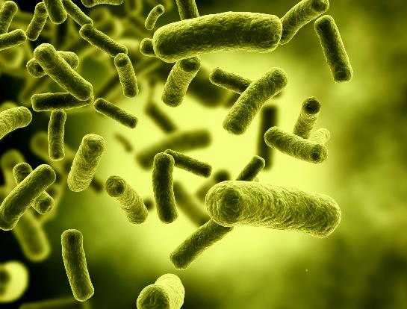

Chemistry for health
MCL for Cl is 4 mg/L
Treatment puts in Cl to keep the water disinfected throughout the system
A trace amount of Cl must be detectable in water at the farthest tap
Chlorine kills bacteria & viruses,
like this E.Coli bacteria
Notes:
All water treatment plants use chlorine to kill bacteria. Chlorine disinfection is required by the Safe Drinking Water Act. The law says that the furthest tap must have a “trace” of chlorine (this trace level will be defined in 2016 as 0.2 mg/L. Too much chlorine in the water is dangerous, but too little chlorine is also dangerous because then disease causing pathogens can be an issue. The primary chlorine MCL = 4 mg/L. We need to “load” water at the water treatment plant with enough chlorine to still show a trace amount (0.2 mg/L) at the furthest tap, however we cannot exceed 4 mg/L. Larger systems have chlorine booster systems throughout of the distribution system to help maintain chlorine levels in the parts of the system farther away from the treatment plant.
**** CHLORINE ACTIVITY

Slide 23
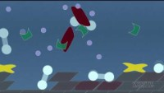
Importance of Water Chemistry:
The Flint Michigan Story
Notes:
Sometimes, when rules and procedures aren’t followed the public’s health is threatened. You have seen an example of this recently in Flint, Michigan. Let’s watch this video to see what they problems were.
What was the problem here?
Who’s fault is it?
Who’s responsibility is it to fix?
If it was your job to fix it, what would you do?

Slide 24
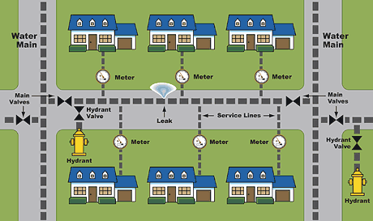
Water meters
Water meters calculate the water you use so that you can be charged
How much water do you use?
Notes:
A water meter measures the amount of water coming into your home or business. Your water meter may be located in your basement or outside in a pit or hole. A meter reader reads the water meter on a regular basis. The utility bills you for the amount of water used. The bill covers the costs of treating and distributing the water. Sometimes, a utility must buy water. All of these costs and the wages for the utility’s staff must be met. Water is a bargain. The average price of water in the United States is less than $4.00 for 1,000 gallons. At that price, a gallon of water costs less than one penny. How does that compare with one can of soft drink? - See more at: http://www.drinktap.org/kids-place/is-water-free.aspx#sthash.GZ5TQWxS.dpuf

Slide 25
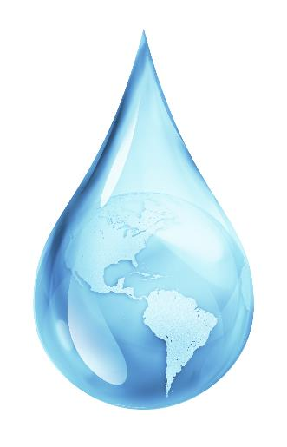

Water use in America
The average American uses 88 gallons of water every day
The poorest countries use less than 5
Notes:
Who can guess how many gallons of water are used on average per person every day? Take guesses and then click slide to show the answer – 88 gallons. Think of all the things you do in a day that use water – have students name those things.
Why do you think that poorer countries use so much less water? Take answers. Discuss no need to water the lawns, fewer clothes, no dishwashers, no access, have to carry water, etc.

Slide 26
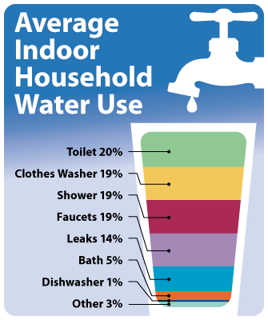
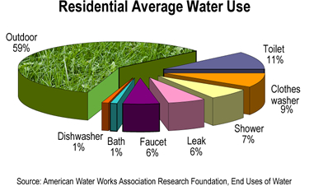
East Bay Municipal Utility District
Notes:
So how do you use the water? Show Water Use slide and have students identify the highest water use. Outdoors = landscaping. Discuss water use inside the house and have them tell you where the most water is used indoors (it is a tie between the toilet and the clothes washer).

Slide 27
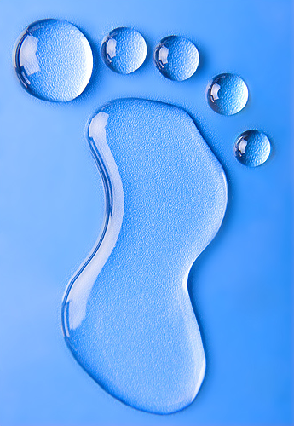


Calculate Your Water Footprint
Southwest Florida Water Management District Water Use Calculator
https://www.swfwmd.state.fl.us/conservation/thepowerof10/
Notes:
**** WATER FOOTPRINT ACTIVITY

Slide 28
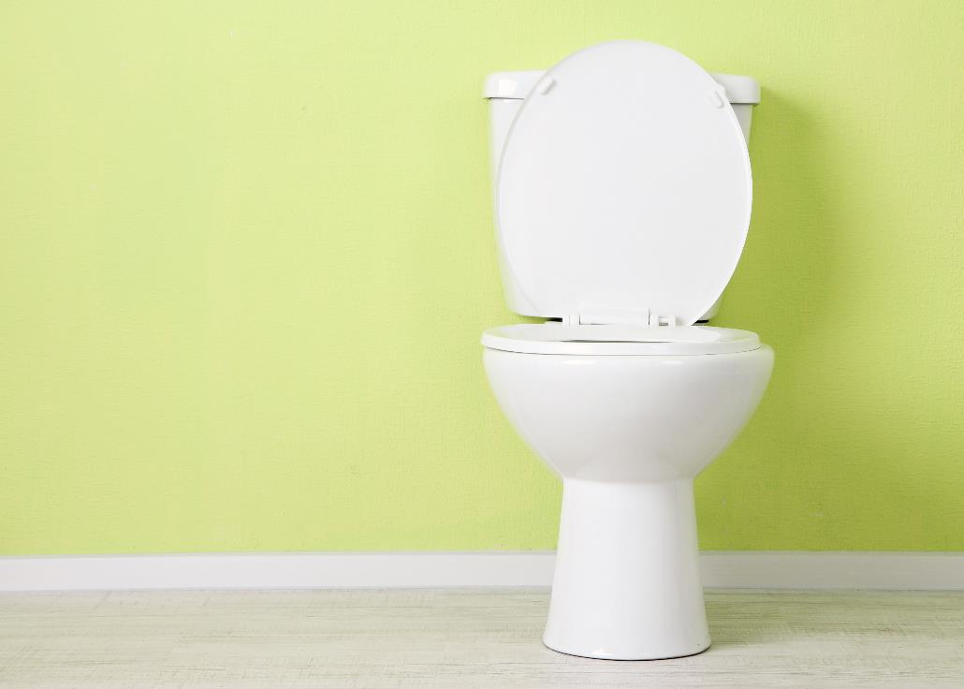
After the Flush,
Where does the water go?
Notes:
The water inside your house from your toilet, sinks, dishwasher, clothes washer, etc goes through a sewer pipe (called a Main) to a wastewater treatment plant.

Slide 29
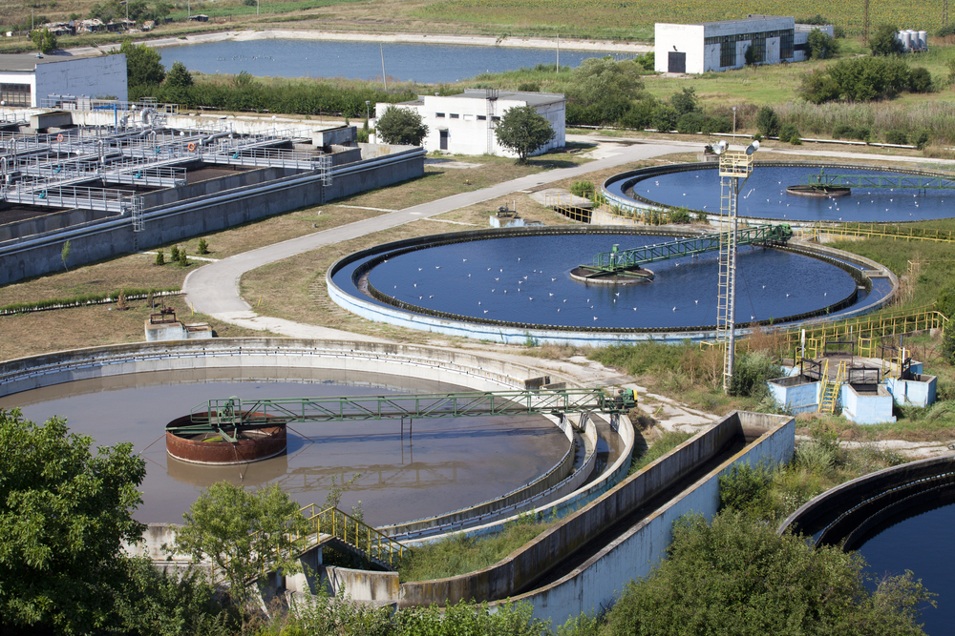
Wastewater Treatment
Notes:
After treatment the water is usually put back in to local streams, rivers or held in ponds to evaporate.

Slide 30
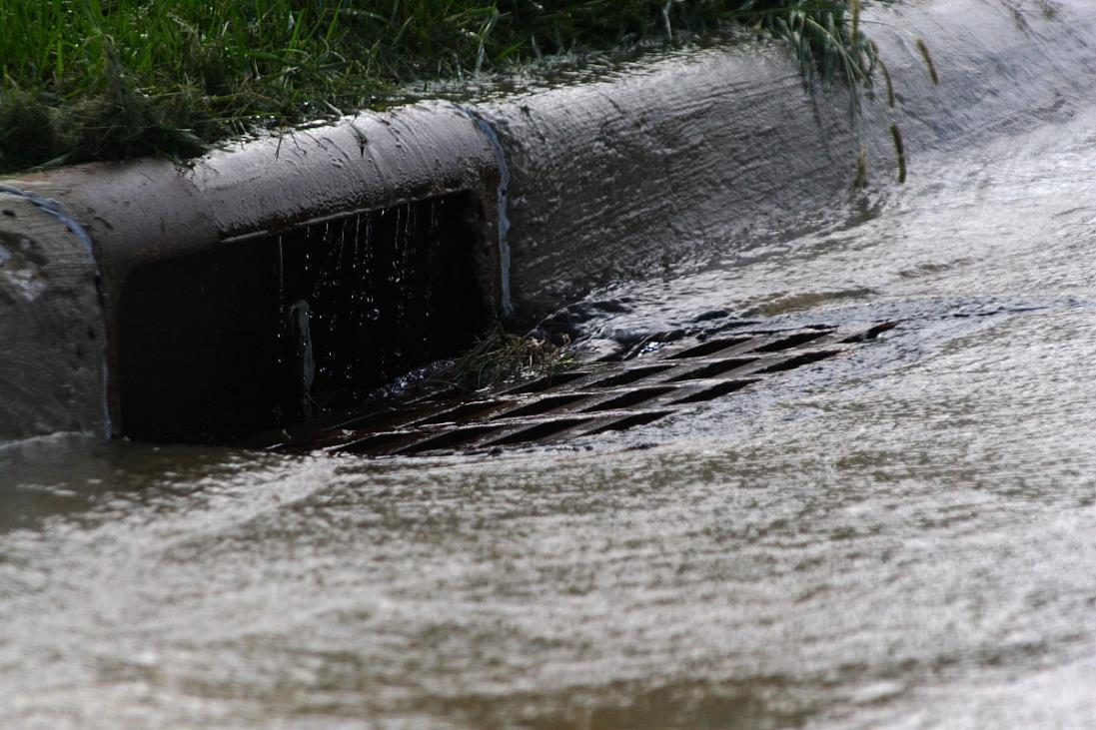
Where does the water go?
Notes:
Outside water flows into storm water drains that dump directly into streams in town. That’s why it is important not to wash spilled oil, soapy carwash water or trash into the gutter.

Slide 31
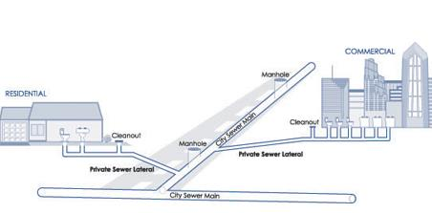
Your home sewer plumbing
Notes:
Wastewater flows from your house through pipes in your yard, to the city’s sewer main where it is combined with all your neighbors wastewater and is taken to the wastewater treatment plant.

Slide 32
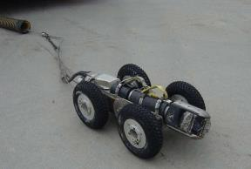
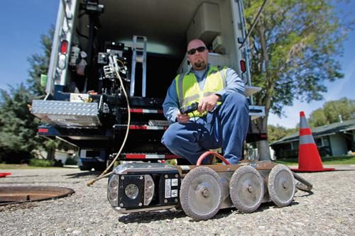
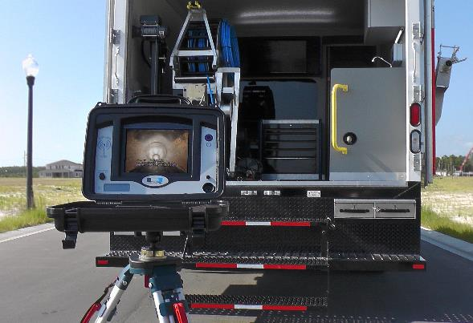
Wastewater Collection
Keeping sewer mains Flowing
Notes:
It is critical to keep wastewater sewer mains flowing smoothly. But there are many things working against that smooth flow: natural clogs, tree roots, clogs caused by flushing things you shouldn’t. Sewer line maintenance crews often use TV cameras to inspect sewer lines and identify trouble spots so that they can be fixed before they become a problem. Cameras are attached to crawlers that are remotely controlled by a worker.

Slide 33
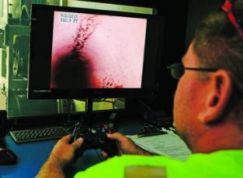
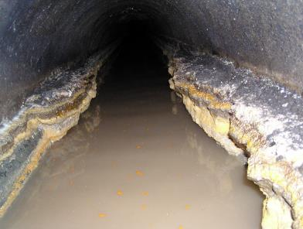
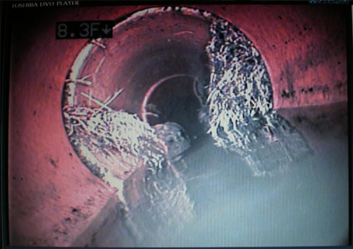
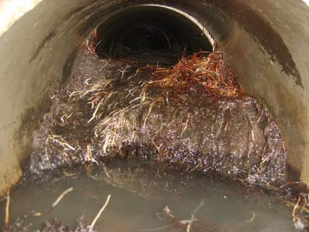
Sewer pipe Pictures
Grease can cause pipes to clog
Tree roots can cause clogs and leaks
Major clogs can cause major problems
Notes:
When clogs or leaks are found crews note the problem and rate it to determine how critical the problem is; that is how quickly do they need to fix it. How would you determine that? (Cost, number of people impacted, etc). It is water system managers’ job to set up a plan to tackle these sorts of questions.

Slide 34
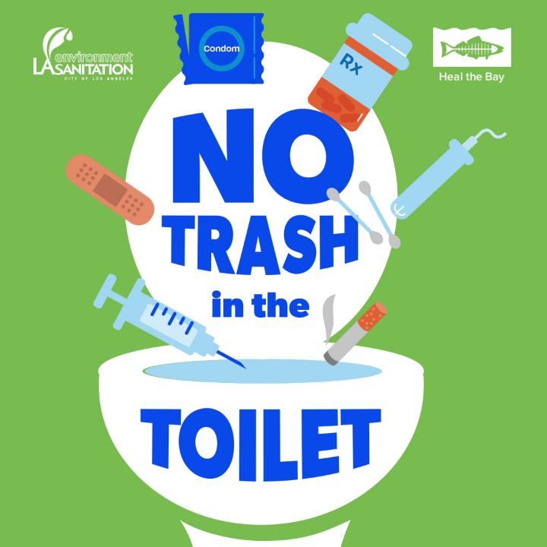
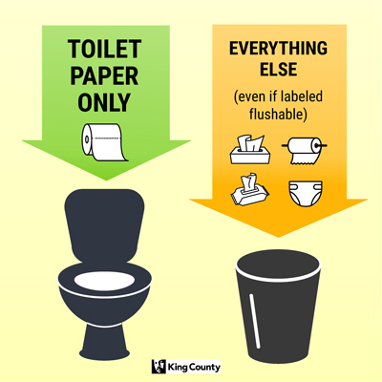
Notes:
Pee, poo, paper – that’s it!
Do not flush: paper towels, diapers, feminine hygiene products, Kleenex, FLUSHABLE wipes, pharmaceuticals, q-tips, cigarettes, condoms, bandaids, anything besides toilet paper and what came outta you.

Slide 35
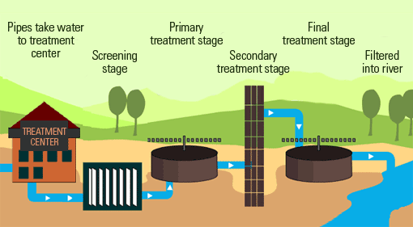
4 steps to wastewater treatment
Notes:
So how do they clean-up the water enough to put it back into the environment? Wastewater is just a large mixture of water from your sinks, toilet, shower, dishwasher, etc. The idea is to separate the solids from the liquids, and clean the liquid back into clear, clean water.
There are 4 steps to the wastewater treatment process (show wastewater treatment slide). The steps are called Preliminary, Primary, Secondary, and Advanced/Tertiary.

Slide 36
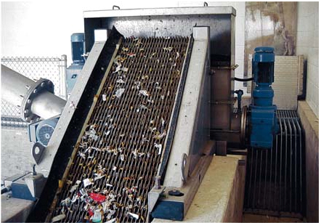
Preliminary Treatment - screen
Screens trap “big stuff”
trash
diapers
rags
branches
coffee grounds
potato peels
Notes:
First, during preliminary, the wastewater flows through screens that trap inorganic material like trash, diapers, rags, branches, coffee grounds, etc. This material eventually gets hauled to the landfill.

Slide 37

Primary Treatment - separate
Notes:
The water is slowed in the Primary treatment step so that the lighter particles like kitchen grease float to the top, and the heavier particles sink to the bottom (bio-solids, also known as “potty bits”).
In this step the solids are removed from the water.

Slide 38

Secondary Treatment - Snack
Notes:
Now we are left with the liquid. How do we turn the brown, smelly water into clean and clear water like one of the vials? The third step is called Secondary Treatment, and in this step microogranisms (mostly bacteria) snack on the organic matter in the wastewater. The mass of bacteria that does the work in this step is called Activated Sludge. This process occurs in aeration tanks because the microbes need different amounts of oxygen to eat the organics, phosphorous, ammonia, and nitrates in the water.

Slide 39

Activated Sludge at Work
Rotifer ingesting filamentous bacteria in activated sludge
Notes:
I have a video that shows microbes at work. Over 50 of these “critters” live in one drop of wastewater. Once the microbes have done their job (usually within 10 hours), they get full and heavy and fall to the bottom leaving the cleaner water to rise to the surface (clarification). The top top is poured off for the final step.

Slide 40

Advanced Treatment - Disinfect
UV light tubes
Notes:
The fourth step is known as Tertiary or Advanced treatment. It’s the last step and may include disinfection with either chlorine or other chemicals, ultraviolet light tubes or ozone that make any remaining microbes inert (changes the DNA of any remaining bugs so that they cannot reproduce).

Slide 41

Effluent Release
Effluent from the
Wichita’s Northwest Wastewater Treatment Plant
flows in to a fishing pond
Fish are thriving and healthy
Notes:
Water then is released in to ponds, creeks, rivers or the ocean, depending on where you live. Or sometimes water is reused to water golf courses or in industrial process. There are some communities who are turning wastewater directly into drinking water. What do you think about that?

Slide 42

Who’s Downstream?
Notes:
Where does the water go when it leaves the wastewater treatment plant? Does it join the larger watershed? Do you see all the cities along the journey of the water to the Gulf of Mexico? Where do they get their water from? The water is used by people in cities downstream who need the water after it’s already been through our houses and wastewater treatment process. Then the people downstream from them use it after it’s been through their systems, and so on. In fact, our water travels from NE to Missouri, then Arkansas before it joins with the Mississippi River and flows through Louisiana before reaching the Gulf of Mexico. The water passes through hundreds of cities along its way to the Gulf – those are a lot of downstream users!

Slide 43


Hydrate Your
Career…
Work in Water
Notes:
Go through the careers and quotes. Take a poll to see what students are attracted to.

Slide 44



Operator
Recycling is more than pop cans and plastic bottles. We recycle water. There is no new water being made, so we have to recycle what we have. At a wastewater treatment plant that’s what we do. We turn wastewater into clean water and put it back into nature to get used by someone else.
Jamie Belden
Wastewater Treatment Plant Operator City of Wichita
(City of Rose Hill pictured)

Slide 45

Chemist
Working in a wastewater laboratory is challenging and interesting. With a wide variety of analytical work needed to evaluate processes and meet discharge permit regulations, you will never be bored.
Rwei-Ying Trefz
Chemist
City of Wichita

Slide 46

Communications
When you pick a career you want to thinks about what you want to do as well as where you want to do it. Doing PR in the water industry is challenging, exciting and significant. You’re repping the greatest commodity on earth.
Mandy Cawby
Customer Relations Director
WaterOne

Slide 47

Regulator
My job affords me the opportunity to protect both the public and environmental health. I accomplish this by enforcing regulations and providing technical and financial assistance. My job challenges me to develop creative approaches to achieve compliance
Andrew Hare
Capacity Development & Enforcement
Kansas Department of Health & Environment

Slide 48

Biologist
Biologists find a balance between ecology and sociology. We connect people to natural resources. I have been drawn to water since I was very young. The mystery of what goes on beneath the surface, combined with the interactions between land and water continues to fascinate me.
Jessica Mounts
Fisheries Biologist
Kansas Department of Wildlife, Parks & Tourism

Slide 49

Engineer
I help design and build water supply systems. I feel like I’m doing something important for the generations to come.
Jerry Blaine
City of Wichita Engineer (Retired)

Slide 50

Law
Water attorneys help people comply with the law, conduct complex transactions involving water issues and handle litigation between competing water users. I grew-up on a farm in SW Kansas, obtaining and preserving adequate water has always been important to me. The complexity and competition involved in obtaining and keeping water rights keeps my water-law practice interesting and rewarding.
Daniel Buller
Attorney
Foulston Siefkin LLP
Notes:
Daniel Buller, Attorney, Foulston Siefkin, LLP
In Kansas, water is essential to the growth of communities, industries, and agricultural operations. At the same time, the complexity and competition involved in obtaining and keeping water rights is more acute than ever before. Having grown up on a farm in Southwestern Kansas, obtaining and preserving adequate water has always been important to me, and attorneys practicing in the area of water law are at the forefront of these fascinating challenges. The positive development of water law is critical to the future of our State, and the need for attorneys practicing in this field will become greater as our resources are depleted. Water attorneys help people comply with state law and regulations, handle complex transactions involving water issues, deal with administrative enforcement actions, and handle litigation between competing water users. This broad diversity keeps my water-law practice interesting and rewarding.

Slide 51

Water is a great industry for young people.
Water will never be obsolete, but eventually the way we run our organizations and the people who run it will be.
We have to keep innovating and evolving how we deliver this life-giving necessity.
Fresh perspectives and new voices have value in the water industry.
Mandy Cawby, WaterOne
College students in New Zealand use drones, water quality testing and phone apps to monitor pollution in rivers and streams

Slide 52



