Slide 1
Example/Template – Remove before using.
This is an example that you can use as a template to create your own presentation for hosting a virtual food summit.
You can alter/adjust this template to suit your needs. This is just an example of what can work.
In the “notes” section of the slides are talking points and instructions for how to use that slide.
For questions, contact Michelle DeHaven at michelle.dehaven@wichita.edu

Slide 2
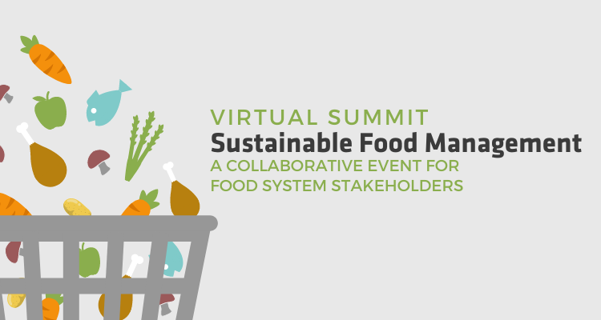
Insert your organization’s logo here.
Notes:
Use this slide as an introduction and welcome.

Slide 3
Insert your organization’s mission, vision, website, information, etc.
Insert your organization’s logo here.
Notes:
Talk about your organization and transition to talking about the issue of food waste.

Slide 4
Food Waste is Costly Environmentally | Economically | Socially
According to the National Resources Defense Council, up to 40% of all food in the US goes uneaten and unused
USDA Economic Research Service reports that food loss and waste costs $161.6 billion annually.
$161.6 billion annually
1 in 8 Americans struggle to put food on the table. (NRDC)
Notes:
This information is the most recent as of December 2021. Please adjust as new data emerges. Sources for the data are included.
According to the National Resources Defense Council, up to 40% of all food in the US goes uneaten and unused (NRDC - https://www.nrdc.org/food-waste) and costs $161.6 billion annually (https://www.ers.usda.gov/data-products/food-availability-per-capita-data-system/food-loss/)
Additionally, 1 in 8 Americans struggle to put food on the table. (NRDC - https://www.nrdc.org/food-waste) resulting in food insecurity, malnutrition, and many physical, mental and emotional issues.

Slide 5
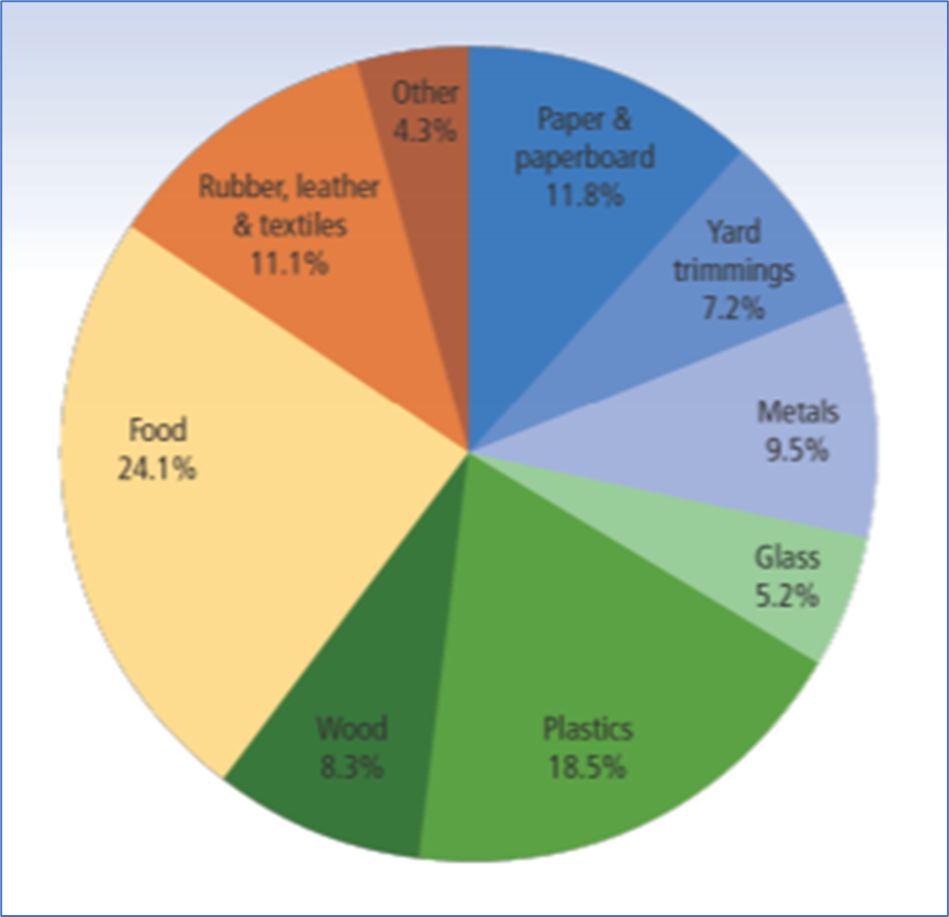
Wasted
EPA estimates that 24.1% of the Total Material Solid Waste is sent to landfills.
According to the USDA, 31% of food created for consumption is wasted.
Notes:
This information is the most recent as of December 2021. Please adjust as new data emerges. Sources for the data are included.
In 2018, Food Loss and Waste (FLW) represented 24.1% of the Total Material Solid Waste sent to landfills.¹
Wasted food represents 31% of food created for consumption.²
Sources:
¹2018 Facts and Figures https://www.epa.gov/facts-and-figures-about-materials-waste-and-recycling/advancing-sustainable-materials-management. Includes Chart.
²The Estimated Amount, Value, and Calories of Postharvest food Losses at the Retail and Consumer Levels in the US. Pg. 22. Retrieved 2/15/20 from https://www.ers.usda.gov/webdocs/publications/43833/43680_eib121.pdf

Slide 6
Greenhouse Gas in Perspective
Learn more
Learn more
Notes:
This information is the most recent as of December 2021. Please adjust as new data emerges. Sources for the data are included.
This waste is responsible for around 6%-8% of total global greenhouse gas emissions! ( Poore, J., & Nemecek, T. (2018). Reducing food’s environmental impacts through producers and consumers. Science, 360(6392), 987-992 & http://www.fao.org/3/a-bb144e.pdf)
This is more than 3 times more than global aviation emissions. If food waste was a country, it would be 3rd on the list of the highest contributors of global greenhouse gas emissions behind China and the US. (https://ourworldindata.org/food-waste-emissions#:~:text=Food%20waste%20is%20responsible%20for%206%25%20of%20global%20greenhouse%20gas%20emissions,-by%20Hannah%20Ritchie)

Slide 7
GHG Emissions- Upstream Lifecycle Emissions vs. Landfilling
4.94 MTCO2eq
per ton of food
0.18 MTCO2eq per ton of food
Source: ReFED Impact Calculator (upstream lifecycle emissions & landfill emissions for residential food waste); LeanPath (graphic)
Notes:
This information is the most recent as of December 2021. Please adjust as new data emerges. Sources for the data are included.
By far the largest impact on GHG emissions is prevention (i.e., not generating the wasted food in the first place) because most of the GHG emissions are created by producing the food, not by end-of-life management of the food.
In this example, landfilling one ton of food waste from the residential sector would result in 5.12 MTCO2eq, but 97% of those emissions (4.94 MTCO2eq) will have already occurred by the time the food is thrown into the trash can; 3% of emissions (0.18 MTCO2eq) are from landfilling.
Diverting food waste from landfill or combustion to composting or AD, for example, while not reducing the amount of wasted food generated, will have very little effect on GHG emissions.

Slide 8
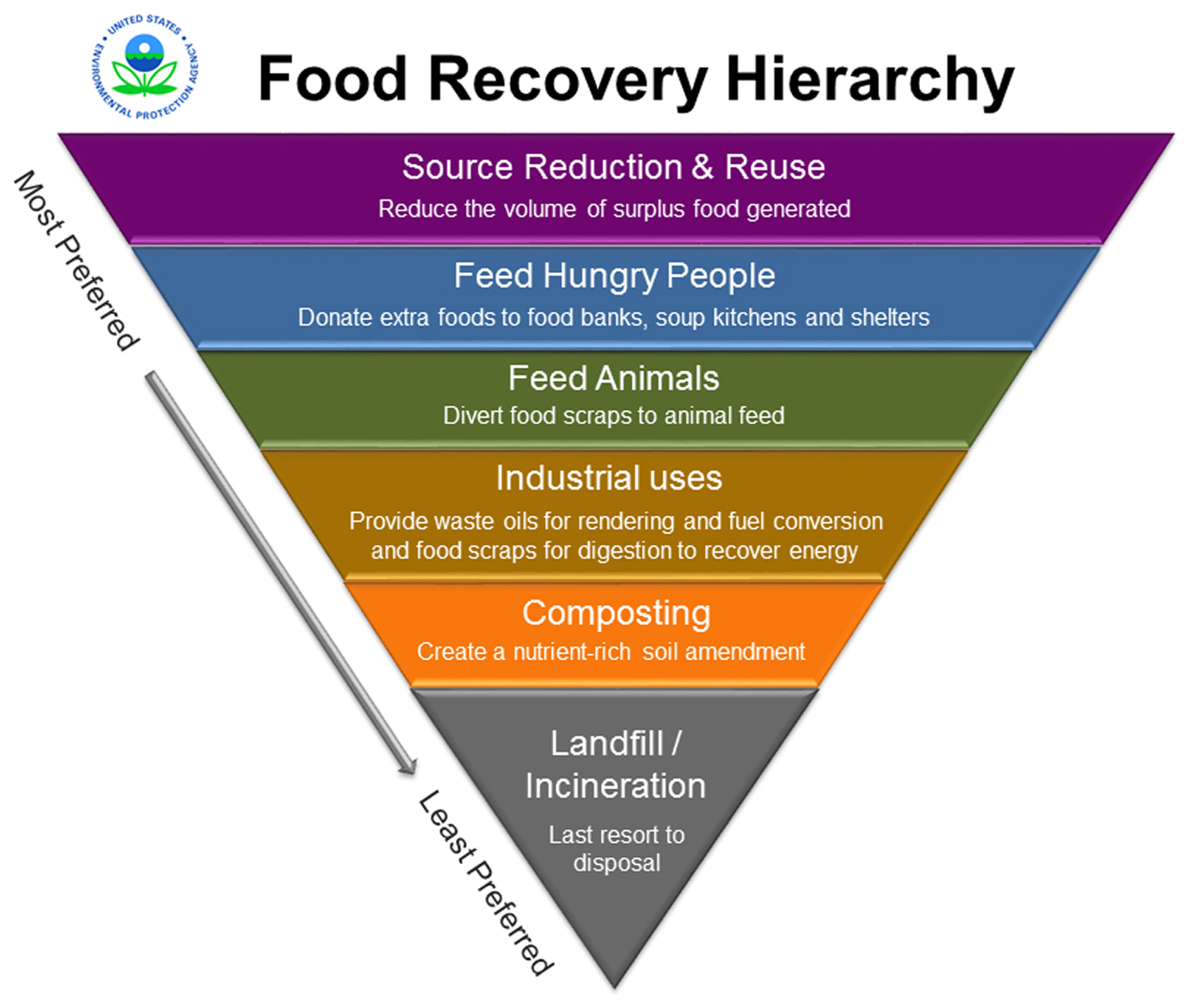
Food Recovery Hierarchy
Notes:
Using EPA’s Food Recovery Hierarchy, we can work towards not only reducing food waste, but also getting best use out of excess food.

Slide 9
Food & the Triple-Bottom Line
Feed People
In 2012, 14.5% of the households in the United States were food insecure. Much of the 1.3B pounds of food sent to landfills is edible and can be used to feed the hungry with liability protection and tax incentives (ERS, 2014).
Protect Resources
Food waste squanders valuable resources throughout the supply chain – including water, land, fuel and electricity. When discarded food is sent to a landfill, it does not return value to the soil, but produces harmful methane gas (EPA, 2018).
Economic Rewards
Landfilled food costs U.S. $161.6B a year. Businesses profit by implementing source reduction and reducing manufacturing waste. Families save by learning food waste prevention strategies. An average family of four loses $1,484 annually on wasted food (ERS, 2014).
Notes:
This information is the most recent as of December 2021. Please adjust as new data emerges. Sources for the data are included.
Food waste is a problem, but with collaboration and community-wide efforts we can feed people, protect resources, and experience economic rewards for the cities and counties across the state….nation….world.
(USDA ERS -USDA 2014 data: https://www.ers.usda.gov/webdocs/publications/43833/43680_eib121.pdf
EPA Sustainable Management of Food Basics: https://www.epa.gov/sustainable-management-food/sustainable-management-food-basics#what)

Slide 10
That’s why we’re here!
Keynote 1
Keynote 2
Panel topics
Breakout Session topics
Notes:
Change the icons in the slide by 1)clicking on the image 2)click on “graphics format” at the top of the screen 3)click “change graphic” (it is all the way to the left on the ribbon at the top) 4)choose what you wish to insert (e.g., another graphic, a photo, etc.)
That’s why we’re here today. These 2 days will cover:
List the topics that will be covered during the entire event
So, let’s kick this off with a conversation about [insert topic] with our first speaker….(Next slide)

Slide 11
Name Organization
Insert Organization Logo here
Insert Presenter Photo
Here
Mission or information about presenter’s organization. Keep it to 1 or 2 sentences.
Highlights from presenter bio
The organization
1 or 2 facts from the bio
Notes:
MICHELLE:
Christina McDonough.
Christina works at the Scott County Health Department and has been involved with the Food Rescue Partnership since it’s onset in 2013. Each year, she helps the Food Rescue Partnership establish a community action plan to promote rescuing food for its best possible use. Christina is a graduate of the University of Northern Iowa where she majored in Health Promotion and is a Certified Health Education Specialist. Her passion for food rescue has carried over into her personal life, where her kids love “left-overs night” when they can put any combination of food together for dinner!
Stop sharing so Christina can share her slides.

Slide 12
BREAK
See you in 10 minutes!

Slide 13
Welcome Back
Insert your organization’s logo here.
Notes:
Introduce next topic
Welcome back everyone.

Slide 14
Name Organization
Insert Organization Logo here
Insert Presenter Photo
Here
Mission or information about presenter’s organization. Keep it to 1 or 2 sentences.
Highlights from presenter bio
The organization
1 or 2 facts from the bio
Notes:
MICHELLE:
Christina McDonough.
Christina works at the Scott County Health Department and has been involved with the Food Rescue Partnership since it’s onset in 2013. Each year, she helps the Food Rescue Partnership establish a community action plan to promote rescuing food for its best possible use. Christina is a graduate of the University of Northern Iowa where she majored in Health Promotion and is a Certified Health Education Specialist. Her passion for food rescue has carried over into her personal life, where her kids love “left-overs night” when they can put any combination of food together for dinner!
Stop sharing so Christina can share her slides.

Slide 15
Next Week
Keynote/Panel Topic
Breakout Session Topics
Keynote/Panel Topic
Notes:
Talk about what will be discussed at the second session if you are having one.

Slide 16
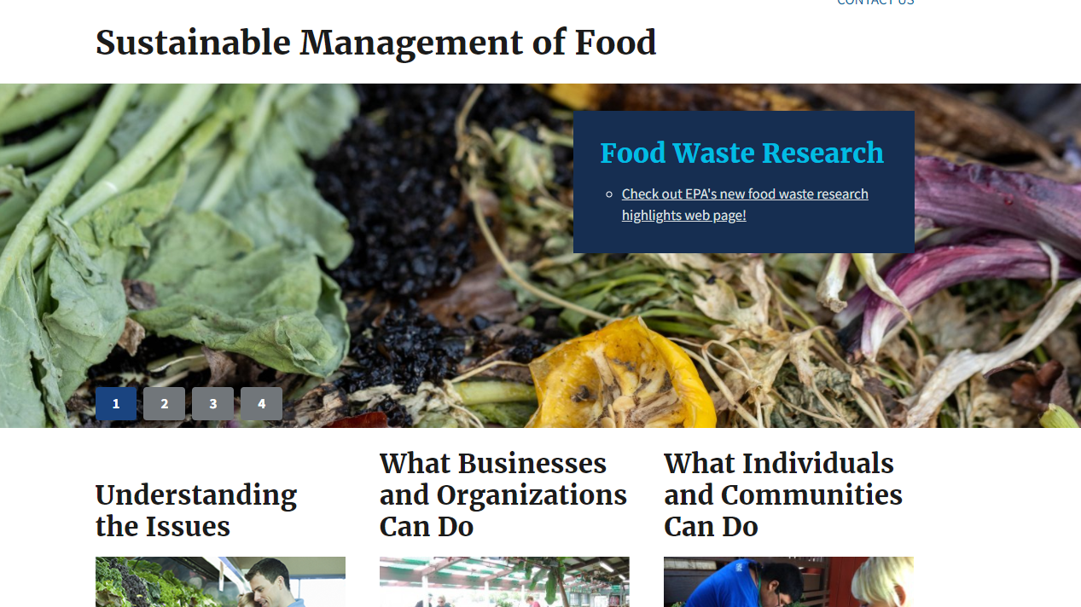
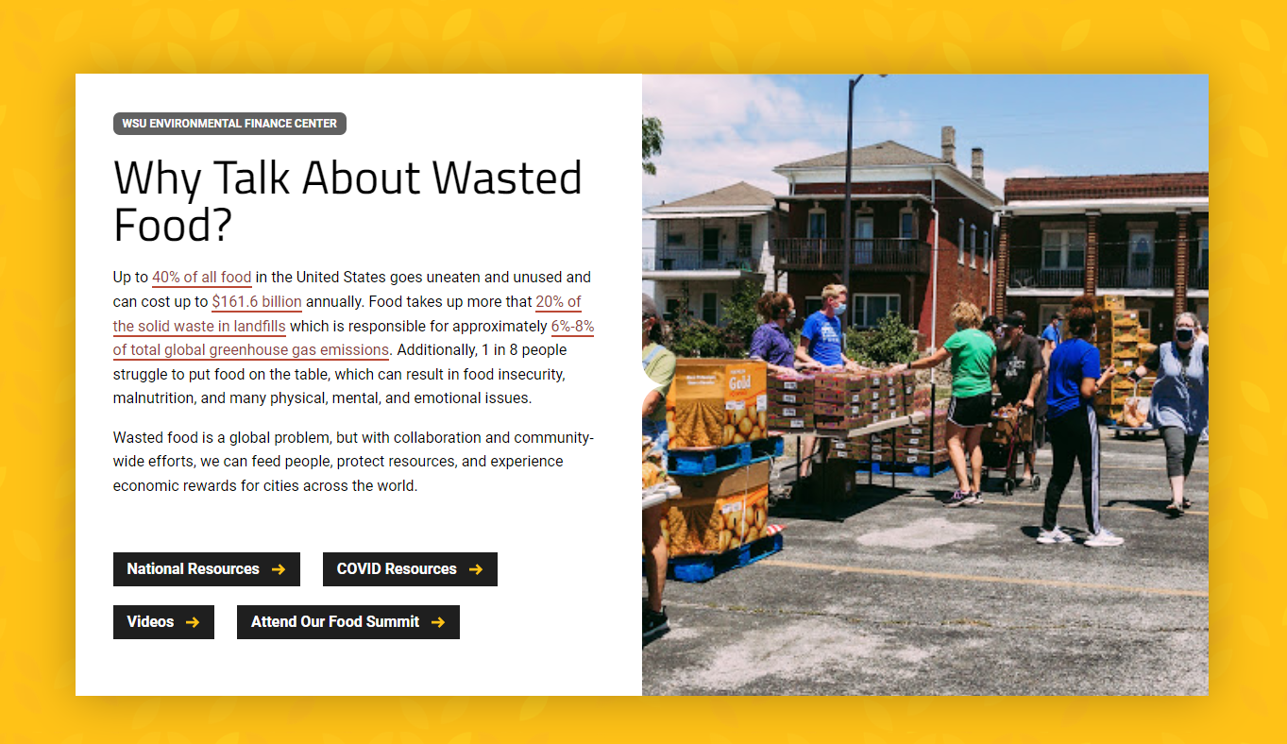
Resources
EPA’s Sustainable Management of Food
www.epa.gov/sustainable-management-food
Environmental Finance Center
www.wichita.edu/foodsummit
Notes:
EPA’s Sustainable Management of Food website hosts a myriad of resources to help communities understand the various ways that food waste can be reduced and managed, including the Food too Good to Waste Toolkit, EPA’s Food Recovery Challenge, and information about the US 2030 Food Loss and Waste Reduction Goal
The Environmental Finance Center at Wichita State University hosts a variety of resources on their food summit website at www.wichita.edu/foodsummit.

