Slide 1
They’re Worth It!
Healthy Watershed Options For
Floodplain Management
Lower Meramec Watershed – Missouri

Slide 2
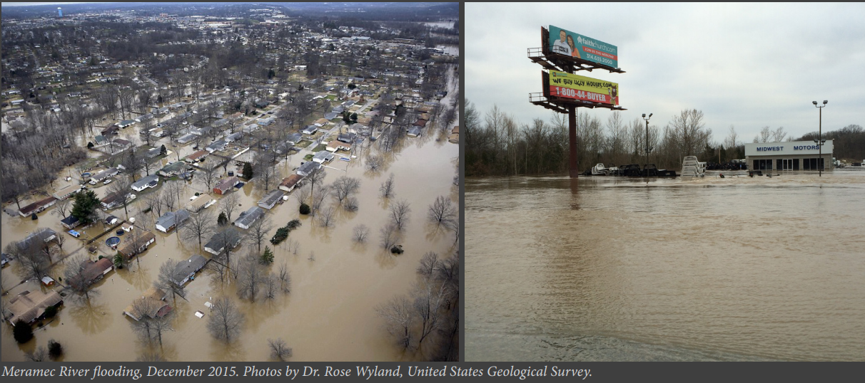
Notes:
The Lower Meramec Watershed is highly flood-prone due to increased frequency of heavy rain events, topography and development that has reduced wetland areas and open spaces able to soak up rainfall. Communities in the Lower Meramec Watershed have experienced repetitive flood damage and three record flood events since 2015.

Slide 3
Project Partners
East-West Gateway Council of Governments
Environmental Finance Center, Wichita State University
Federal Emergency Management Agency
Missouri Division of Natural Resources
Missouri State Emergency Management Agency
The Nature Conservancy
Region 7, Environmental Protection Agency
U.S. Army Corps of Engineers
Notes:
As a result of the flooding, the United States Army Corps of Engineers (USACE) Silver Jackets initiated a Floodplain Management Plan project that brought together local, state and federal organizations to reduce flood risk and other disasters. Initiated by the Urban Waters Federal Partnership, the Healthy Watershed Options for the Meramec River Project was developed as a piece of the ongoing risk mitigation efforts.

Slide 4
Notes:
As the risk mitigation efforts progressed, the use of nature-based stormwater solutions was identified as an area of interest. Of particular interest is using healthy watershed best practices, such as source water protection, green infrastructure (GI), including low impact development (LID), and open space protection to mitigate flooding and enhance the value of ecosystem services and aesthetic values.
Communities in the watershed identified political, capacity and funding as barriers to implementation of healthy watershed options, and requested that a cost-benefit analysis be developed, along with resources and tools that could be used to support decision-making for healthy watershed stormwater projects. As the EPA Region 7 Environmental Finance Center, the WSU EFC was called upon to develop and conduct the cost-benefit analysis and support tools for the communities to help make the case for healthy watershed options that reduce flooding.

Slide 5
Notes:
Stormwater management is evolving. In decades past, stormwater systems were built simply to move water from where it fell to nearby rivers or drainage areas as quickly as possible. Most of the time, stormwater was an “extra” responsibility of the public works or streets department. Today, stormwater is more than a system of conveyance. It is part of a comprehensive and integrated urban water resource that is managed to enhance water quality, water quantity, recreation, neighborhood aesthetics, groundwater recharge and wildlife habitat. Stormwater is now seen as part of the “one water” system: a system that understands the value of water no matter where it is in the water cycle.
EPA’s Guidance for Municipal Stormwater Funding report

Slide 7
The New Stormwater Paradigm
Notes:
The “Guidance for Municipal Stormwater Funding” warns that “The new [stormwater] paradigm has … resulted in greater public expectations. In addition to the effective control of drainage and flooding, the public also expects riparian corridors, wetlands, recreation amenities, trails, visually pleasing facilities, and a continued maintenance effort.”
Higher level of service expectations, along with increasing regulations, more intense rainfall, construction costs and aging infrastructure, has created a gap between what is expected and what can be done within a stormwater program with available funding. In that gap stands a barrier that is preventing the stormwater program from meeting community expectations.

Slide 8
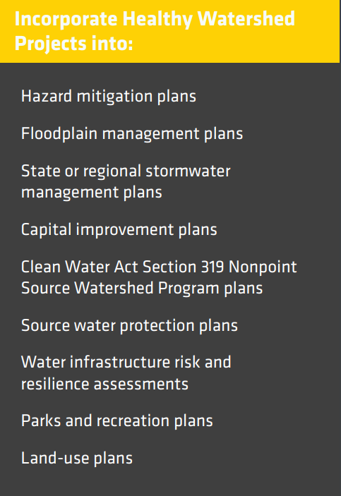
Integrating healthy watershed project plans into state hazard mitigation plans can:
Institutionalize healthy watershed options
Leverage funds
Increase eligibility for insurance discounts for Community Rating System jurisdictions
Create opportunities for public education
Align other local and regional plans – increasing likelihood the plans are fulfilled!
Notes:
Healthy watershed options can be incorporated into a variety of planning efforts. Inclusion of green infrastructure in water resource planning is increasingly encouraged at the state and federal levels.
By integrating healthy watershed projects into a range of planning conversations, processes and documents, projects will become more coordinated and supported by a variety of departments, agencies and public interests.
Integrated planning highlights the interconnectedness of water and the co-benefits of healthy watersheds to almost every aspect of a community. Healthy watershed options are an ideal fit for hazard mitigation plans (HMPs) which are long-term strategies for protecting people and property from hazardous events. HMPs are vital to breaking the cycle of disaster, damage, reconstruction and repeated damage.

Slide 9
Why a Cost-Benefit Analysis?
Decision Making Tool
CBAs estimate the costs and benefits of a project to help determine the best way to achieve the community goals while maximizing the benefits at the lowest cost
Notes:
A cost-benefit analysis (CBA) is a decision-making tool that estimates the costs and benefits of a project to help determine the best way to achieve the community’s goals while maximizing the benefits at the lowest cost.
Communities in the Lower Meramec Watershed have a variety of healthy watershed project choices. Still, funding is often limited, and local priorities compete with flood risk reduction and other watershed projects.
When considering a healthy watershed project, a community would like all the tools available to consider the choices that will make environmental, social, safety and financial impacts on their community.
It’s about dollars, but it’s also about more than the cost of the project in dollars.

Slide 10
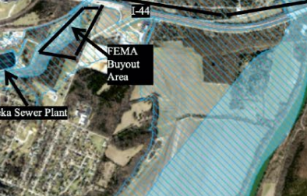
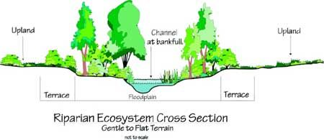
Lower Meramec Healthy Watershed Cost-Benefit Analysis
USDA
Flood-prone Property Acquisition
Floodplain Restoration
Open Space Preservation (Mix: park land, walking trails & floodplain restoration)
Municipalities are encouraged to consult with trusted financial advisors to interpret and assess the results of this report
Notes:
The CBA for the Lower Meramec Healthy Watershed Options project estimates the costs and benefits of implementing three healthy watershed options:
Flood-prone property acquisition
Floodplain restoration
Open space preservation (parkland, walking trails, etc.)
An comprehensive analysis is provided for all flood-prone properties in each city and county in the Lower Meramec Watershed project area. This CBA does not consider individual properties or projects, but the entire community as a whole.
In this CBA, a flood prone property is one that is within FEMA’s 1% Annual Exceedance Probability. The land in this zone has a 1% chance of being flooded in any given year. It is sometimes referred to as the 100-year floodplain. The properties identified in this study align with the Army Corps of Engineers’ “Lower Meramec Multi-Jurisdiction Floodplain Management Plan: For Communities of the Lower Meramec Basin.”

Slide 11
CBA Calculations
Healthy watershed benefits are quantified, in dollars, and align with FEMA’s Final Sustainability Benefits Methodology Report.
Environmental and flood hazard reduction benefits are calculated annually, per acre of floodplain restored, over a 20-year period.
All analyses were performed at a community level. No property specific analysis were completed.

Slide 12
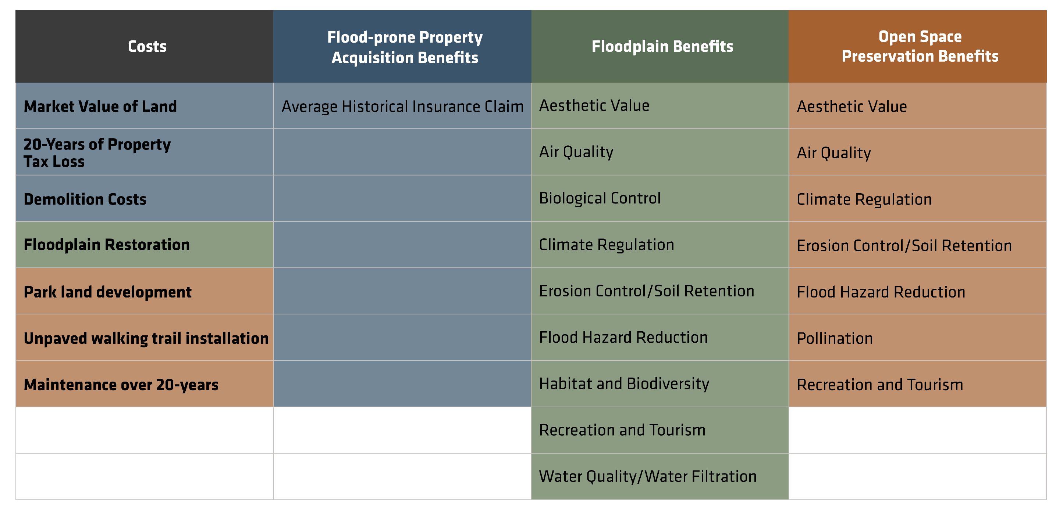
CBA Costs and Benefits
Notes:
This table shows the costs and benefits included in the CBA calculations in this study.
The blue shaded area indicates the costs and benefits included in the Flood-prone Property Acquisition calculations.
For the Floodplain Restoration calculations, the green cost and benefits are added to the blue ones to encompass the 1% AEP property acquisition and restoration costs and benefits.
The orange costs and benefits are added in for the open space CBA calculations in proportion to the amount of land that is developed into open space and that which is restored to floodplain.

Slide 14
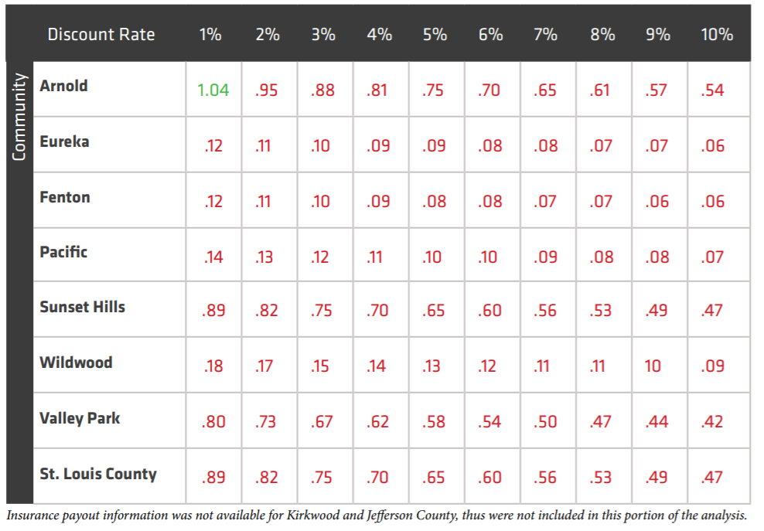
CBA: Acquisition
Flood-prone property acquisition is Step #1
Acquisition must be paired with other community enhancing efforts for the benefits to outweigh the costs.
Notes:
CBA Scores indicate the value of the potential benefits for the community. For acquisition the only “benefit” calculated is avoided flood insurance claims. For example: Sunset Hills’ CBA score at the 3% discount rate is .70. This means that for every $1 spent the return on investment is 70-cents.
This is why we say that flood-prone property acquisition is only Step 1 to reducing flood risk with nature-based solutions that “pay off”.
Flood-prone property acquisitions must be paired with other community enhancing efforts in order for the benefits (as calculated in this study) to outweigh the costs.

Slide 15
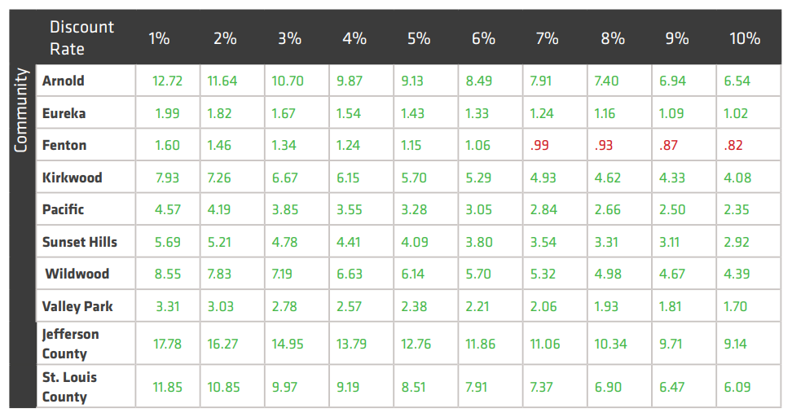
CBA: Acquisition + Floodplain Restoration
Over 20-years, the benefits of restoring the 1% AEP to natural floodplain are greater than the costs.
If Sunset Hills invests $1M in floodplain restoration, they could see $4.78M in benefits (flood hazard reduction, reduced insurance costs, erosion control, recreation, biodiversity, etc.)
This table reflects the high-cost estimates. Floodplain Restoration costs are $30,000/acre in this calculation.

Slide 16
Open Space Models
Low –Acreage Community Model
Communities with less than 25 acres in 1% AEP
Kirkwood and Wildwood
Park land: 1 acre
Floodplain restoration: remaining
Walking trail (unpaved): 417 linear ft per acre
Maintenance: 20 years
Community/County Model
City park land: 1 acre/99 acres
Floodplain restoration: remaining
Walking trail (unpaved): 417 linear ft per acre
Maintenance: 20 years
Remaining Counties: 1,556 – 1,263 acres
Remaining Cities:112 - 411 acres
County park land: 1 acre/499
Notes:
It is unrealistic that a community would apply the same treatment, floodplain restoration, across their entire 1% AEP. To provide a more realistic and well-rounded approach to healthy watersheds, models were developed. The Meramec Models combine healthy watershed projects across each community. The combination and corresponding CBAs allow communities to determine the feasibility and effectiveness of developing projects across the entire 1% AEP in their city or county.
There are two cities with less than 25 acres in the 1% AEP: Kirkwood and Wildwood.
The Low-Acreage Community Model, for these two communities:
One-acre of developed park land
Floodplain restoration on the remaining land within the 1% AEP
Walking trail (unpaved) installed18; 2 to 3-feet wide, 417 linear feet per acre
All features include installation and maintenance over 20 years
The remaining cities have 112 – 411 acres in the 1% AEP. For their City Model we included:
One-acre of developed park land for every 99 acres of floodplain restoration
Floodplain restoration on the remaining land
Walking trail (unpaved) installed; 2 to 3-feet wide, 417 linear feet per acre
All features include installation and maintenance over 20 years
The Lower Meramec Counties have more than 1,200 acres of land in the 1% AEP. The County Model we included:
One-acre of developed park land for every 499 acres of floodplain restoration
Floodplain restoration on the remaining land
Walking trail (unpaved) installed; 2 to 3-feet wide, 417 linear feet per acre
All features include installation and maintenance over 20 years

Slide 17
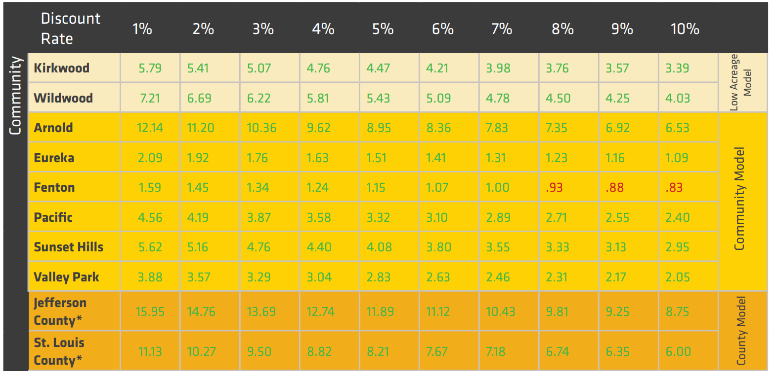
CBA: Acquisition + Floodplain Restoration + Open Space Models
Over 20-years, the benefits of implementing the combination of restoration, park land and walking trails are greater than the costs.
Benefits > Costs
In all cities and counties at most discount rates
This table reflects the high-cost estimates for all model costs to ensure the full range of cost variability.
Notes:
For all Lower Meramec communities, excluding Fenton, at the highest discount rates, the benefits of implementing the models, over 20 years, outweigh the cost of installing and maintaining the model’s various treatments, even at the highest restoration cost estimates. Each model appears to be cost-effective over a 20-year project lifespan.
At the 3% discount rate (host-cost model), the community’s overall return on investment for cities in the watershed is between $1,340 and $10,360 for every $1,000 spent.
Even when additional costs are incurred through the installation and maintenance of parks and walking trails, the community and environmental benefits outweigh the costs.

Slide 18
Healthy Watershed CBA Takeaways
To reduce flood risk with healthy watershed solutions: Step 1 is to acquire flood-prone properties
To ensure that benefits outweigh the costs: Acquisition MUST be paired with floodplain restoration or enhancement (park land, trails, open space, etc.)
For most communities in the Lower Meramec this CBA showed: Investment in healthy watershed solutions provides cost-effective, long-term environmental, financial, safety and quality of life benefits
Notes:
Mention that this shouldn’t be viewed just as restoration, but also as preservation.

Slide 19
How to Pay?
Notes:
Now that the CBA has indicated that investments in implementation of healthy watershed solutions are “worth it” for Lower Meramec communities. The next question they ask is, “how do we pay for these healthy watershed products?”
The role of Environmental Finance Centers across the US is to help communities answer that question. And so, the second part of our project was to help the communities identify various funding and financing opportunities for the great healthy watershed projects they have begun and will start planning.

Slide 20
Stormwater Funding
Revenue
Stable funding flow
Staff
Ongoing services
Maintenance
System repairs
Regulatory compliance
Project Funds
One-time funds
Targeted
Construction
New development
System Upgrades
Notes:
A stormwater management program needs two types of funding:
Revenue – an ongoing stable flow of funding that provides financial support for staff, ongoing services, system repairs, regulatory compliance, etc.
Regular, ongoing funding for a stormwater management program is often provided by general use dollars which compete with all other community priorities – parks, fire, police, libraries, streets, etc.
Many communities are moving towards developing their own funding stream for stormwater management programs. There are various ways to provide this dedicated funding source that do not compete with other community priorities. Taxes, fees, incentives, etc. can be used as a mechanism to build a stormwater fund that sufficiently provides for on-going operation, maintenance, regulatory compliance, repairs, staff, equipment, bond repayment and building a reserve fund.
Project Funds – a one-time targeted funding that provides financial support for construction, new development, system upgrades, etc.
Some stormwater projects are too costly to implement without outside resources
Grants, loans and bonds can provide a one-time influx of funding to accomplish specific and targeted projects that enhance the community’s stormwater management.
Most communities use a mixture of funding sources to meet their stormwater service goals.
Grants, loans and bonds are not recommended for the ongoing, regular operation of a stormwater management program. Revenue should be sufficient for a stormwater program’s ongoing expenses.
Project funds are used to help a community reach their desired level of service, while revenue funds maintain the desired level of service.

Slide 21
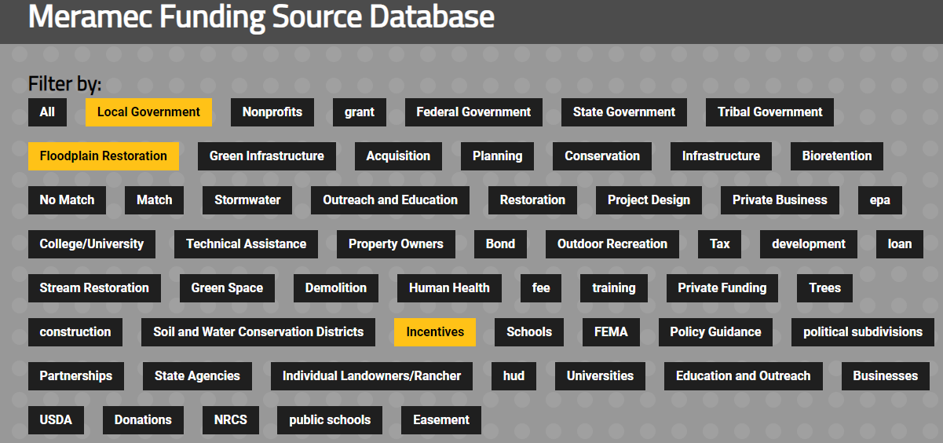
Notes:
In order to help the Meramec and all Missouri communities consider various funding sources, the EFC created the Missouri Watershed Funding Search Tool.
This online database allows you to search a wide variety of funding opportunities for healthy watershed projects using keywords and tags to help communities match their project needs with the right funding to build a portfolio that provides for capital and revenue needs of a stormwater management program.

Slide 22
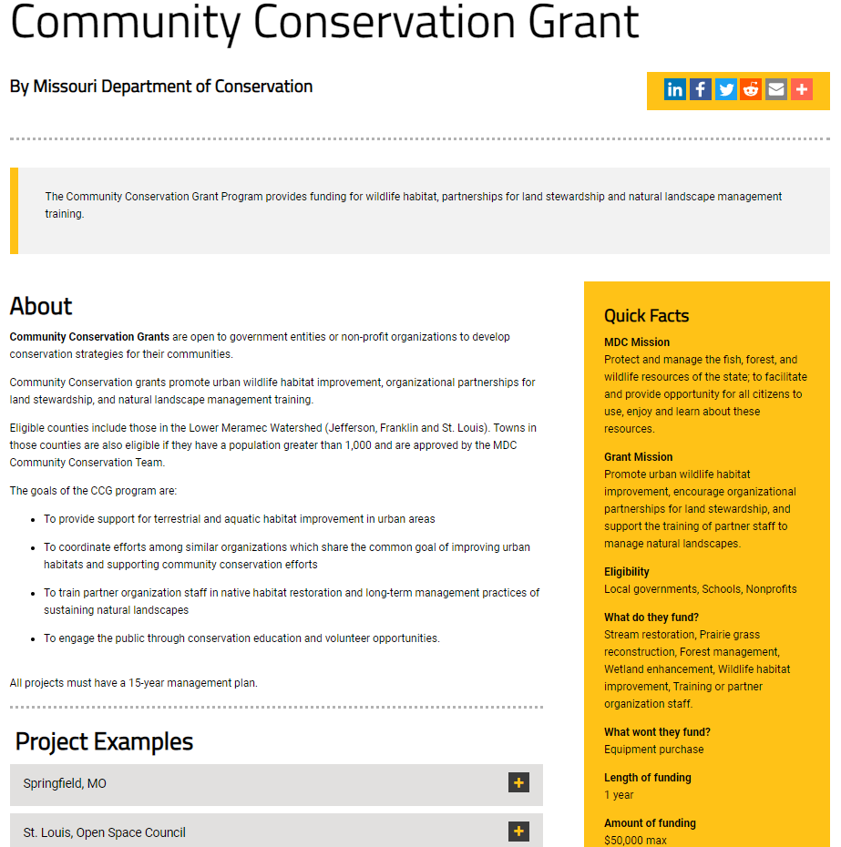

Slide 23
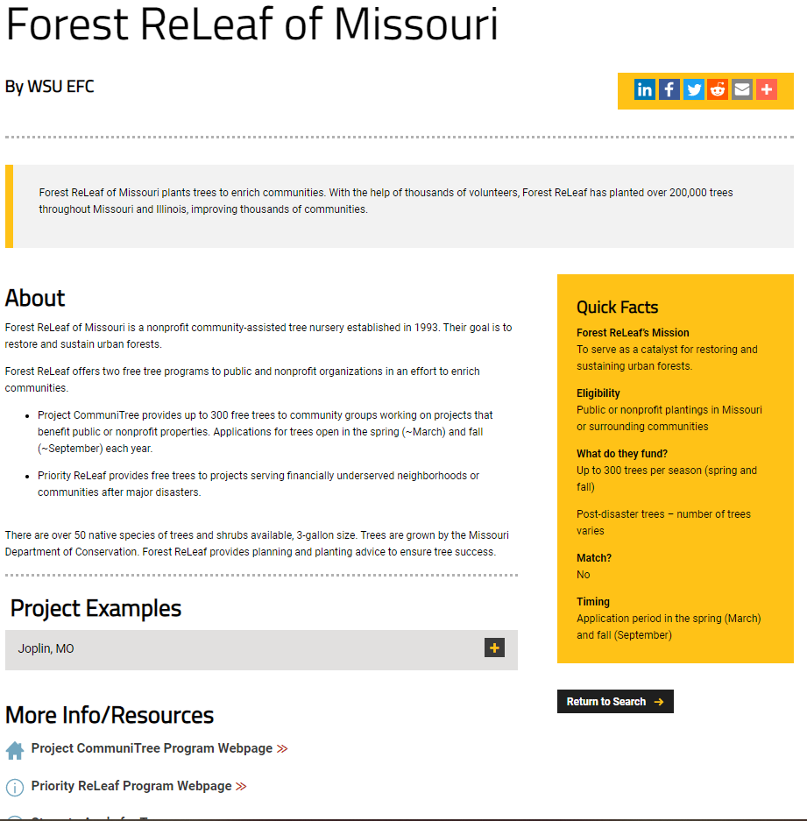

Slide 24
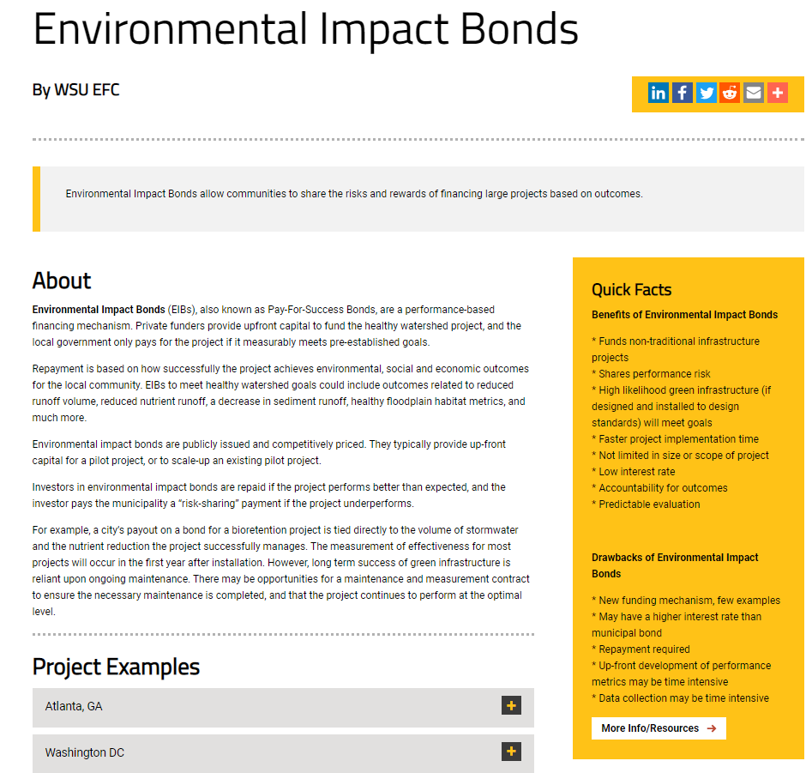

Slide 26
CONTACT US
This project was funded by a grant (AI97756601) from the United States Environmental Protection Agency (EPA) National Nonpoint Source Program to the Wichita State University (WSU) Environmental Finance Center (EFC). The contents of this presentation do not necessarily reflect the views and policies of the Environmental Protection Agency, nor does the EPA endorse trade names or recommend the use of commercial products mentioned in this document.
Tonya Bronleewe
tonya.bronleewe@wichita.edu
www.wichita.edu/efc

