Slide 1
Supporting Students' Metacognition
Moriah beck
Associate professor of Chemistry

Slide 2

New strategy to improve student learning
“Teach Students How to Learn: Strategies You Can Incorporate into any course to improve student metacognition, study skills, and motivation”
Book by Saundra Yancy McGuire

Slide 3
Set-up
After first exams were graded and returned to students
Report class average
Use this lecture to motivate and equip students with new tools to learn the material
  Show them the data on previous students
  Teach them about metacognition, study cycle,
  Writing assignment
Set a goal! Hold students accountable!

Slide 4

Ace Dr. Beck’s CHEM 103:
Metacognition is the Key!

Slide 5

Inspired by Saundra Y. McGuire, Ph.D.
Retired Asst Vice Chancellor & Professor of Chemistry
Director Emerita, Center for Academic Success

Slide 6
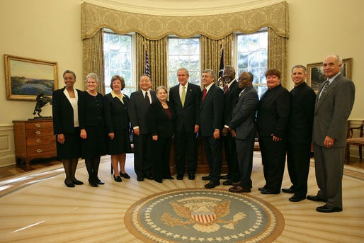
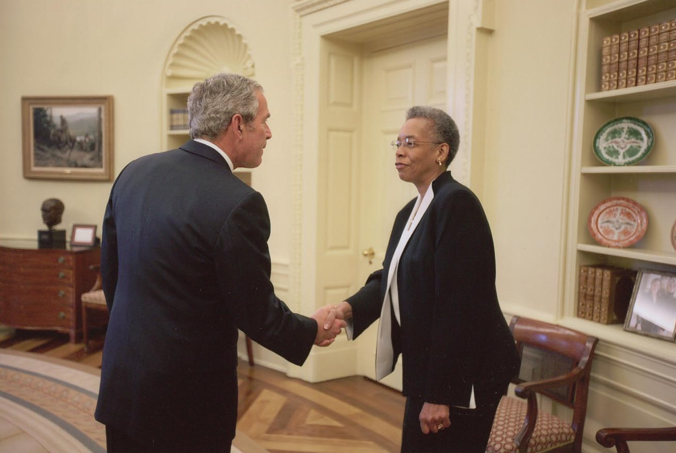
Presidential Award
White House Oval Office
November 16, 2007

Slide 7
The Story of Four LSU Chem 120 Students
Robert Final Grade:
42, 100, 100, 100 A
Kristy
60, 100, 99, 84 A
Blanche
63 79, 87, 100 A
Joshua
68, 50, (50), 87, 87, 97 A

Slide 8
Get the Most Out of Homework
Start the problems early--the day they are assigned
Do not flip back to see example problems; work them yourself!
Don’t give up too soon (<15 min.)
Don’t spend too much time (>30 min.)

Slide 9
Performance in Gen Chem I in 2011 Based on One Learning Strategies Session*
Attended Absent
Exam 1 Avg.: 71.65% 70.45%
Exam 2 Avg.: 77.18% 68.90%
Final course Avg*.: 81.60% 70.43%
Final Course Grade: B C
The one 50-min presentation on study and learning strategies resulted in an improvement of one full letter grade!
*Cook, E.; Kennedy, E.; McGuire, S. Y. J. Chem. Educ., 2013, 90 (8), 961–967

Slide 10
Performance in Gen Chem 120 Sp 2013 Based on One Learning Strategies Session
Attended Absent
Exam 1 Avg.: 71.33% 69.27%
Homework Total 169.8 119.1
Final course Avg*.: 82.36% 67.71%
Final Course Grade: B D
The 50-min presentation on study and learning strategies resulted in an improvement of two letter grades!

Slide 11
Desired outcomes
You will analyze your current learning strategies for Chemistry 103
You will understand exactly what changes you need to implement to make an A in the course
You will have concrete strategies to use during the remainder of the semester, and you will
  USE them in Chem 103 and beyond!
You will become a more efficient learner by studying smarter, not necessarily harder

Slide 12
Reflection Questions
What’s the difference, if any, between
studying chemistry and learning chemistry?
For which task would you work harder:
A. Make an A on the test
B. Teach the material to the class?

Slide 13
Which mode have you been in?
Study mode
2. Learn mode

Slide 14
For which task would you work harder?
Make an A on the test
2. Teach the material

Slide 15
To Ace Chem 103
(and everything else!)
Stay in learn mode, not study mode
Study as if you have to teach the material, not just make an A on the test.

Slide 16
Why is this so important?
Because 103 is Harder Than High School Chem
The course moves a lot faster
The material is conceptually more difficult and cumulative
The problems are more involved
The tests are less straightforward and require you to apply several concepts at one time

Slide 17
Using Metacognition to Become an Expert Learner in Chemistry

Slide 18
Metacognition
The ability to:
think about thinking
be consciously aware of oneself as a problem solver
monitor and control one’s mental processing (e.g. “Am I understanding this material?”)
accurately judge one’s level of learning

Slide 19
This pyramid depicts the different levels of thinking we use when learning. Notice how each level builds on the foundation that precedes it. It is required that we learn the lower levels before we can effectively use the skills above.
Bloom’s Taxonomy
Evaluation
Making decisions and supporting views; requires understanding of values.
Graduate School
Combining information to form a unique product; requires creativity and originality.
Synthesis
Identifying components; determining arrangement, logic, and semantics.
Undergraduate
Analysis
Using information to solve problems; transferring abstract or theoretical ideas to practical situations. Identifying connections and relationships and how they apply.
Application
Restating in your own words; paraphrasing, summarizing, translating.
Comprehension
High School
Memorizing verbatim information. Being able to remember, but not necessarily fully understanding the material.
Knowledge
Louisiana State University  Center for Academic Success  B-31 Coates Hall  225-578-2872  www.cas.lsu.edu

Slide 20
At what level of Bloom’s did you have to operate to make A’s or B’s in high school?
Knowledge
Comprehension
Application
Analysis
Synthesis
Evaluation

Slide 21
At what level of Bloom’s do you think you’ll need to be to make an A in Chem 103?
Knowledge
Comprehension
Application
Analysis
Synthesis
Evaluation

Slide 22
How do you move yourself higher on Bloom’s Taxonomy?
Use the Study Cycle!

Slide 23
The Study Cycle
4
Reflect
3
Review
Preview
Preview before class – Skim the chapter, note headings and boldface words, review summaries and chapter objectives, and come up with questions you’d like the lecture to answer for you.
4
Reflect
Attend
Attend class – GO TO CLASS! Answer and ask questions and take meaningful notes.
Review
Review after class – As soon after class as possible, read notes, fill in gaps and note any questions.
Study
Study – Repetition is the key. Ask questions such as ‘why’, ‘how’, and ‘what if’.
Intense Study Sessions* - 3-5 short study sessions per day
Weekend Review – Read notes and material from the week to make connections
Assess
Assess your Learning – Periodically perform reality checks
Am I using study methods that are effective?
Do I understand the material enough to teach it to others?

Slide 24
Intense Study Sessions
1 | Set a Goal | (1-2 min) | Decide what you want to accomplish in your study session
2 | Study with Focus | (30-50 min) | Interact with material- organize, concept map, summarize, process, re-read, fill-in notes, reflect, etc.
3 | Reward Yourself | (10-15 min) | Take a break– call a friend, play a short game, get a snack
4 | Review | (5 min) | Go over what you just studied

Slide 25
Effective Metacognitive Strategies
Always solve problems without looking at an example or the solution
Memorize everything you’re told to memorize (e.g. equations)
Always ask why, how, and what if questions
Test understanding by giving “mini-lectures” on concepts
Spend time on chemistry every day
Use the Study Cycle with Intense Study Sessions
Attend SI sessions on a regular basis
Aim for 100% mastery, not 90%!

Slide 26
Metacognition activity
What do you believe is important to understand and learn in this class?
What do you believe to be critical characteristics of successful students in this class?
How will you study and prepare for exams in this class?

Slide 27
Which One of the Next Two Slides More Accurately Describes YOUR Actions Before Test 1?

Slide 28
Top 5 Reasons Folks Did Not Do Well on Test 1 in Gen Chemistry in Fall 2009:
1. Didn’t spend enough time on the material
2. Started the homework too late
3. Didn’t memorize the information I needed to
4. Did not use the book
5. Assumed I understood information that I had read and re-read, but had not applied

Slide 29
Top 5 Reasons Folks Made an A on Test 1:
1. Did preview-review for every class
2. Did a little of the homework at a time
3. Used the book and did the suggested problems
4. Made flashcards of the information to be memorized
5. Practiced explaining the information to others

Slide 30
Which group did you most resemble?
Group that did not do well
2. Group that made an A

Slide 31
Mindset
Fixed Intelligence Mindset
Intelligence is static
You have a certain amount of it
Growth Intelligence Mindset
Intelligence can be developed
You can grow it with actions

Slide 32
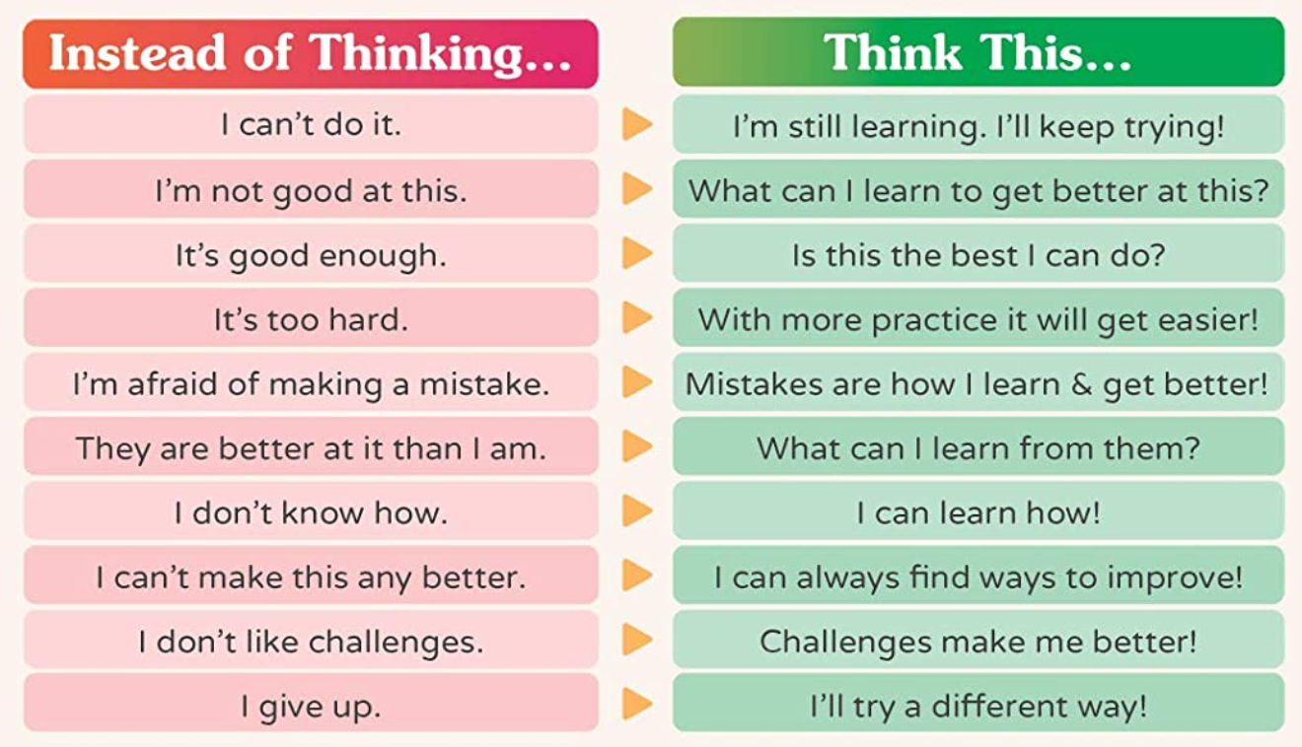
Responses to many situations are based on mindset
 | Fixed mindset response | Growth mindset response
Challenges | Avoid | Embrace
Obstacles | Give up easily | Persist
Tasks requiring effort | Fruitless to try | Path to mastery
Criticism | Ignore it | Learn from it
Success of others | Threatening | Inspiration
Notes:
Emphasize action, not ability!!!

Slide 33
Email from Joshua, Chem 1201 student
“…Personally, I am not so good at chemistry and unfortunately, at this point my grade for that class is reflecting exactly that. I am emailing you inquiring about a possibility of you tutoring me.”
April 6, 2011
----------------------------------------------------------
“I made a 68, 50, (50), 87, 87, and a 97 on my final. I ended up earning a 90 (A) in the course, but I started with a 60 (D). I think what I did different was make sidenotes in each chapter and as I progressed onto the next chapter I was able to refer to these notes. I would say that in chemistry everything builds from the previous topic.
May 13, 2011 Semester GPA: 3.8

Slide 34
Get the Most Out of Homework Reprise
Start the problems early--the day they are assigned
Do not flip back to see example problems; work them yourself!
Don’t give up too soon (<15 min.)
Don’t spend too much time (>30 min.)

Slide 35
Get the Most from SI Sessions, Tutorial Centers, Office Hours, and Study Groups
Try to understand the concept or work the problem by yourself first
Come prepared to ask questions
Explain the material to the tutor or instructor

Slide 36
Challenge to YOU!
Metacognition Discussion – February 25, 2020
Average on Exam 2: 80%
How do I know you CAN do this?
Because students at the
LSU Dental School did it!

Slide 37
The 2004 LSU Dental School First Year Class:
An Amazing Success Story!
Metacognition Discussion – August 13, 2004
Histology Exam – August 23, 2004
Previous class averages: 74 – 78
Challenge to class on August 13: 84 average
Reported average on August 24: 85!

Slide 38
Writing Exercise
What strategy will you use
for the next three weeks?

Slide 39
Which one strategy are you most likely to implement for the next test?
Do preview review
2. Do homework differently
3. Use the textbook more
4. Do more problems
5. Practice teaching the material
6. None of the above

Slide 40
If you don’t try it within the next 48 hours...
… you probably never will.

Slide 41
Final Note
Please schedule a time to visit with Dr. Beck if you want to follow up on any of these learning strategies or have specific questions.
I wish you a fantastically successful future!

Slide 42
Exam 2 Bonus Questions
What new “learning” strategy did you use before this exam?
How would you define metacognition?
What do you predict your grade on this exam will be? Is this an improvement over your first exam? Why or why not?

Slide 43
My results…
Exam/average
68
67
70
76
Individual Student Success
Flower 47, 51, 98, 96.5
Stem 54, 51, 67, 89
Petal 45, 56, 92, 106
Rose 53, 59, 89, 93
Pollen 77, 56, 83, 97

Slide 44
Ambrose’s
Levers affecting student motivation
Value – How important do I find this goal?
Nature of the environment - Do I feel supported or unsupported?
Belief in the ability to succeed – Do I believe I can design and follow a course of action to meet this goal?
Notes:
Motivation is the “personal investment an individual has in reaching a desired state or outcome.

Slide 45
Student obstacles to motivation
Students may work long hours.
Students may have an attention-deficit disorder or related diagnosis
Students may be interested primarily in credentials.
Students may feel As and Bs are their just rewards for consistent attendance.
Student may not know how to manage their time.
Student may have few learning skills.

Slide 46
Faculty-related obstacles to student motivation
increased motivation
increased learning
increased success
positive emotions
The classroom environment is daunting or unsupportive.
Faculty expectations are unclear.
Students are paralyzed by a sink-or-swim course structure.
Notes:
Motivation cycle

Slide 47
