Slide 1
Teaching Matters
Off to a good start!
Presented by the Retention Fellows
September 9, 2022

Slide 2
Agenda for today
Introductions and Lunch
Retention Fellows Presentations
Q&A
Reflection Questions
  Break-out groups discuss
  Share favorites with whole group
Wrap-up and Future Plans

Slide 3
Introductions
Moriah Beck, Chemistry & Biochemistry
Katie Lanning, English
Gery Markova, Management
Cindi Mason, Industrial, Systems and Manufacturing Engineering
Sarah Taylor, Public Health
Carolyn Shaw, Political Science
Carolyn Speer, OIR

Slide 4

Retention priority for wsu
Systematize the use of academic data to identify courses with high non-pass rates and to assess the effectiveness of course and program re-design, tutoring and other efforts to improve outcomes in these courses
Standardize academic advising to ensure students receive consistent support across all majors
Develop intentional pathways to help students learn about, select, and transition between academic majors
Strengthen financial aid through collaboration with other units and coordinated, proactive outreach to students
Diagnostic Analysis and Playbook
Presented in March 2022

Slide 5
The Diagnostic Analysis is the first of two deliverables in the Diagnostic Process
Diagnostic process
Diagnostic objectives: Identify challenges; Prioritize where to focus; Lay out clear next steps
Current step
Diagnostic Inputs
Diagnostic Analysis
Pl Playbook
1
2
IPEDS data
Analysis Purpose
Playbook Purpose
Executive Summary
Executive Summary
Surveys: Campus Stakeholders, Institutional Data and Operations
Follow-up interviews
(Refine and build for Playbook)
Supporting Insights
Prioritized Actions
Institutional Data
Next steps
Longer-term Journey
Appendix
Appendix
Other
(e.g., institution strategic plan, client provided materials, etc.)
Provides data-driven insights relating to key challenges
Provides clear path forward to improve

Slide 6
Retention, progression, and graduation gaps
overall_1_132373145373109707 columns_1_132373145373109707
Key challenges
While 1st Year retention is consistent, there is a sizeable drop-off in the number of those students graduating within 6 years.
WSU vs National 4-Year Public Average
6-Year Graduation Rate, 2015-2020
1st Year Retention vs. 6-Year Graduation, 2010-2014 cohorts
Average gap between
first-year retention and
6-year graduation,
2010-2014 cohorts
-25 pp.
Source: IPEDS

Slide 7
Keys to Successful Implementation
overall_1_132373145373109707 columns_1_132373145373109707
1 |  | Ensure that leadership communicates clear and unwavering buy-in
2 |  | Publicly and regularly connect the Playbook recommendations to your Strategic Plan
3 |  | Prioritize the plan in budget decisions
4 |  | Be ready to support the plan from multiple perspectives
Talking Points |  | Every 100 additional degree-seeking students that WSU retains generate approximately $800K in additional tuition and fee revenues annually. 100 Bachelor’s students who stay enrolled though graduation rather than dropping out in the first year generate roughly $3 million in additional tuition and fee revenues for the university. Individuals holding Bachelor’s degrees will earn, on average, $900K+ more over their careers when compared to individuals having only a high-school diploma. 100 additional students will add $90 million to their communities’ economies over their lifetimes.

Slide 8
Goal setting, study strategies and metacognition
What do you hope to learn?
What grade do you expect?
How confident are you? Why?
Estimate of hours each week spent studying?
Select study strategies
Why are you taking this class?
Outside obligations?
New ideas for study strategies?
Responses…
I do get nervous about asking questions when I'm not understanding a concept. For me, it takes a minute for my brain to process the information and to click in my head. I've had previous professors made me feel like I'm unintelligent for not understanding something.
I also want to find out more about those squiggles in the picture that Dr. Beck showed us. What secrets are those folded proteins hiding and furthermore, why do they look like squiggles? I also think crystallography sounds interesting....
Honestly, I am very burnt out and my previous chemistry classes have somewhat destroyed my confidence.
I tend to stress myself out by overthinking or delaying my studies. The thought of failing stresses me out immensely, so I often try to avoid the "problem" when really I need to start the "problem," which is studying.
>Admitting this is a good first step. Now is the time to make specific plans to help you achieve this change in mindset and the behaviors that support it.

Slide 9
Promoting metacognition …getting feedback
Weekly Learning Paragraph
5% of overall grade, “good faith effort”
Give feedback to class as whole
Examples of prompts:
  How does the material you learned in class relate to your everyday life?
  What was the hardest thing this week that we’ve talked about?
  What questions are you asking yourself about the material covered so far?
  What do you predict your grade on the first quiz will be? Was this was you anticipated before taking the quiz? Why or why not?
https://youtu.be/m1KJBlA3urE
Dr. Mary Pat Wenderoth

Slide 10
Setting Expectations in your course
“Product-based” approach
Learning outcomes
Assignments & exams
Due dates
In-class work
Grades
“Process-based” approach
Weekly routine
Scaffolding/relationship between assignments
Value of discussion, group work, etc.
What work really looks like (revision, trial and error, etc.)

Slide 11
Setting expectations in your course
Pre-Course Survey
Why are you taking this course?
What are your academic and/or professional goals?
What do you consider an academic strength of yours?
What is something you hope to do or learn in this course?
What previous experience do you have in this subject?
What challenges do you anticipate in this course?
What else should I know in order to best support you in this course?

Slide 12
Reflection questions
What types of activities do you use on the first day?
  What works and what hasn’t worked so well?
How do you ensure that students read the syllabus?
How do you connect personally to your students?
Things went wrong! Here’s what I did to fix it (recover, etc.)
How do you communicate the work of your course to students?

Slide 13
Steps to student Project Engagement
1. Discovery
student finds source on own
2. Ownership
student presents own research on source
3. Outreach
student reaches out to organization that they believe needs to know about source

Slide 14
Student Discovery Example
English 360: Major British Writers I
Large survey course with broad timespan and big textbook
Built into the course title are assumptions about “major” writers and “important” or canonical literature
I invite students to ask what seems to be the criteria for a text to be included in our textbook?
I introduce them to digital archives and databases of thousands of examples of British literature across the centuries
Students “play” in the archive and find a text that they like that has not been included in our textbook

Slide 15
Student Ownership Example
Research and Presentations
Students read and research these discovered texts
They try to answer questions like: who wrote this text? what is it about? What devices, styles, or genres does it use that compare to what we expect from the time period? What is it doing that is different from what we expect?
Students then build an argument: Why do they think the text has been excluded from the anthology or broader canon of literature? Is this exclusion fair?
Students present this work to their peers

Slide 16
Student Outreach Example
Raising the Stakes by Moving Outside the Classroom
These presentations are a way to “test the waters” of their argument and get some feedback from peers and professor
Students then write a letter to the editor of our anthology
This letter proposes changes to the anthology (most often: a recommendation to include the text the student has discovered and taken ownership of in presentations)
When I am not the only audience, and when there are stakes beyond a grade, students often get more engaged
Our editors often respond!

Slide 17
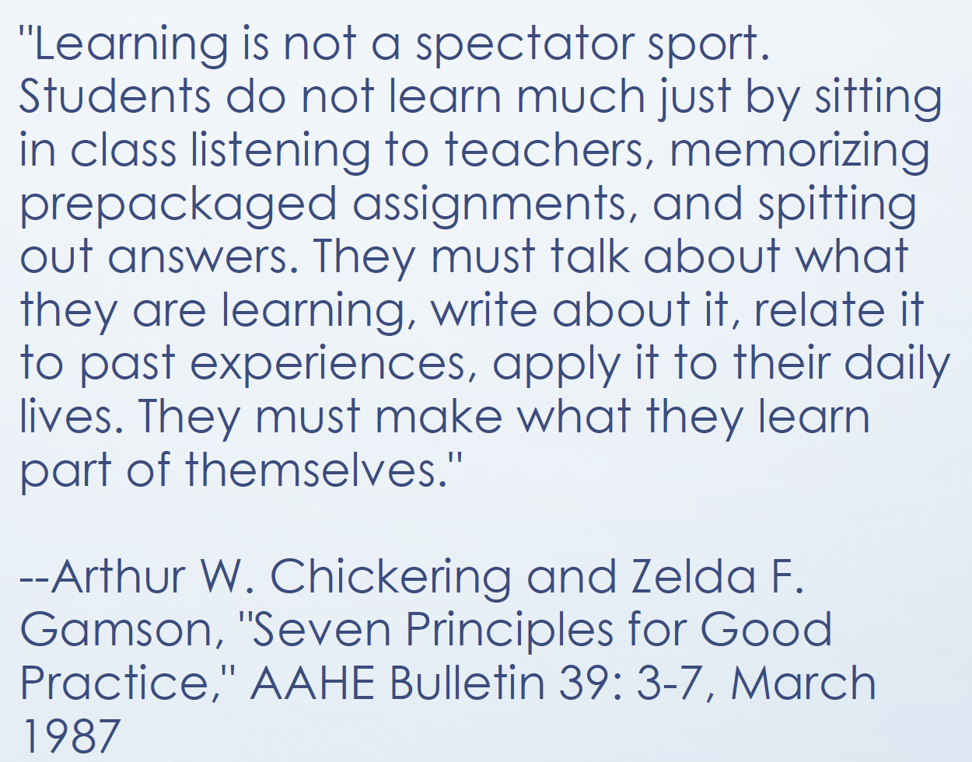

Active learning

Slide 18

Active and passive: We Need both
Active Learning (learner-centered)
Skills can be practiced and translated to real world
Interactive, 2-way learning
Reinforces important material
Students receive more frequent and immediate feedback
Creates sense of community, social belonging and enhances social skills
Passive Learning (teacher-centered)
Exposure to new material
Greater control over classroom
Ability to clarify material
Presentation of large amount of material in short time
Instructional materials can be prepared in advance
Content can be presented in an organized, structured, and meaningful way

Slide 19
Considerations
Learning outcomes
Design activities to reinforce learning outcomes
Choose topics that students typically find confusing
Use problems or questions that will challenge and interest your students
Relate activity back to learning outcomes
Lecture Material
Cut content from lectures to make room for activities
  Remove least important parts
Where does the content go?
  Record mini-lectures for students to watch prior to class
  Have students read before class and complete low-stakes quiz

Slide 20
Active learning techniques
Think-pair-share
Case studies
Role-playing
Ethical dilemmas
Debate
Peer review of writing
Polling
White-boarding
Peer teaching
Online ”scavenger hunt”
Game-based learning
Problem solving using real data
Project based learning
Socratic questioning

