Slide 1
Teaching Matters: Classroom Assessment
Presented by the Retention Fellows
October 7, 2022

Slide 2
Agenda for today
Introductions
Retention Fellows Presentations
Q&A
Reflection Questions
Break-out groups discuss
Share favorites with whole group
Wrap-up and Future Plans

Slide 3
Introductions
Moriah Beck, Chemistry & Biochemistry
Cindi Mason, Industrial, Systems and Manufacturing Engineering
Katie Lanning, English
Gery Markova, Management
Sarah Taylor, Public Health
Carolyn Shaw, Political Science
Carolyn Speer, OIR

Slide 4
Classroom Assessment
Formative Assessment
Summative Assessment
Surveys
https://www.celt.iastate.edu/instructional-strategies/evaluating-teaching/assessment-overview/

Slide 5
Formative Assessment
Carolyn Speer
Carolyn Shaw

Slide 6
Formative Assessment: All Benefit, No Downside!
Match formative assessments to content and/or tasks that have a history of not being done
Text readings, longer videos, graphs/tables/data that is dense
No need for proctoring because taking the assessment is designed to trigger resource use (all assessments are “open book”)
Communicates what you see as important and allows students to judge their own understanding while reinforcing research skills
“Offloads” objective content to auto-scoring in Bb, no extra work!
Allows for subjective content to be concentrated in written and applied work, all of which can be resubmitted if it misses the mark

Slide 7
SUMMATIVE Assessment
Gery Markova

Slide 8
surveys
Sarah Taylor
Moriah Beck

Slide 9
Tinto’s Longitudinal Model of Institutional Departure
Tinto, V., 1975, “Dropout from Higher Education: A Theoretical Synthesis of Recent Research,” Rev. Educ. Res., 45(1), pp. 89–125.

Slide 10
SOME assessment examples
Cindi Mason

Slide 11
FORMATIVE ASSESSMENT
Some general methods…
Think, Pair, Share
Panopto Quizzing
Group discussion questions/quizzes

Slide 12
SUMMATIVE ASSESSMENT
Some general methods…
Project-based learning
Problem-based learning

Slide 13
ASSESSMENT through project-based learning

Slide 14
ASSESSMENT through project-based learning
IME 452: Work Systems
The documentation, measurement, and design of work systems. Includes methods engineering, process mapping, work measurement systems, process improvement, economic justification, and community impact.
Project:
Analyze the activities in a process of relevance to your community using concepts learned in Work Systems. Work system of study can be selected from VolunteerICT.
At the end of the semester, present an analysis of the work system with a clear plan to improve such process in terms of a specific performance metric.
Projects presented at the Spring Service-Learning Showcase

Slide 15
ASSESSMENT through project-based learning
IME 553: Production Systems
Overview of the vocabulary and basic quantitative techniques used in the analysis and control of production systems, involving both manufacturing and service operations.
Topics include strategic dimensions of operations management, sales and operations planning, basics of forecasting, inventory control models, operations scheduling, and operations management issues in services.

Slide 16
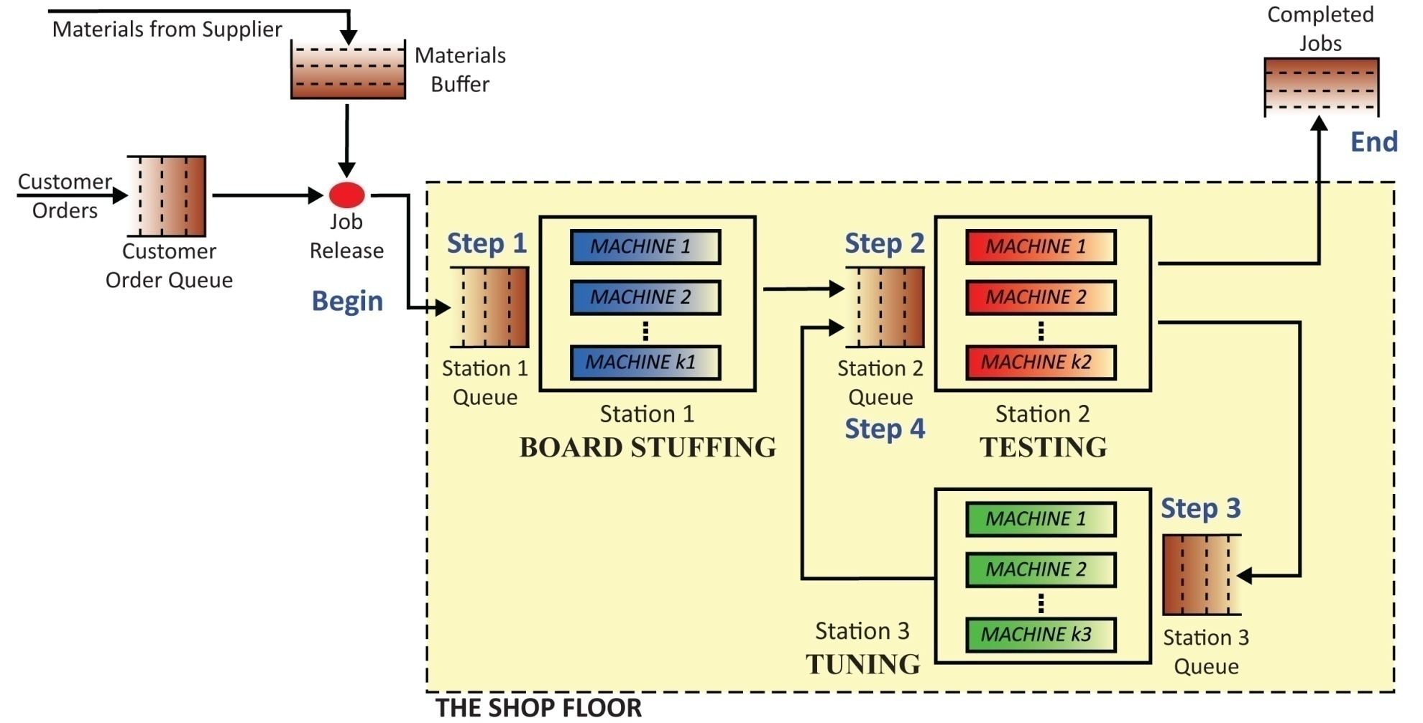
ASSESSMENT through project-based learning
IME 553: Production Systems
Project:
Initial analysis and plan
Analysis of 50-day data
Plan: Create a data-driven plan for playing the game
Team Dynamics
Play! Week of Simulation
Final Analysis
Littlefield Technologies

Slide 17
ASSESSMENT THROUGH PROBLEM-BASED LEARNING
IME 224: Engineering Probability and Statistics
This course is designed for undergraduate students majoring in engineering. It reviews graphical and numerical methods for summarizing and describing datasets, discusses basic concepts of probability, introduces discrete and continuous random variables, and presents statistical methods for making inferences about population parameters.

Slide 18
ASSESSMENT THROUGH PROBLEM-BASED LEARNING
IME 224: Engineering Probability and Statistics
QUIZ 1 – CHAPTER 1: Sampling & Descriptive Statistics
Introduction:
Product Sample
My Factory

Slide 19
ASSESSMENT THROUGH PROBLEM-BASED LEARNING
IME 224: Engineering Probability and Statistics
QUIZ 1 – CHAPTER 1: Sampling & Descriptive Statistics
Background:
I am the CEO of Mason Jar Desserts. In order to meet increasing demand, I am considering purchasing additional equipment so that we can increase our batch size and reduce the number of set-ups. (i.e. run one variety of dessert jars on current equipment while running another variety of dessert jars on the new equipment). I need to compare the cost of new equipment to the cost savings of decreasing the number of required set-ups.

Slide 20
ASSESSMENT THROUGH PROBLEM-BASED LEARNING
IME 224: Engineering Probability and Statistics
QUIZ 1 – CHAPTER 1: Sampling & Descriptive Statistics
Challenge:
You are a Process Engineer at Mason Jar Desserts, and as your boss, I have asked you to conduct a work measurement analysis to determine the set-up time required to produce a batch of dessert jars. At our large processing plant, the set-up times (in minutes) for a random sample of 20 batches were recorded. The data are shown in the table below.
30 | 12 | 27 | 37 | 43 | 40 | 32 | 41 | 42 | 46
45 | 43 | 30 | 16 | 39 | 40 | 42 | 34 | 36 | 33

Slide 21
ASSESSMENT THROUGH PROBLEM-BASED LEARNING
IME 224: Engineering Probability and Statistics
QUIZ 1 – CHAPTER 1: Sampling & Descriptive Statistics
Summary:
Summarize your results for me (CEO of Mason Jar Desserts) to help me make the decision on whether or not to purchase extra equipment. Note that you do not need to provide a final recommendation on whether or not to purchase the equipment. Costs will play a major role in that decision, and I am gathering costs from our finance department.

Slide 22
ASSESSMENT THROUGH PROBLEM-BASED LEARNING
IME 224: Engineering Probability and Statistics
QUIZ 1 – CHAPTER 1: Sampling & Descriptive Statistics
For full credit, your summary should include the following:
At least two measures of central tendency along with the reason for reporting those measures and what they mean.
At least two measures of variation along with the reason for reporting those measures and what they mean.
At least one measure of relative standing along with the reason for reporting it and your interpretation of the meaning.
At least two visual displays of the data to provide an overall picture along with an explanation of what you can observe from those displays.
Determine if there are any outliers and provide a recommendation for what should be done with the outliers if they exist.

Slide 23
ASSESSMENT THROUGH PROBLEM-BASED LEARNING
IME 224: Engineering Probability and Statistics
QUIZ 2 – CHAPTER 2: Probability
Extension from Quiz 1:
Opted not to purchase new equipment
Made some equipment modifications for quick-change set-ups
Moved some internal set-up to external set-up
Standardized set-up process
Averaging 30-minute set-up time

Slide 24
ASSESSMENT THROUGH PROBLEM-BASED LEARNING
IME 224: Engineering Probability and Statistics
QUIZ 2 – CHAPTER 2: Probability
Extension from Quiz 1:
Now I am trying to reduce the number of set-ups with scheduling. We make our dessert jars to order, but some of our jars go to local stores that order standard quantities bi-weekly. I would like you to do some analysis using last month’s orders to help me plan for next month.

Slide 25
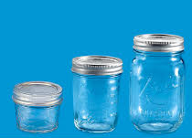
ASSESSMENT THROUGH PROBLEM-BASED LEARNING
IME 224: Engineering Probability and Statistics
QUIZ 2 – CHAPTER 2: Probability
Product Options:
chocolate
Pint
Half
Pint
vanilla
Quarter Pint
Chocolate
Strawberry
Cream Cheese
Vanilla
spice
strawberry
yellow cake

Slide 26
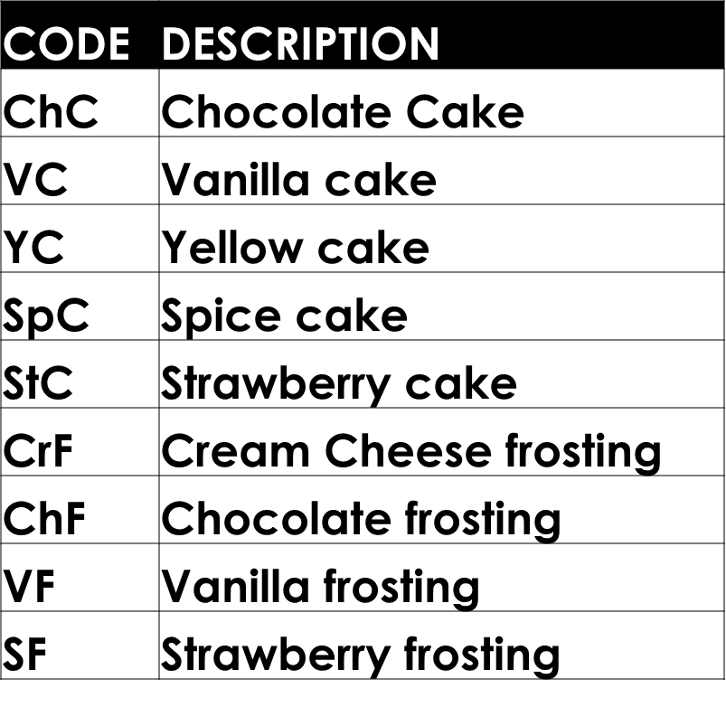
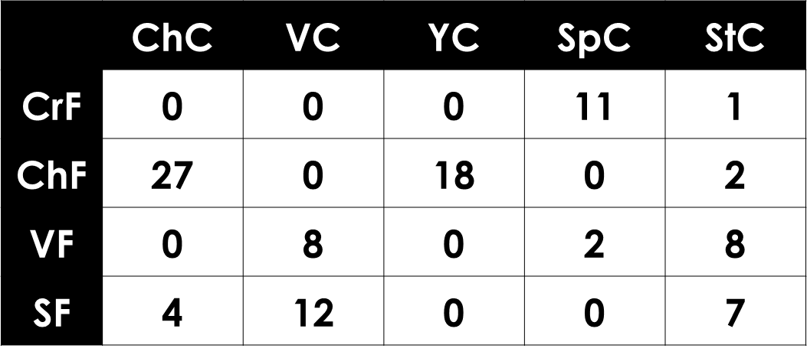
ASSESSMENT THROUGH PROBLEM-BASED LEARNING
IME 224: Engineering Probability and Statistics
QUIZ 2 – CHAPTER 2: Probability
Product Options:
Last 100 Orders

Slide 27
ASSESSMENT THROUGH PROBLEM-BASED LEARNING
IME 224: Engineering Probability and Statistics
QUIZ 2 – CHAPTER 2: Probability
Application:
Counting methods (permutations, combinations, partitions)
Compound events – unions and intersections
Conditional probability

Slide 28
ASSESSMENT THROUGH SURVEYS
All team project courses
Peer Evaluations

