Slide 1
21st Century Workforce Skills

Slide 2
Career Readiness Competencies
Career & Self-Development
Communication
Critical Thinking
Equity & Inclusion
Leadership
Professionalism
Teamwork
Technology
National Association of College & Employers (NACE) – Career Readiness Competencies

Slide 3
What hasn’t changed…
Communication - Clearly and effectively exchange information, ideas, facts, and perspectives with persons inside and outside of an organization.
Critical Thinking - Identify and respond to needs based upon an understanding of situational context and logical analysis of relevant information.
Leadership - Recognize and capitalize on personal and team strengths to achieve organizational goals.
Professionalism - Knowing work environments differ greatly, understand and demonstrate effective work habits, and act in the interest of the larger community and workplace.
Teamwork - Build and maintain collaborative relationships to work effectively toward common goals, while appreciating diverse viewpoints and shared responsibilities.
National Association of College & Employers (NACE) – Career Readiness Competencies

Slide 4
What HAS changed…
Much greater emphasis on…
National Association of College & Employers (NACE) – Career Readiness Competencies
Career & Self-Development—Proactively develop oneself and one’s career through continual personal and professional learning, awareness of one’s strengths and weaknesses, navigation of career opportunities, and networking to build relationships within and without one’s organization.
Equity & Inclusion—Demonstrate the awareness, attitude, knowledge, and skills required to equitably engage and include people from different local and global cultures. Engage in anti-racist practices that actively challenge the systems, structures, and policies of racism.
Technology—Understand and leverage technologies ethically to enhance efficiencies, complete tasks, and accomplish goals.

Slide 5
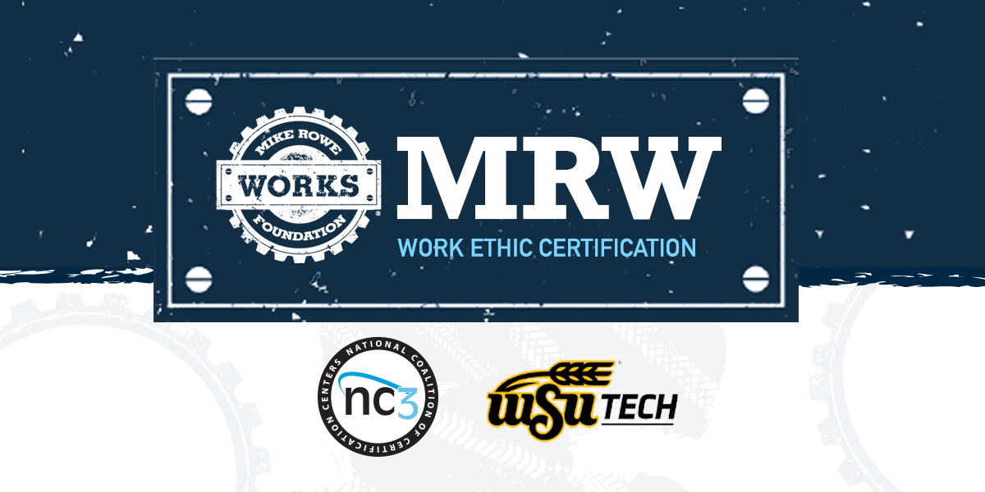
Employability VS Technical Skills
Blueprint for Personal Success (PDV 105)
Topics include:
Goal Setting
Entry Level Leadership
Communication
Teamwork and Diversity
Career Management
Lifestyle Design
Disruption in Industry.

Slide 6
What is the mikeroweWORKS Foundation?

Slide 7
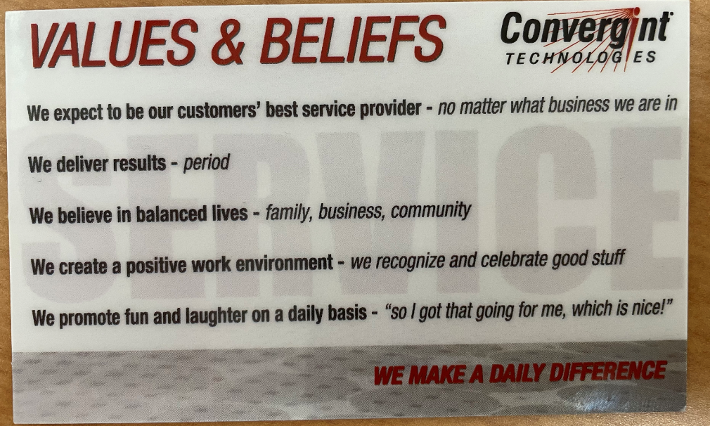
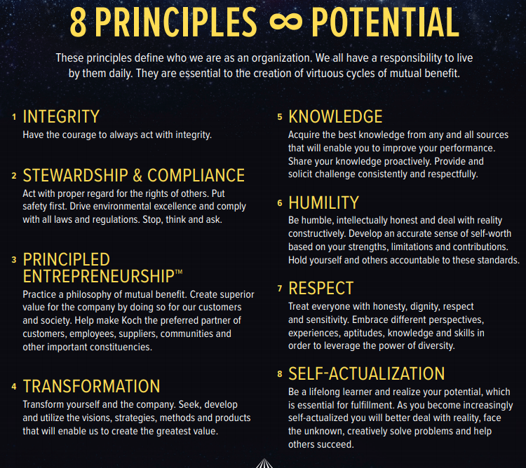
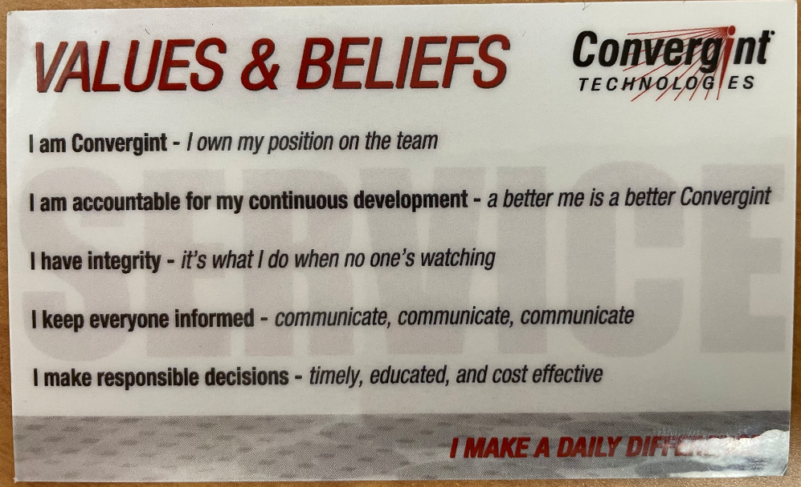
What do Employers Hire for FIRST

Slide 8
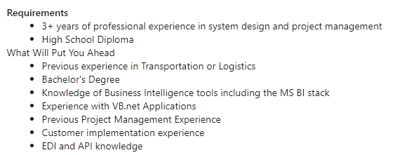
Lifelong Continuous Learning
Upskilling
Technical Skills (including LinkedIn Learning)
Extending/getting outside your comfort zone
Public Speaking
Taking the lead on a project
Increasing Responsibility
Saying YES, whenever you can
Understanding Personal Strengths
MBTI
Strengths Finders
KOLBE
Study Greatness
Expand your network
Ask for advice (mentorship)
Personal Skill Gap Analysis
Tell students to GO GET THOSE SKILLS!!!

Slide 9
References & Other Resources
McKinsey Global Survey on reskilling
Best Way to Close Gaps by McKinsey
Business Priorities in the Post-Pandemic Era
Building Workforce Skills at Scale
Building Agile Capabilities
The Journey to Agile

Slide 10
Questions or Thoughts?
Megan Madasz, Director of Industry & Workforce Collaboration
316.677.1876, mmadasz@wsutech.edu
Brian Austin, Director of Applied & Experiential Learning
316.978.6983, brian.austin@wichita.edu

