Slide 1
Intermediate Blackboard
Taylor Moore, M.A.
Instructional Design and Access
2018-19
Notes:
Welcome to this Intermediate Blackboard training presentation, created by the Instructional Design and Access team, and presented by Taylor Moore.

Slide 2
Overview
Welcome
Purpose of this training
Pre- self-assessment
Presentation agenda
Refresher of Intro to Blackboard Training
Notes:
Welcome to Intermediate Blackboard. My name is Taylor, and today we will be reviewing some intermediate Blackboard elements. This presentation is designed to further develop your understanding of Blackboard tools and settings, and to continue building on the Introduction to Blackboard training presentation. In order to determine if this is the right presentation for you, it is important to assess where you are in your comprehension of the LMS. The Introduction to Blackboard presentation covers the following: What is Blackboard and where can you find it? Navigating Blackboard. Using Announcements and course email. Uploading content. Using discussion boards and assignments tools. How the Grade Center in Blackboard works, and how to interpret Ally scores. If you are not familiar with or would like training on these topics, it may be beneficial to review the Introduction to Blackboard training before continuing with this presentation at a later date.
If you have already viewed the Introduction to Blackboard presentation or feel you have a basic understanding of using Blackboard, this is the right presentation for you. We will discuss the creation of tests, assignment settings and tools, proper grade center set up, use of student preview mode versus test student, and the creation and settings of the groups tool. These are extremely rich topics, each deserving of their own presentation, so while we will start on these concepts, we will not cover everything in this presentation. For more advanced training please review the Advanced Blackboard presentation which includes using test pools, surveys, Panopto assignments, wikis, journals, Now that you have determined if this is the right presentation for you, let’s continue.

Slide 3
Intro to Blackboard Training Covers
What is Blackboard?
Navigating Blackboard
Announcements
Email
Content
Discussion Boards
Assignments
Grade Center
Interpreting Ally scores

Slide 4
Advanced Blackboard Training
Using test pools
Surveys
Panopto Assignments
Wikis
Journals
Notes:
If you are familiar with the trainings discussed in the Introduction to Blackboard and Intermediate Blackboard presentations, please proceed to the Advanced Blackboard Training which reviews: Using Test Pools, Panopto Assignments for students, using wikis, using journals, surveys,

Slide 5
Creating Tests in Blackboard
Notes:
Let’s start our intermediate training with creating tests in Blackboard.

Slide 6
Tests
Building a Test with individual test questions
Using Create Question Set v. Random Blocks v. Find Questions
Important Test Settings
Notes:
In this section, we are going to discuss building Blackboard tests with individual test questions. Review the differences between using the “Create Question Set” versus “Random Blocks” versus “Find Questions” functions. And discuss some important test settings to use and ones to stay away from.

Slide 7
Tests, Surveys, and Pools
Go to your Blackboard course, and select Tests, Surveys, and Pools from the list of Course Tools.
Notes:
Tests can be built in a number of ways in Blackboard. To begin the process of creating a test, start by logging into your course and locating the “Tests, Surveys, and Pools” section under the Course Tools tab.

Slide 8
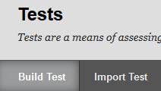
Select Tests
Next, select Tests. Then select “Build Test”.
Notes:
The “Tests, Surveys, and Pools” area contains three links. It is important to determine early if you will be building a test or a test pool. While tests are the final product that students will access, pools are often used in tests to provide variety and randomization of questions. Again, while we will explore the Test feature in this training, for more information about test pools please review the Advanced Blackboard training.
To continue with building your test, select the “Tests” link. Blackboard allows you to Build Test or import a test file. Select “Build Test” to move to the Test Information page.

Slide 9
Name the Test
Provide your test with a name, description, and instructions.
Select “Submit” in the bottom right-hand corner.
Notes:
The Test Information page is where you will name your test, as well as provide a description and further instructions to students. When students access the test during the semester, this will be their guide to taking the exam. Though it is important to provide this information to students, you can fill in these sections at a later date if you would prefer. It is important to remember that your naming convention for the test should be specific and clear, this will make it easier to identify when you deploy it in the course, as well as making it clear to students during the semester. Additionally, be careful to avoid specific dates and times when writing the description and instructions, as these are often forgotten about from semester to semester and can cause confusion for students if the test is reused in a later course. When you are finished providing a name, description, and instructions, click submit to proceed to the next step.

Slide 10
Create or Reuse Questions
Multiple ways to create test questions. Create, Reuse, or Upload Questions.
Use test question pools with Create Question Set or Create Random Block.
You can also find questions from a previously created test.
Notes:
You are now in the Test Canvas page. This is where you can create a question from scratch or reuse questions from a previously created pool or exam. If you choose to reuse questions, you will need to decide whether to use Create Question Set, Create Random Block, or Find Questions. Question Sets are groups of questions that can be presented in a random fashion determined by the instructor. Random Blocks are groups of questions randomly selected from a question pool. And Find Questions allows the test creator to gather questions, organized by criteria such as question type, category, topics, level of difficulty, and keywords. These options are discussed more in depth in the Advanced Blackboard training. For this training we will briefly review creating a question from scratch.

Slide 11
Create Question
Select “Create Question”.
If you choose to Create a question, you will need to select the type of question you want to create.
Notes:
Select the Create Question option and review the dropdown menu that descends featuring all the different questions types available in the test tool. These include Multiple Choice, Multiple Answer, True/False, Short Answer, Essay and more.

Slide 12
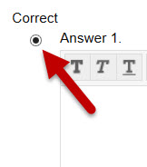
Write the Question
Type or paste in your question and answers into the Question Text Box and Answer Text Boxes, respectively.
Indicate the correct answer by marking the circle next to the correct answer option.
Notes:
Once you have selected your question type, you will proceed to the Create/Edit Question page. This is where the question text and answer options are provided. You can type in the text or copy/paste using the keyboard shortcuts. Next to the upper left-hand corner of each answer option, there is a small radio button. This is used to indicate which answer option is correct. Select the button next to the correct answer and review the questions options area before selecting submit.

Slide 13
Additional Question Options
You can also adjust the answer numbering, orientation, allow for partial credit, and show answers in a random order
Submit when finished.
Notes:
The question Options area of the Create/Edit question page allows you to adjust the answer numbering, orientation, allow for partial credit, and to show answer in a random order. It is important to note that when choosing to show answers in a random order, you take into account whether any of the answer options rely on the position of the others. For example, if an answer states, “Both A and C”, but the answer options are randomized. Answers originally set in the A and C position, may wind up in the B and D positions instead. This leads to significant confusion for students. Once you have selected the options you want to apply to the individual questions, click submit to create another question or to move back into the Test Canvas area.

Slide 14
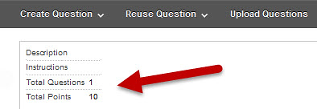
Adjusting the Points
Next, you can adjust the points associated with the individual question.
When you are finished creating questions and are ready to deploy it, click “OK” in the bottom right-hand corner.
Notes:
Once a question has been created, you will be redirected to the Test Canvas area, where you can adjust the points each question is worth. Click into the “points” box for the individual question and update the associated points. You can also choose to make the individual question worth extra credit. While students will be able to earn the points associated with the question, the points are not added to the Total points possible for the test. As you are creating the test, it is important to check and verify your Total Questions and Total Points status located in the Test Canvas area below the Create Question button. Once you have completed your question creation and adjusted your questions, you can click the “OK” button in the bottom right-hand corner of the page as you are ready to deploy the test into the course for student access.

Slide 15
Deploying the Test
The Test must be placed somewhere in the course.
Notes:
To deploy the test, select the area of your course that you want the test housed for students to access it. Often this is in a specific module folder located in the Course Content area or in an Exams tab, however you can choose any content location in your course. With that in mind, it is critical that you are consistent when placing your tests. If you place tests one and two in their corresponding module folders, all remaining tests should also be placed in their corresponding folder for consistency purposes.

Slide 16
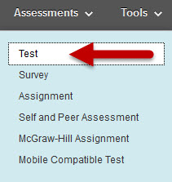
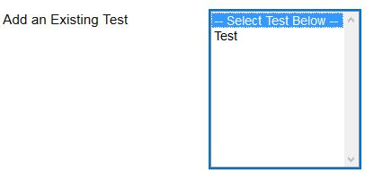
Choose Assessment
Once you are in the area that you want the test to be, select “Assessments” from the ribbon, and mouse over or click it to get the dropdown to appear. Select “Test” from the options that appear.
And select the newly created test from the list available and select submit.
Notes:
Once you are in the area that you want the test to be placed, select the Assessments tab at the top of the page in the “ribbon”. When the Assessments dropdown menu appears, select the Test link. A list of available existing tests will appear. Select the test you have created and select the submit button. This will lead you to the Test Settings/Test Options page.

Slide 17
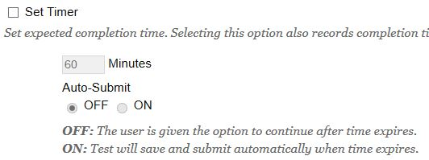
Test Settings to Use
Important Test Settings to Use:
Make the Link Available
Set a Timer
Use Auto-Submit
Use Display Dates
Use Exceptions
Notes:
In the Test Settings page, provide a description of the test if you have not already done so when first creating the test. Then review the array of options available on this page. For the purposes of this training we are going to discuss the settings briefly. First, ensure that the link has been made available. This setting is directly under the description textbox, and is defaulted to the “No” position. Most often this setting is left to the “No” position to help delay student access to the test, however the display dates—which we will discuss shortly—are better options for this purpose. Next, set a timer for the test if desired and select “auto-submit” to “on”. The timer is set in minutes and provides students with periodic time status updates during the exam. If auto-submit is set to “off” the exam will prompt the student at the end of their time and allow them the option to continue past the set timer. If the student goes beyond the timer, the instructor may then be required to approve the test before the score is admitted into the grade center. If auto-submit is set to “on”, the test will be automatically submitted at the end of the timer, regardless of how much of the test is completed. Moving on, the display dates can be used to allow and disallow student access to the test and are specific to the date and time down to the minute. As mentioned a moment ago, instead of marking no for the “link availability” setting, using the display dates allows you to pre-set when the test will become available prior to the actual date/time. This means you can set a test to open days, weeks, or months in advance. Lastly, become familiar with the “exceptions” area of the test settings page. This is the area you will use in the event that you need to adjust the timer, availability dates, or number of attempts for a single students.

Slide 18
Test Settings to Avoid
Important Test Settings to Avoid
Force Completion
Password
Avoid Internet Explorer
Notes:
Now that we have reviewed settings that are important to use, there are two settings it is highly recommended that you avoid using. The first is force completion. IDA recommends that you never use force completion. This setting will force the test to be completed in one sitting, which has the great potential for problems for students and instructor. If the internet flickers out—even if restored a few moments later—force completion will force the test closed regardless of how long a student was in it prior to the issue. This may mean the vast majority of the test is not complete when it is forced closed. As a result, students may email in a panic requesting access back into their test and this requires you to reset the test manually in Blackboard. Another setting it is recommendation to avoid is the use of a password to lock access to the test. Passwords are notoriously problematic as they are easily lost, misspelled, or forgotten which again may result in panicked student emails. Lastly, while this does not specifically refer to a test setting, it is critical to address the issue of using Internet Explorer especially with tests. Please inform and remind all students to avoid using Internet Explorer with Blackboard and tests, as there are a number of known issues related to the incompatibilities between I.E. and Blackboard tests.

Slide 19
Assignment Settings & Other Tools
Notes:
The next section we will discuss is assignment settings and other tools.

Slide 20
Refresher on Assignments
The Introduction to Blackboard presentation discussed the creation of an assignment submission area and some of those settings.
Notes:
Some basics about creating assignments have already been addressed in the Introduction to Blackboard presentation. We will not discuss those settings in this presentation, instead choosing to build upon that foundational knowledge. Please review the Introduction to Blackboard presentation if you would like a refresher on the basics training for creating assignments.

Slide 21
SafeAssign and Rubrics
SafeAssign allows you to check written work for plagiarism
Rubrics allow you to include clear grading guidelines and criteria.
Do not use Self and Peer Assessment
Notes:
In this section we are going to discuss SafeAssign, which allows you to check written work for plagiarism, rubrics which allow you to provide students with clear grading criteria and to use the criteria directly in the assignment grading process for streamlining and consistency. Although Self and Peer Assessment is another written assignment based tool, it is recommended that you do not use Self and Peer assessment due to its restrictive settings, potential to cause student confusion, and limited functionality.

Slide 22
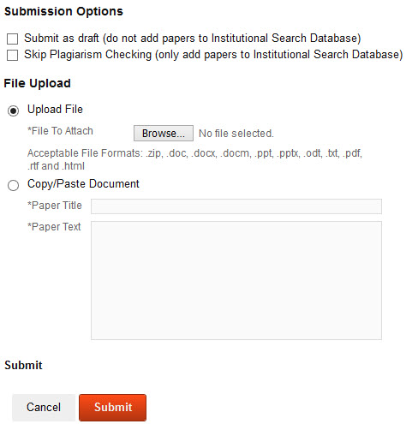
Using Direct Submit SafeAssign
Under the “Course Tools” panel, select “SafeAssign”.
Select “DirectSubmit”, followed by “Submit Paper”.
Submission Options Include:
Submit as draft
Skip Plagiarism
Upload File
Copy/Paste Document
Notes:
SafeAssign is a plagiarism checking tool that examines a written work and provides a report indicating percentages of matching to other known works. Basics about this tool are provided in the Introduction to Blackboard presentation, so we will be focusing—instead—on the use of DirectSubmit. Direct Submit can be used from the instructor-side to manage and submit papers directly to the SafeAssign service, instead of requiring them to be entered from the student side through an assignment submission portal. To access the Direct Submit tool, locate the Course Tools panel and select the SafeAssign tool. Next select the DirectSubmit button, followed by Submit Paper. The submission options allow the content to be submitted as a draft which will keep the content out of the database as it is understood that the final draft may be added later but is not plagiarized; and also allows you to skip the plagiarism check entirely, but add the content to the database. This may be helpful for adding in an original work that you do not want others to use in their work without proper attribution. The file upload section provides options for how the content is uploaded with DirectSubmit. You can upload a file using the browse button, or copy/paste using the keyboard short cuts. Once you are ready to submit the work, select the submit button at the bottom of the page to run the report.

Slide 23
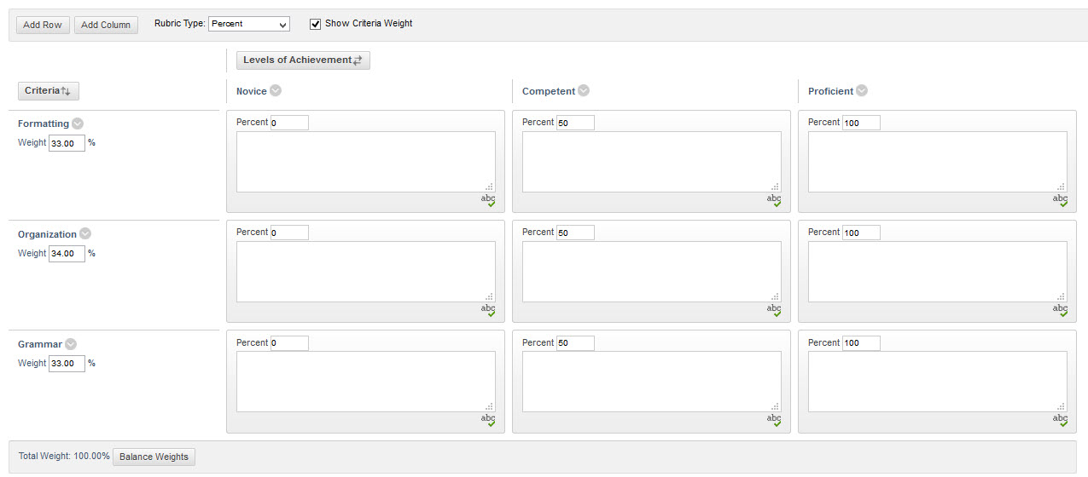
Using Rubrics
Benefits of using rubrics
Under the “Course Tools” panel, select “Rubrics”
Create a new rubric or import one from a previous semester.
Fill in the grid appropriately with grading criteria for the assignment.
Notes:
Rubrics are another great tool to use with assessments as they can provide clear grading criteria to students and a streamlined grading process for the instructor. Select the Rubrics link located in the Course Tools list, and click on Create Rubric or Import a rubric from a previous semester. Please note that in order to import a rubric, the file must be in a specific type of format and not a regular word, excel, or pdf file. Once you have selected Create Rubric, fill in the rubric name, description, and grading criteria grid. Although the default includes three columns (Novice, Competent, and Proficient) and three rows (Formatting, Organization, Grammar) each with their own percentage weight, the grid is able to be edited to match your own categories, points, or percentages. Rubrics can be used with a number of assessment types including essay test questions, short answer questions, written assignments, discussion boards and more. When you are finished with your adjustments, select the submit button.

Slide 24
Grade Center Set Up
Notes:
Now that your assessments are created, it’s time to discuss Grade Center Set Up.

Slide 25
Grade Center Settings
Set External Grade
Check Total Points Possible
Notes:
To start, ensure that you have set your total column as External Grade.
To do so, select the down arrow to the right of the column name and select “Set as External Grade”. Please note that a small green checkmark will appear to the immediate left of the column name that is set as the external grade for verification purposes. Next, review your total points possible in the course. You can do this in two ways, first by placing your mouse over the title of the total column. The Grade Information Bar will update to depict the Total Grade | Possible points in the course. If your points do not seem accurate, review your grade center more thoroughly to identify and resolve the error. The second way through the column organization button which we will discuss later.

Slide 26
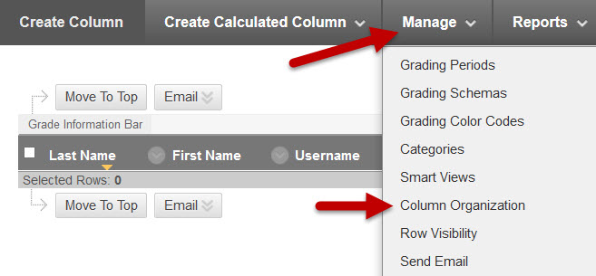
Grade Center Organization
Use Column Organization to check points, hidden columns, and arrange your grade center
Delete Unneeded Columns
Notes:
Another way to view your total points possible, as well as the points associated with each column, it by using the Column Organization feature, located under the Manage tab on the Grade Center ribbon. The organization page will list each column, the date it was create, and the points associated with that column. It will also illuminate columns that were hidden from the instructor’s regular grade center view. By utilizing the column organization tab, you may be able to more quickly and accurately identify any point discrepancies. To help improve your grade center organization, also consider deleting unneeded or unused columns. For example, if you do not use weighted grades, you can delete the column from the grade center to help improve the overall organization. Although there are many additional grade center features that deserve review, we are going to focus next on some simple do’s and don’ts of the grade center to wrap up this portion of our Intermediate training.

Slide 27
Do’s of the Grade Center
Do recognize key indicators or symbols in the grade center
Do check your total points for the course
Do organize your grade center columns
Do test your grade center before opening your course to students
Do seek assistance early
Notes:
To start, Do recognize key indicators or symbols in the grade center. These will be essential to understanding your role as assessments are assigned and submitted. A blue circle is a pending symbol, and indicates that there is an attempt in progress. Seeing this symbol over a significant length of time, may indicate that the student needs to fully submit their work, or that there is an issue that needs to be resolved. The exclamation point inside of the yellow circle indicates that the instructor’s attention is required and manual grading may be necessary. The small grey circle indicates an exemption for that particular student and assignment. Next, Do check your total points for the course to help avoid confusion and issues with grading later in the course. Do organize your grade center columns. This will provide more efficient and effective grading and review. Do test your grade center before opening the course to students. This goes hand in hand with checking the total points. It is best to know if there are any issues early so that the problem can be resolved before it begins to impact students. Finally, Do seek assistance early. Seek assistance from OneStop and Instructional Design as necessary. If you have technical questions, submit a ticket to OneStop, if you have a training need, email IDA@Wichita.edu

Slide 28
Don'ts of the Grade Center
Don’t hide assignment columns from instructor view
Don’t use weighted grades with extra credit
Don’t wait to ask for assistance
Don’t assume students understand their total columns
Notes:
Moving on to the Don’ts of the Grade Center to wrap up this section. Don’t hide assignment columns from the instructor view. It is easy to forget that these hidden columns exist which can lead to confusion and grading issues down the road. Don’t use weighted grades, especially with extra credit. Because of the way that weighted grades are designed, they cannot be used with extra credit. If it is attempted, it will require the instructor to manually add in extra credit once all other calculations are complete. This process easily causes confusion on all sides. Don’t wait to ask for assistance. If you are experiencing any issues related to your grades/grade center, seek help immediately so that a solution can be found and the grades righted as quickly as possible. And Don’t assume students understand their total columns. Weighted grades, running totals, and non-running totals all have inherent risk for causing confusion for students. Be as transparent as you can with how the grade center functions and provide clarity where necessary to help students understand how their grades and assessments will function and count for credit.

Slide 29
Using Groups
Notes:
Before we move on to Test Student and Preview User, let’s discuss using groups.

Slide 30
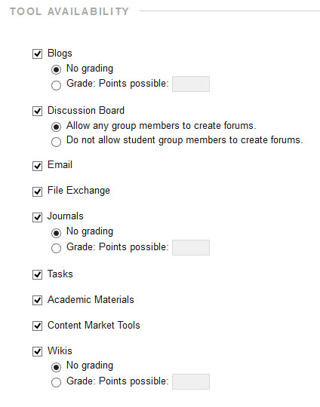
Creating Groups and Pick Tools
Choose Self Enroll, Random Enroll, or Manual Enroll
Provide a name, description, and the tools you want to be available to the groups
Notes:
To use groups, you can access the groups tool link through the Users and Groups tab of the Control Panel. Select create group and choose between single group and group set. You can choose between self-enroll, random enroll, or manual enroll. Self-enroll allows students to choose which group they will enroll in and enroll themselves, random enroll uses Blackboard and all enrolled student users to randomly distribute students to the indicated number of groups as mentioned in the creation page, and manual enroll requires the instructor to manually select which users will be placed in each group. It is important to note that if you select random enroll, only the student users currently enrolled in the course will be distributed into the groups, meaning any users enrolled at a later time will not be automatically enrolled and will need manually placed into their group or groups. Once you have selected the type of group you want to create, you will be directed to the description and tools page, where you can add a name and description for the groups, as well as select which tools they will have access to. Select the submit button to move to the membership editing page.

Slide 31
Dividing Groups
Indicate the number of groups
Random enroll, manual enroll users, and add or delete groups.
Notes:
In the Edit Group Set Enrollments or Edit Group Set Membership page there are a number of options available. In the image to the right, the number 1 draws attention to the “Hide members already in another group” setting. This setting helps to provide organization when manually enrolling users in a group so that a single user is not placed in the multiple groups unless specifically desired. The number 2 is placed to bring attention to the Randomize Enrollments button. It is important to note that if you want to use a random enrollment method for assigning groups but worry that there may be additional enrollments or drops that won’t be accounted for, you can choose the manual enroll option and then select this randomize enrollments options once the course is more fully underway. Number three indicates that each group is listed as the name you provided previously with a number after to provide an additional designator. If you want to rename individual groups, you can do so from this page. The number four rests near the “Add Users” button which demonstrates that you can choose to manually enroll a user. If at any time a group needs to be deleted, this is accomplished through the “Delete Group” button present for each group as represented by number five. Finally, number six showcases the “Add Group” button, which can be used to increase the number of groups from your original indication.

Slide 32
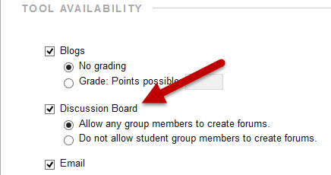
Group Tools
Assignments
Discussions
Notes:
After setting up your groups, you can choose what type of assessments and tools the groups utilize. For this training we will briefly discuss group assignments and discussions.

Slide 33
Using Group Assignment Submissions
Create a course assignment
Select the “Group Submission” option found under the “Submission Details” area of the “Create/Edit Assignment” page.
Select all groups intended to submit the assignment and use the arrows to move the groups from “Items to Select” to the “Selected Items” box.
Notes:
Once you have created your groups, you can create group assignments. Start by building an assignment as directed in the Introduction to Blackboard presentation. In the create/edit assignment page, locate the Submission Details link under the grading area. Select the group submission option found in the Assignment Type. From the “Items to Select” box, highlight all groups that are intended to submit the assignment, and use the add arrow to the right of the box to move the groups into the “Selected Items” area. If you decide a group that was added to the Selected Items area needs to be removed, highlight the group and use the remove button to transfer it back to the “Items to Select”. Finish setting up the assignment and submit as normal.

Slide 34
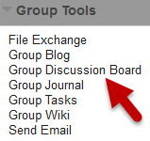
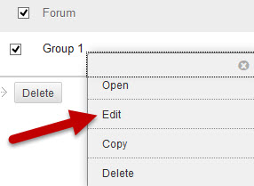
Using Group Discussions
When you create your groups, ensure you mark the use of discussion boards
To assign graded group discussions, click on individual group name from the groups page
Click on “Group Discussion Board” link
Edit the forum or create a new one
Notes:
Another group assessment tool you can use is the group discussion board. When you create a group, ensure you select the discussion board tool. This will create a single forum for each group. To make the discussion boards graded, you will need to go into each group and edit the individual discussion board. To do this, go to the groups page and click the group’s name. Once you are in the individual group page, select the discussion board tool. Use the down arrow to the right of the forum name and select edit.

Slide 35
Graded Group Discussion
Select “Grade Discussion Forum”, indicate points, due date, and rubrics (if applicable).
Notes:
This will allow you to edit the discussion forum for the individual group and assign points. In the image to the right, the 1 marks the “Grade Discussion Forum” setting under the grade category. Select the grade discussion forum setting and assign points. Next, move on to the setting marked by number 2, “Show participants in needs grading””. This is where you can determine how many posts a student must submit before it shows in the needs grading area. The third area marked in the photo is the Due Date area which can be specified down to the date and time to the minute. Lastly, the number 4 draws attention to the Add Rubric button. As mentioned previously, adding a rubric can provide specific grading criteria to students and allow for a more streamlined and consistent grading process.

Slide 36
Student Preview and Test Student
Notes:
So far we have discussed a number of settings and options revolved around creating assessments and reviewing your gradebook, now it is time to assess your course design from the student perspective. Using Student Preview and Test Student will allow you to do just that.

Slide 37
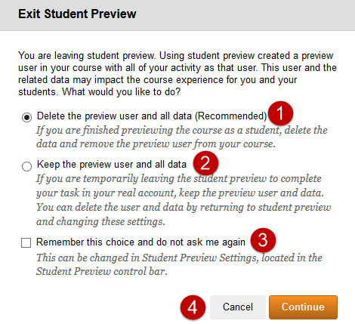
Using Student Preview
Select the Student Preview Mode icon
Explore all aspects of your course
Make a note of aspects that didn’t work as intended
Take tests and submit assignments
Keep or delete data
Notes:
Using Student Preview Mode is a great way to take a quick tour of your course from the perspective of a student. Select the Student Preview Mode icon present in the upper right-hand corner of the screen. This icon appears like two arrows with a small circle between them creating an “eye”. If this icon is not present, check to make sure you edit mode is on. When you enter Student Preview Mode, a banner will appear that alerts you that student preview mode is on. Review your course and make a note of any areas that don’t function as intended. You can take tests, submit assignments, and navigate the entire course as a student would see it at that particular moment. When you decide to exit the preview mode, select the “Exit Preview” button in the upper-right-hand corner. A pop-up window will appear with three options. Delete preview user and data, keep preview user and data, and remember choice/do not ask again. In the image, number 1 sits next to the “delete user and data” option. This will delete all of your preview user activity including any submissions, test attempts…etc. The number two, in the image is next to the “keep user and data” option. This will allow you to see your preview user activity from the instructor side. The number three in the image asks if you want to remember your choice to delete or keep the preview user and not to ask again. It is recommended that you do not use the “remember choice” option. If you want to keep the preview user data temporarily and delete it later, you can do so by entering student preview mode again and simply choosing the option to delete the user and data. Finally, the number 4 is placed near the cancel and submit buttons for exiting student preview mode.

Slide 38
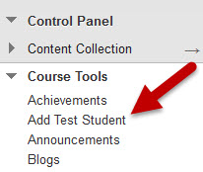
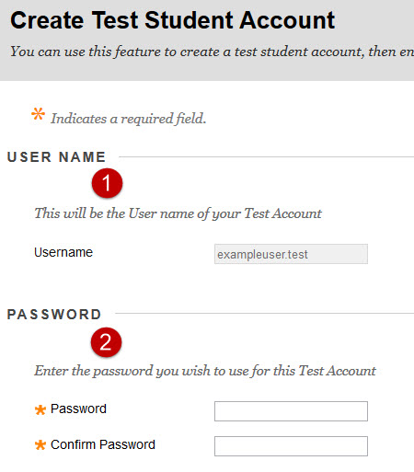
Enrolling a Test Student
Select “Add Test Student” from “Course Tools”
Set a password for the Test Student and “enroll” the test student
Log out of Blackboard and log in with your Test Student username and password
Notes:
Test students are similar to the student preview mode feature, as it will allow you to experience the course from the student perspective. While it is similar to the test student tool, there may be some small differences as the test student uses a real student login to allow you to explore the course. To enroll a test student, access the Course Tools from the Control Panel, then click Add Test Student. This will take you to the Create Test Student Account page, where you can follow the steps to create and enroll your test student account. In the image, the number 1 showcases the “username area” where the test student user name is created. The default will name your test student as your WSU id and add dot test to the end. The number 2 on the image draws attention to the password creation area. These sections are required. Lastly, this page will confirm that you want to enroll the new test student in your course. Once you have finished filling out the page, click submit and your test student is enrolled. To log in as the test student, log out of blackboard and log back in with your newly created test student credentials.

Slide 39
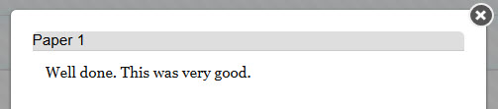
Using a Test Student
Allows you to view course as a student
Slight change in viewpoints from Student Preview
Test Student appears in the grade center
Submit assessments
Review how feedback is delivered
Notes:
The Test Student account will allow you to navigate the course and Blackboard as a whole from the student side. The test student will be added to the course, including the grade center, which allows you to navigate the My Grades area, submit assignments and view what instructor feedback will appear like to students. Make a note of areas that don’t match your intended set up and when you are finished with your review, log out and log back in with your primary wsu id and credentials.

Slide 40
How to get help
Come see us in the IDA Blackboard and Accessibility labs
1:00-3:00pm every Tuesday and Wednesday in the C-space in the library
Email us at IDA@Wichita.edu
Submit a OneStop ticket for technical support
Remember
IDA = training
OneStop = technical support
Notes:
We have covered an enormous amount of information in this presentation, but if you have any questions, please seek assistance from IDA and additional training such as the Introduction to Blackboard and Advanced Blackboard presentations. If you have questions you want to ask and Instructional Designer directly, IDA runs a lab time between 1:00 and 3:00 PM every Tuesday and Wednesday in the C-space in the library. These are come and go, manned labs, that allow you to ask questions and get additional training as needed. You can also email us at IDA@Wichita.edu. For technical support, please use the OneStop support service. Remember, IDA is for training; the one stop is for technical support.

Slide 41
Thank you. Questions?
Please send questions to IDA@Wichita.edu
Notes:
Thank you taking this training presentation. If you have any questions please email them to IDA@Wichita.edu.

