Slide 1
TITLE
Notes:
Welcome to the academic resources conference 2020 at Wichita State University

Slide 2
What GTA’s Need to Know for Fall 2020
Notes:
This session covers what GTA’s need to know for the fall 2020. It is appropriate for all GTAs and anyone hoping to receive a GTA appointment for fall of 2020. This is Carolyn Speer. I am the manager of instructional design and access.

Slide 3
Agenda
Course codes & scheduling
FAQ
Hybrid training
The form
Blackboard training
ARC track for you
Advice
Next steps
Notes:
This is an optional training and, while valuable, does not take the place of mandatory training offered for new GTAs on August 11 from 9:00-11:30am. In today’s training, we will cover course codes and scheduling, the universities curriculum FAQ, information about hybrid courses and how to receive training in them, filling out the course information form for your students, why you need and how to find blackboard training, finding the ARC track for GTA’s, some advice from Dr. Carolyn Shaw, and your next steps.

Slide 4
Course codes and scheduling
All “TCI” classes for fall will be HYB
You have control of what HYB means for you in most cases
No on campus classes after Thanksgiving
Notes:
As you may have heard already, Wichita State University we’ll offer only hybrid and online courses for the fall of 2020. This means that if you are a graduate teaching assistant with a course appointment, your course will be either fully online or hybrid in the fall of 2020. In addition, no classes will be allowed on campus meetings after Thanksgiving break for the fall term.

Slide 5
All classes are IIE or HYB…huh?
If your class was fully online before, it still is
If you were teaching an in-person class, it’s now HYB
You have control over the kind of HYB you teach (assuming the department doesn’t dictate a style), and you take the responsibility for ensuring your class conforms with WSU decisions
Notes:
This is what all that means: if you already had an online course appointment for the fall 2020 semester, that class is still fully online. That means it has a course code of I IE. But if your course appointment for the fall was intended to be on campus it no longer has the course code TCI. All traditional classroom instruction courses are now HYB, and must be delivered in a hybrid format for fall. Nevertheless, as the instructor of record you will have a great deal of control over what that means for your class. If you are not a direct instruction GTA the instructor of record for the course will be making these decisions. But if you are the instructor of record, you will be called upon to make several decisions for your course this fall. Of course, some of this will vary by department, so before you finalize any decisions, check with them.

Slide 6
An FAQ for you
https://www.wichita.edu/about/COVID-19/curriculum.php
Bookmark this link!
Notes:
At this point, you probably have many questions. The university has worked to anticipate what you will need and want to know. There is an extensive FAQ online at the web address: https://www.wichita.edu/about/COVID-19/curriculum.php. It is important that you do not lose this web link so please book mark it.

Slide 7
Hybrid options and training
Blended, in-person testing
Blended, online testing
Online, in-person testing
Online, in-person enrichment
Fully online, “temporary”
Mostly in-person
Think through what you value and what you can support
Go through options at https://Wichita.edu/hybrid
Notes:
You have many options when it comes to hybrid class delivery. If you go to the web address: https://Wichita.edu/hybrid you can work through many possible ways to organize your class. For GTA’s there are six likely formats: blended delivery with in person testing, blended delivery with online testing, online delivery with in person testing, online delivery with in person enrichment opportunities, fully online with temporary status, or mostly in person. Different types of hybrid designs fit different content better. This is more than simply a decision about what is your preference. It is important to try to limit in person contact if possible to try to limit the spread of Covid 19 on our campus. But some courses do not lend themselves to easy online delivery. For example, if you are a GTA in a lab class, you may find that much of your course needs to be in person. Again, these are decisions your department can help you with and may want to guide you in.

Slide 8
Please fill out the form
Decisions to make:
Will you require in-person contact?
Will you require synchronous online contact?
Will you have flexible attendance?
https://wichitastate.co1.qualtrics.com/jfe/form/SV_bBg34VahPrvrwih
Notes:
At the core, the hybrid decisions you need to make boiled down to just a few: Will you require in person contact? Will you require synchronous online contact? Will you have flexible attendance? Once you have made these decisions, there is a form you need to fill out so your students know what to expect in your course. Because the HYB designation covers many different kinds of course delivery formats, this form will be critical for our students as they make their scheduling decisions for fall.

Slide 9
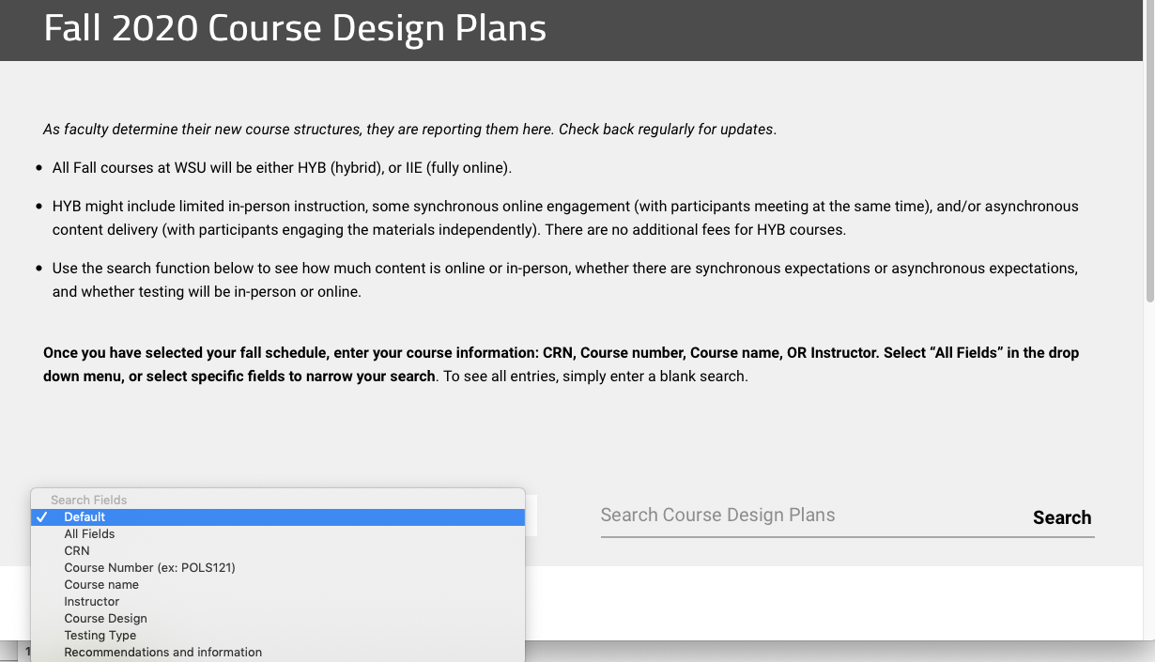
What students see on https://Wichita.edu/fall2020
Notes:
Once you fill out that form, it will help to populate a webpage that students can use to search class delivery methods. Students can search for that information at the web address https://Wichita.edu/fall2020. It is critically important that you fill out this form.

Slide 10
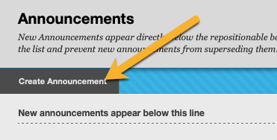
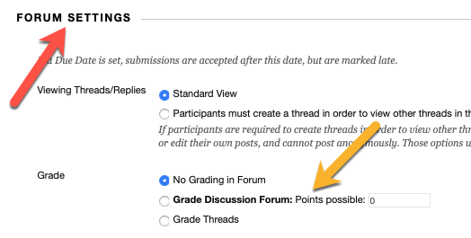
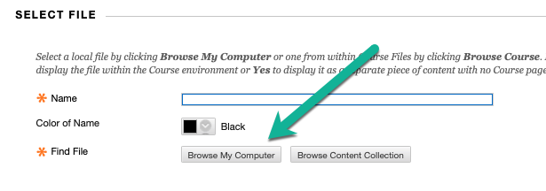
Blackboard training: https://Wichita.edu/BbTraining
Notes:
Once you make you’re hybrid decisions about Your course, it is very likely that you are going to require training in blackboard. Wichita State office of instructional design and access has a lot of blackboard training available to you. You can find our online/ on demand training in blackboard at this web address: https://Wichita.edu/BbTraining

Slide 11
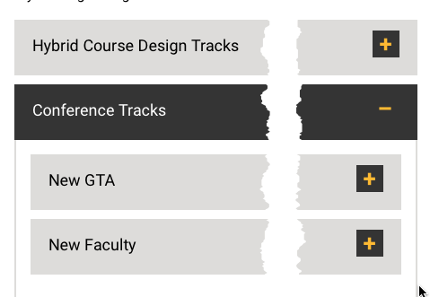
ARC training track for you
https://Wichita.edu/ARCTracks
Notes:
You should also be aware that the academic resources conference has training available all week and archived at its website for the entire summer. There is a special track just for GTA’s! You can find information about this conference track at this web address: https://Wichita.edu/ARCTracks you are not required to go through the training in this track, but we certainly encourage you to avail yourself of as much training as possible this summer. Getting trained will help you, the professors you work with, and your students.

Slide 12
Hard won and heartfelt advice to you
From Dr. Carolyn Shaw: “Be flexible. Not just with your students, but also with your teaching. It’s okay to try something new and find that it doesn’t work! Adjust it and try something else. Also, work closely with your faculty mentor and don’t be afraid to ask questions about any part of all this.”
Notes:
Dr. Carolyn Shaw, the associate vice president of strategic enrollment management has some advice for you: “be flexible. Not just with your students, but also with your teaching. It’s okay to try something new and find that it doesn’t work! Adjusted and try something else. Also, work closely with your faculty mentor and don’t be afraid to ask questions about any part of all of this.”

Slide 13
Next steps
Confirm that you are, or are likely to be teaching in the fall
Make your hybrid decisions and fill out the form!
Search for necessary training
Fill out a course set-up request: https://wichitastate.co1.qualtrics.com/jfe/form/SV_djnpZ6ngRkFOpEh
Tell a GTA friend!
Notes:
While this is a short presentation, there is a lot of information in it. At this point your next steps should be to confirm that you are, or you are likely, to be teaching in the fall. Once you know you are teaching, make your hybrid decisions and make sure to fill out the form. You can also request help with your online course set up. You do that by filling out the form at this web address: https://wichitastate.co1.qualtrics.com/jfe/form/SV_djnpZ6ngRkFOpEh finally, you now know things most other GTA’s do not. Tell your GTA friends what you know. And please share this slide deck with people if they are interested.

Slide 14
Thank you! IDA@Wichita.edu
Notes:
Thank you very much for your kind attention in this session. You can send your questions to: IDA@Wichita.edu

