Slide 1
National Survey of Student Engagement (NSSE) 2013
Tiffany Franks
Assistant Director, Office of Planning & Analysis
October 25, 2013

Slide 2
NSSE 2013WSU Participation
What is NSSE?
Annual survey that collects data about student participation in activities and programs that promote learning & personal development
Results from NSSE can be used to identify aspects of the undergraduate experience that can be improved through changes in policies and practices
NSSE is administered every other year (odd years) at WSU to first-year students and seniors, last administered in spring 2013

Slide 3
NSSE 2013WSU Participation
For 2013, 1,254 and 3,305 email invitations to take NSSE were sent to first-year students and seniors, respectively
Survey responses for first-year students totaled 262 (21%), and 842 for seniors (25%)
Notes:
The average response rate for most surveys is 30%

Slide 4
NSSE 2013 Participation
568 postsecondary institutions participated in NSSE 2013, with 335,702 students, 41% first-year students and 59% seniors
Overall response rate was 30%, 27% for first-year students and 33% for seniors

Slide 5
NSSE 2013 WSU Participation cont.
First-year respondents were 62% female and 92% were enrolled full-time
Senior respondents were also 62% female, and 78% were enrolled full-time

Slide 6
NSSE 2013 WSU Participation cont.
Freshmen Race/Ethnicity
Notes:
Race & ethnicity are a fairly good representative sample of the WSU UG student body

Slide 7
NSSE 2013 WSU Participation cont.
Seniors Race/Ethnicity
Notes:
Race & ethnicity are a fairly good representative sample of the WSU student body

Slide 8
NSSE 2013 Participation
Other demographics of all NSSE participants:
29% were 24 years or older
35% lived on campus
46% were first generation college students
34% began college at another institution other than where they took NSSE
WSU Participants:
38.2 were 24 years or older
6% lived on campus
43% were first generation college students
46% began college at another institution other than where they took NSSE
Notes:
The % of new freshmen who live on campus is 34%, more seniors completed NSSE so campus living % smaller

Slide 9
Changes to NSSE 2013
NSSE updated and revised the survey for 2013; 23% are new items, 22% were left unchanged, and 50% were modified, either a major or minor modification

Slide 10
Changes to NSSE 2013
Instead of using “benchmarks”, NSSE is now using “Engagement Indicators and Measures of Participation in High Impact Practices”
Longitudinal comparisons of individual questions & historical benchmarks are somewhat limited due to different scoring metrics and deletion of some survey items

Slide 11
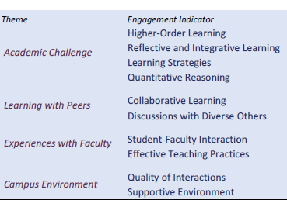
Changes to NSSE 2013 cont.
There are 10 different engagement indicators which fall under one of four “themes”

Slide 12
NSSE Engagement Indicator Scoring
Each Engagement Indicator is scored on a 60 point scale (never=0, sometimes=20, often=40, very often=60)
Mean comparisons are given for each Engagement Indicator for WSU peer institutions (n=10), institutions with the same Carnegie Classification (Research University-High Research Activity, n=36) and all NSSE institutions (n=567)

Slide 13
WSU Peer Institutions
Comparison peer institutions were selected by the President and the President’s Executive Team and approved by the Kansas Board of Regents. WSU peer institutions are:
Florida Atlantic University (Boca Raton, FL)
Oakland University (Rochester Hills, MI)
Portland State University (Portland, OR)
University of Akron (Akron, OH)
University of Arkansas at Little Rock (Little Rock, AR)

Slide 14
WSU Peer Institutions cont.
WSU Peer Institutions continued:
University of Colorado Denver (Denver, CO)
University of Nebraska at Omaha (Omaha, NE)
University of Nevada, Reno (Reno, NV)
University of South Alabama (Mobile, AL)
Western Michigan University (Kalamazoo, MI)

Slide 15
WSU Results and Peer Comparisons cont.
Mean Comparisons of First-Year Students for questions relating to Academic Challenge
Notes:
All 4 indicator mean scores are significantly lower compared to all 3 groups, effect size less than 0.3 (effect size measures difference between means and quantifies the size of the difference between groups, statistical significance calculated as a P value, if P value below 5% (.5) the difference is large enough to be considered “significant”) effect size 0-.20 = small, .20-.50 = medium, .50 & higher = large

Slide 16
WSU Results and Peer Comparisons cont.
Mean Comparisons of First-Year Students for questions relating to Learning With Peers
Notes:
The mean scores for collaborative learning is significantly lower compared to all 3 groups, & discussions with diverse others is sig lower for WSU peers, but no difference with Carnegie and NSSE schools

Slide 17
WSU Results and Peer Comparisons cont.
Mean Comparisons of First-Year Students for questions relating to Experiences With Faculty
Notes:
No difference among mean scores and groups except WSU mean significantly lower on student-faculty interaction with all NSSE schools

Slide 18
WSU Results and Peer Comparisons cont.
Mean Comparisons of First-Year Students for questions relating to Campus Environment
Notes:
WSU mean significantly lower on Supportive Environment compared to Carnegie class and all NSSE schools, no difference with WSU peers, and not difference between all groups on Quality of Interactions

Slide 19
WSU Results and Peer Comparisons cont.
Mean Comparisons of Seniors for questions relating to Academic Challenge
Notes:
WSU mean significantly lower on higher order learning and quantitative reasoning compared to all 3 groups, sig lower on reflective & integrative learning with WSU peers & all NSSE schools, no difference on learning strategies

Slide 20
WSU Results and Peer Comparisons cont.
Mean Comparisons of Seniors for questions relating to Learning With Peers
Notes:
No difference on any indicator except sig lower on collaborative learning compared with Carnegie class

Slide 21
WSU Results and Peer Comparisons cont.
Mean Comparisons of Seniors for questions relating to Experiences With Faculty
Notes:
WSU mean sig lower on Student-Faculty Interaction compared to Carnegie class & all NSSE schools, sig lower on Effective Teaching Practices compared to all NSSE schools

Slide 22
WSU Results and Peer Comparisons cont.
Mean Comparisons of Seniors for questions relating to Campus Environment
Notes:
WSU had sig lower mean on Quality of Interactions compared to all NSSE schools, no difference between peers & Carnegie, WSU also had sig lower means on Supportive Environment with all 3 groups

Slide 23
High Impact Practices
High Impact Practices are activities with positive associations with student learning and retention, demand time and effort, facilitate learning outside of the classroom, require meaningful interactions with faculty and students, encourage collaboration with diverse others, and provide frequent and substantive feedback

Slide 24
High Impact Practices cont.
NSSE founder George Kuh suggests all undergraduate students experience at least 2 High Impact Practices during their education
Students were asked 6 questions regarding High Impact Practices (first-year students only asked questions 1-3)
Seniors’ responses include their entire time at WSU, not just the current academic year

Slide 25
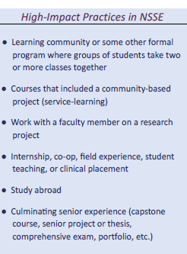
High Impact Practices cont.

Slide 26
High Impact Practices
High Impact Practices at WSU

Slide 27
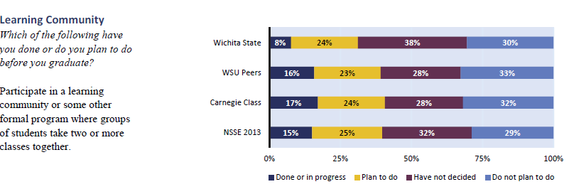
High Impact Practices at WSU First-Year Students

Slide 28
High Impact Practices at WSU First-Year Students

Slide 29
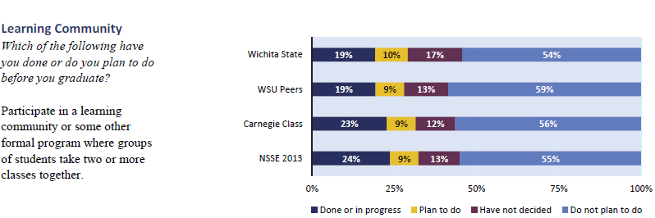
High Impact Practices at WSU Seniors

Slide 30
High Impact Practices at WSU Seniors

Slide 31
High Impact Practices at WSU Seniors

Slide 32
Perceived Gains Among Seniors
Students reported how much their experience at WSU contributed to their knowledge, skills, and personal development in 10 areas:

Slide 33
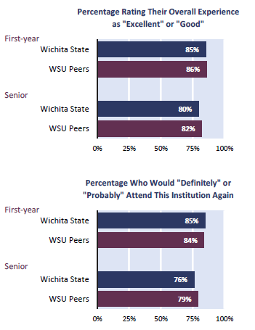
Satisfaction with WSU
Students rated their overall experience at WSU and whether they would attend WSU again:

Slide 34
NSSE Caveats
As with all surveys, NSSE also has some caveats:
Survey is voluntary, which leads to lower response rates and may not be a representative sample of the student population
Different methodologies used when selecting comparison groups (may not be selecting schools that would be appropriate for NSSE comparisons)
Lack of awareness or interest in student engagement

Slide 35
Using NSSE Data
NSSE data can be used in a variety of ways:
Self-studies for accreditations
Assessment & Improvement
Faculty & Staff development
Institutional Advancement
State System Performance Reviews

Slide 36
Using NSSE Data at WSU
NSSE is used at WSU in several ways:
Results for specific questions posted on the Voluntary System of Accountability College Portrait (on WSU home page), all institutions participating in the College Portrait that use NSSE also report this data
Performance Indicators for Kansas Board of Regents Foresight 2020
Notes:
Show slide of Foresight 2020 with NSSE questions high lighted

Slide 37
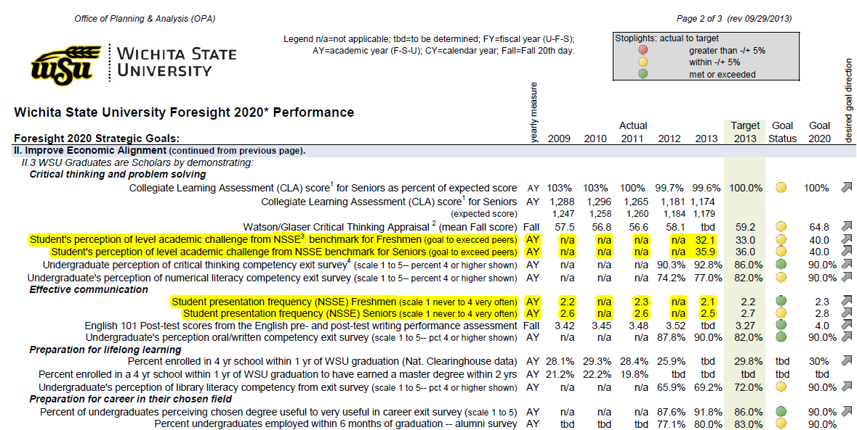
Using NSSE Data at WSU cont.

Slide 38
Using NSSE Data at WSU cont.
Student Interaction with Campus Faculty and Staff
52.0% of seniors believed that the campus staff were helpful, considerate, or flexible
75.0% of seniors believed that faculty are available, helpful, or sympathetic
93.0% of seniors reported that faculty members provided prompt feedback on their academic performance
61.0% of seniors discussed readings or ideas with faculty members outside of class
Notes:
Home page of College Portrait

Slide 39
Questions?
Any questions? You may also email questions that may arise later to tiffany.franks@wichita.edu

